Slide 1
Electronic Health Records

Slide 2
Learning Objectives
Deﬁne key words.
Describe electronic health records in various care settings.
Explain how improving the quality of patient care links to electronic health records.
Build a case for electronic health records as central components in integrated and networked systems.
Discuss how personal health records can be linked to Electronic Health Record Systems.
Review the progress in electronic health record development.
.

Slide 3
Learning Objectives
Describe key functions, requirements and expectations for electronic health records.
Relate accreditation and regulatory requirements to EHR systems.
Describe health informatics standards and their general impact on health information technology and electronic health record systems.
Describe the obstacles encountered in progressing toward electronic health records.
Define and characterize interoperability for health information technology and EHRs.

Slide 4
Electronic Health Records: The Case for Quality and Change The Patient Record
Principal repository for information concerning a patient’s health care
Rapidly changing to a hybrid paper-electronic format or a fully electronic format
Patient record systems may:
Store data electronically through online systems
Maintain clinical data repositories
Use links to diagnostic applications for ongoing information
Combine elements with scanned copies of paper images
Notes:
During migration to fully electronic record, users will need a transition record system on which they can rely.

Slide 5
Electronic Health Records: The Case for Quality and Change The Patient Record
Two-fold challenge for the industry:
Information in the records is continually expanding in context and form.
Technology to make the content available for health care team members across multiple settings is more available and a more realistic option.

Slide 6
Electronic Health Records: The Case for Quality and Change Industry Forces that Advance Electronic Health Record Adoption
There is a prediction that “a 50% growth in health care software investment could enable clinicians to cut the level of preventable deaths by half in 2013” (Gartner Research Group on Information Technology).
New England Journal of Medicine (2008) reports that physicians identify positive effects of EHR in several dimensions of quality of care and high levels of satisfaction.

Slide 7
Electronic Health Records: The Case for Quality and Change Industry Forces that Advance Electronic Health Record Adoption
Drive to adoption of EHR is strengthened by:
Patient safety concerns
National focus on health information technology
Health services quality
Paper record shortcomings
Cost-containment demands

Slide 8
Electronic Health Records: The Case for Quality and Change Patient Safety Concerns
Institute of Medicine (IOM) issued series of reports on the nation’s health care on the basis of a concerted, continuing effort to assess and improve the quality of care.
Following reports that call for better systems and data, push for EHR increased.
The Veteran’s administration (VA) has made substantial progress in use of hospital EHR systems and has shown that care can be improved and made more efficient through their use.
Kaiser system demonstrated patient safety improvements through use of EHR and new care team measures – reduced cardiac death by 73%.
Notes:
Most notable reports issued by IOM (for this purpose) are “To Err Is Human: Building a Safer Health System” and “Crossing the Quality Chasm: A New Health System for the 21st Century”

Slide 9
Electronic Health Records: The Case for Quality and Change National Focus on Improving Health Information and Technology
Key elements for advancing IT in health care:
Creating and diffusing EHRs
Interconnecting clinicians and care sites for sharing patient information
Using technology tools to support and remind clinicians about care and safety matters
Charging the American consumers with adopting PHRs are key elements for advancing IT in health care
Notes:
ONCHIT formed the American Health Information Community in June 2005 to help with the nationwide transition to EHRs.

Slide 10
Electronic Health Records: The Case for Quality and Change National Focus on Improving Health Information and Technology
In February 2009 – President Obama signed the Health Information Technology for Economic and Clinical Health (HITECH) Act.
It provided 17.2 billion dollars to providers to facilitate EHR adoption.
It uses incentives through the Medicare and Medicaid programs.
It gives support for providers to acquire technology.
Established technology centers.
There is workforce retraining to improve the technological skill set in the industry.

Slide 11
Electronic Health Records: The Case for Quality and Change Cost-Containment and Return on Investment
EHR systems will save costs and add efficiency:
Eliminating paper supplies
Eliminating clerical staff to process paper records
Reducing transcription costs
Improved staff productivity
Clinical quality improvement/medical outcome improvement
Reduced cycle time
Improved process accuracy
Improved customer (physician/patient) satisfaction
Improved employee satisfaction

Slide 12
What Are Electronic Health Record Systems and How Do They Work? Electronic Health Records
Broadest interpretation: a record of all types of care to prevent and treat illness
Ideally maintained:
Over a long period
In a manner that is accessible to those who need access to specific information
In a manner that is accessible to those who need aggregate information to prevent illness and improve future treatment
Today, EHRs designed for:
Large hospitals
Group and single practices in ambulatory care
Long-term care
Behavioral health
Home health
Hospice
Notes:
Initially defined from a national perspective by an Institute of Medicine committee in 1991.

Slide 13
What Are Electronic Health Record Systems and How Do They Work? Electronic Health Record Systems and Their Functions
2003 IOM issued “Key Capabilities of an EHR System” called for basic functions or applications that should be included and linked in EHR systems:
Health information and data – central repository for patients’ data from a variety of sources
Results management – from diagnostic tests
Order entry/management – order tests and prescribe medications and treatments
Decision support – help clinicians manage care through evidence-based guidelines
Electronic communication and connectivity – communicate among providers and resources to coordinate care
Patient support – offer education for the patients
Administrative processes – better scheduling and billing
Reporting and population health management – report infectious disease, support epidemiology research
Notes:
List builds on the initial concepts of an EHR system and includes capabilities from health data to connectivity and resource availability.

Slide 14
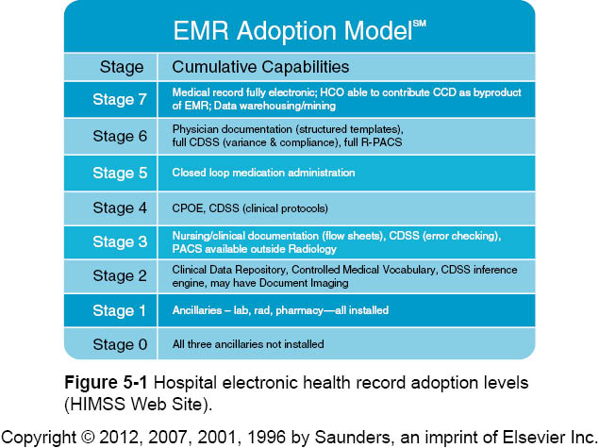

Slide 15
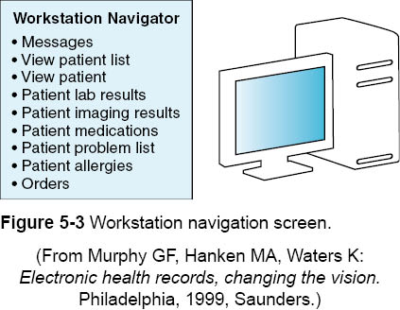

Slide 16
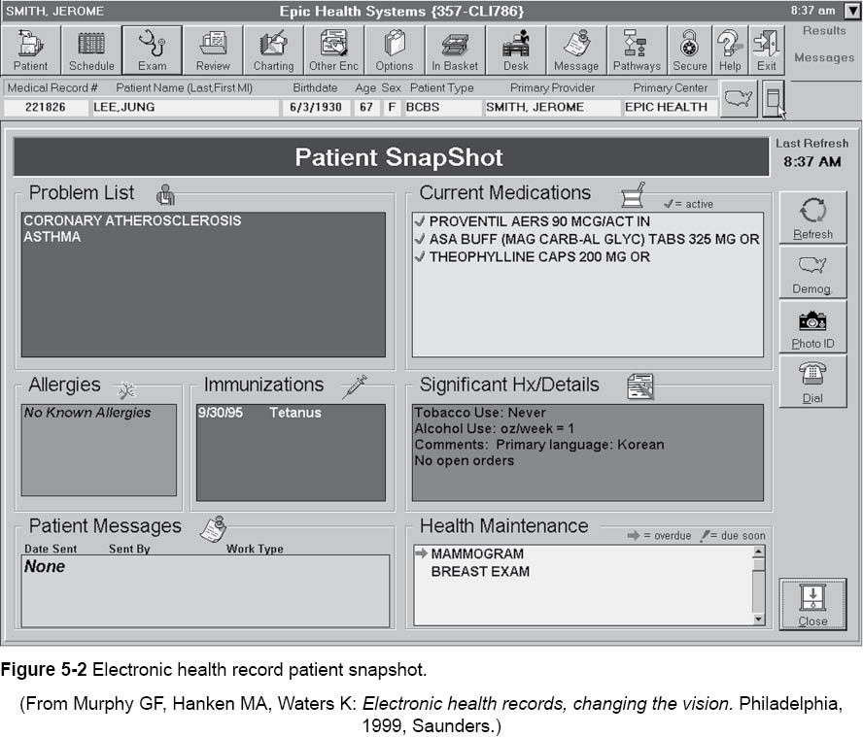

Slide 17
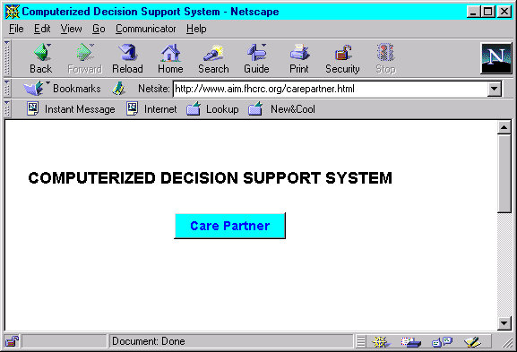
Electronic Patient Record

Slide 18
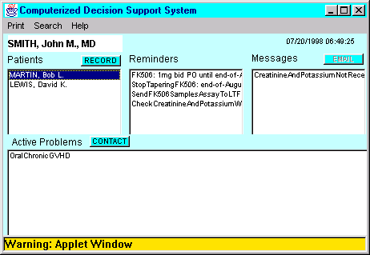
Electronic Patient Record

Slide 19
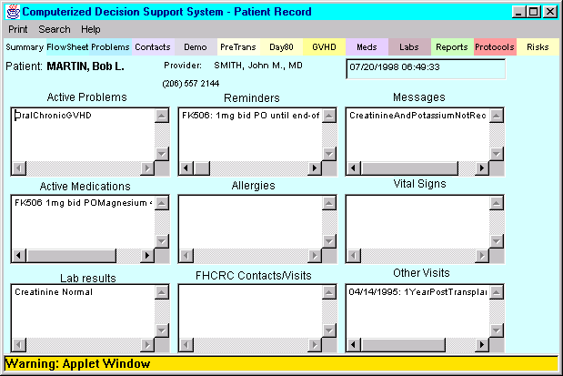
Electronic Patient Record

Slide 20
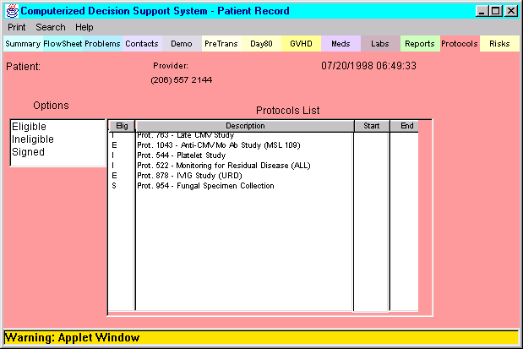
Electronic Patient Record

Slide 21
What Are Electronic Health Record Systems and How Do They Work? Electronic Health Record Systems and Their Functions
More specific capabilities of EHR systems may include:
Registration-Admission, Discharge Transfer administrative applications
Patient financial services
Order communications/results retrieval systems that allow staff to enter orders from paper records and view the status of the orders and the ancillary diagnostic results
Departmental clinical applications – lab, radiology, pharmacy, dietary, radiology
Specialty clinical applications (intensive care, emergency department, peri-operative/surgical, oncology)
Smart Peripherals (medicine dispensing devices, robotics, monitoring equipment, etc.)
Notes:
This is an expansion of the IOM list.

Slide 22
What Are Electronic Health Record Systems and How Do They Work? Electronic Health Record Systems and Their Functions
Computerized physician order entry (CPOE) systems designed for providers to enter orders online with capability to link to advice that can be used in the care process
Results Management (diagnostic test results/feedback)
Data repositories that collect and store data from feeder systems and deliver patient record information to users through workstations
Patient care charting to capture continuing documentation that replaces traditional paper-based progress notes and, depending on the scope of the documentation capture, transcribed documents
Document scanning/imaging systems that capture paper documents and capture and store diagnostic images (EDMS)

Slide 23
What Are Electronic Health Record Systems and How Do They Work? Electronic Health Record Systems and Their Functions
Clinical messaging systems that streamline communication between providers, providers and systems, and patients and providers often through Web browser-style user workstations
Provider-patient portals that use the Internet to enable patients to access their health information, communicate with their providers, and arrange for health services such as appointments and prescription renewals
Clinical decision support systems that link patient data to medical knowledge resources and offer feedback directly to clinicians responsible for patient care

Slide 24
What Are Electronic Health Record Systems and How Do They Work? Electronic Health Record Systems and Their Functions
Personal health records (PHRs) that are maintained by the patients in electronic form that can be authorized for access by the patient’s provider and to which data can be electronically sent by the provider
Population health reporting that serves epidemiology and research
Electronic Medication Administration Record (EMAR) and bar code identification - automates processes of hospital medication administration
Clinical data warehouse
Health Information Exchange provisions

Slide 25
What Are Electronic Health Record Systems and How Do They Work? Standards Development and the EHR
Many organizations create or assist in the development and publication of health care standards to progress toward EHR systems.
Examples:
ASTM
HITSP
HL7
CCHIT
AHIMA

Slide 26
What Are Electronic Health Record Systems and How Do They Work? ASTM Standards Development
National standards development body formed more than 90 years ago.
Recently formed a section to deal with health care informatics.
Standards are voluntary.
Developed through consensus process.
Improved through feedback from users.

Slide 27
What Are Electronic Health Record Systems and How Do They Work? ASTM Standards Development
ASTM (American Society for Testing and Materials) standard – published guide that defines and describes consistent management of business processes or data
May specify design of a computer application
May specify how to define data elements
May be written as guides
Offer models for adoption
May offer a blueprint

Slide 28
What Are Electronic Health Record Systems and How Do They Work? ASTM Standards Development
Most recently reapproved in 2007
Applies to short-term and long-term contacts
Delineates the components and content of the patient record
Includes definitions that conform to standard nomenclature
Applies to all types of healthcare services including:
Acute care hospitals
Nursing homes
Skilled nursing facilities
Home health care
Specialty care environments
Ambulatory care

Slide 29
What Are Electronic Health Record Systems and How Do They Work? ASTM Standards Development
Paper-based record → forms created to allow documentation of similar activities in one form or a series of related forms.
Computerized record → data can be manipulated and reorganized with other data.
Patient data operates as a database (when in a computerized format).
Must be well organized
Must contain all the data elements necessary to describe the health care process
More flexible in the ways data can be organized, reorganized, and retrieved
Notes:
In a paper-based record, the information is static once it is recorded.

Slide 30
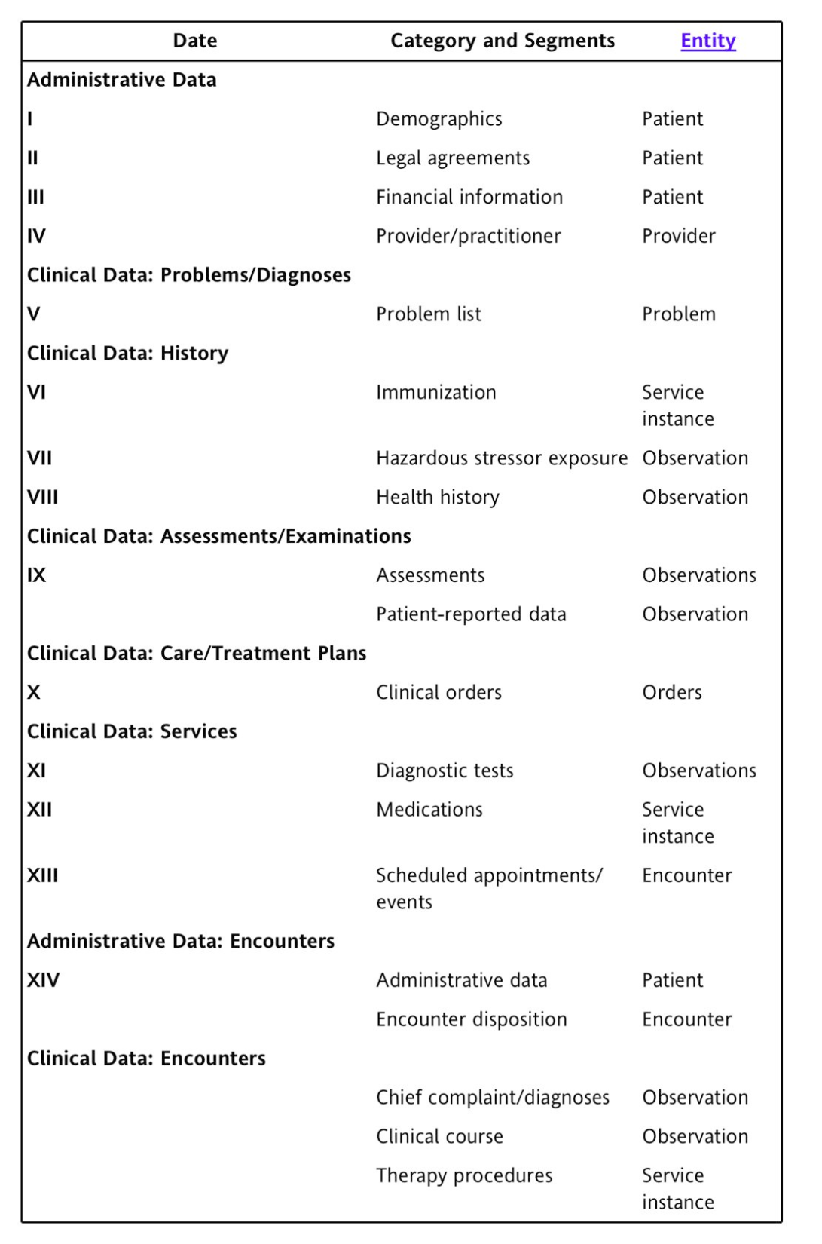

Slide 31
What Are Electronic Health Record Systems and How Do They Work? ASTM-E1384 Major Segments
Segment 1: Demographics
The root of the record
Personal data elements
Sufficient to identify the patient
Collected from the patient or patient representative
Not related to health status or services provided
May require frequent updating to satisfy various national standards and regulations

Slide 32
What Are Electronic Health Record Systems and How Do They Work? ASTM-E1384 Major Segments
Segment 2: Legal Elements
Records legal data that characterize the patient’s agreements to care and any caveats regarding that care
Legally binding directions or restraints on patient care
Release of information
Disposal of body or body parts (or both) after death

Slide 33
What Are Electronic Health Record Systems and How Do They Work? ASTM-E1384 Major Segments
Segment 3: Financial Elements
Identifying data elements for all parties responsible for payment for patient healthcare services
References to financial bodies that will cover the cost of care

Slide 34
What Are Electronic Health Record Systems and How Do They Work? ASTM-E1384 Major Segments
Segment 4: Provider/Practitioner Data
Identifies the primary organization, establishment, or practitioner responsible for the availability of health care services for this specific episode or encounter
Practitioner individuals who are:
Licensed or certified to deliver care to patients
Who had face-to-face contact with the patient
Who provided care on the basis of independent judgment
Type of health care setting or practice type

Slide 35
What Are Electronic Health Record Systems and How Do They Work? ASTM-E1384 Major Segments
Segment 5: Problem List
Master list of all of a patient’s problems or diagnoses
Specified clinical problems
Diagnosis
Ongoing list of clinically significant health status events and factors
Should be amended as more precise definitions of problems become available
Notes:
The significant health status events and factors may be resolved or unresolved.

Slide 36
What Are Electronic Health Record Systems and How Do They Work? ASTM-E1384 Major Segments
Segment 5: Problem List
Should contain:
all past and existing diagnoses
pathophysiological states
potentially significant abnormal physical signs and laboratory findings
disabilities and unusual conditions
Includes health alerts (if any):
Allergies
Contagious conditions
Adverse reactions to specified treatments

Slide 37
What Are Electronic Health Record Systems and How Do They Work? ASTM-E1384 Major Segments
Segment 5: Problem List
May include:
Social problems
Psychiatric problems
Risk factors
Allergies
Reactions to drugs or foods
Behavioral problems

Slide 38
What Are Electronic Health Record Systems and How Do They Work? ASTM-E1384 Major Segments
Segment 6: Immunization Record
Chronological list of all immunizations administered to the patient and their current status
Also includes acquired or induced immunity or resistence to particular pathogens

Slide 39
What Are Electronic Health Record Systems and How Do They Work? ASTM-E1384 Major Segments
Segment 7: Exposure to Hazardous Substances
What, when, where, and how data on actual or potential exposure to all biological, physical, or chemical agents that might be associated with adverse health effects
Data for epidemiological studies to determine correlations of disease with exposure to environmental stressors
Chronological record of exposure to hazardous chemical, physical, biological or radiological stressors to the body

Slide 40
What Are Electronic Health Record Systems and How Do They Work? ASTM-E1384 Major Segments
Segment 8: Family/Prenatal/Cumulative/Health/Medical/Dental/Nursing History
Long-term relevant natural family and patient history and signs which would aid practitioners in:
predicting or diagnosing illness
actual or potential alterations in health
predicting the outcome of the patient’s care

Slide 41
What Are Electronic Health Record Systems and How Do They Work? ASTM-E1384 Major Segments
Segment 9: Physical Examination and Assessment
Characterize patient’s health status in tandem with the patient history
May include:
a general or specialty medical or dental exam
assessments by nursing, dietary, social service, therapy specialists, or dental hygienists
Assessments may be all-inclusive or related only to specific problems

Slide 42
What Are Electronic Health Record Systems and How Do They Work? ASTM-E1384 Major Segments
Segment 9: Physical Examination and Assessment
Records observations of practitioners during structured and systematic examinations
Records assessments of the patient during encounters or episodes
Includes objective observations
Includes measurements that quantify attributes of each body system
Categories allow characterization of expressed problems with observational evidence in explicit common terms

Slide 43
What Are Electronic Health Record Systems and How Do They Work? ASTM-E1384 Major Segments
Segment 10: Care/Treatment Plans and Orders
Directs a patient’s treatment
Includes detailed data on the orders and treatment plans
Includes compliance with any diagnostic or therapeutic treatment plans
May be a short-term tool applied in acute care or other setting where interdisciplinary roles carry out the plan activities
Typically based on protocols and guidelines
May be a broad perspective program that identifies:
Planned clinical encounters
Education
Scheduled events related to a specific diagnosis or set of problems
Notes:
Therapeutic treatment plans may be written, oral, or standing.

Slide 44
What Are Electronic Health Record Systems and How Do They Work? ASTM-E1384 Major Segments
Segment 10: Care/Treatment Plans and Orders
Clinical order
Action-oriented message describing an intervention in the health of a specific patient
Originated by or under the supervision of an authorized practitioner
Acts as a communication and coordinating mechanism for all the practitioners and ancillary professionals who may participate in the explicit and implicit actions set in motion by the order
Legal implications regarding responsibilities for the ordered intervention and quality of care
Complex network structure; relationship between specific data elements within the clinical order and other data elements

Slide 45
What Are Electronic Health Record Systems and How Do They Work? ASTM-E1384 Major Segments
Segment 11: Diagnostic Tests
Chronological list of all diagnostic tests ordered and conducted on the patient
Includes significant details of tests performed to aid in the diagnosis, management, and treatment of the patient
Includes documentation of results from:
Pathology
Clinical laboratory
Radiology
Nuclear medicine
Respiratory
Other diagnostic examinations

Slide 46
What Are Electronic Health Record Systems and How Do They Work? ASTM-E1384 Major Segments
Segment 12: Medications
All long-term medications
Significant details on all medications prescribed or administered
Data about the therapeutic chemical substances and treatments prescribed as interventions in the disease process
Linked by reference to the orders segment
May also reference the problem list
Additional attributes provided by the pharmacist
Notes:
Includes medications prescribed or administered in the course of or as a consequence of an encounter or episode.
Attributes include adverse effects reported in the history or physical examination segments.

Slide 47
What Are Electronic Health Record Systems and How Do They Work? ASTM-E1384 Major Segments
Segment 13: Scheduled Appointments
List of planned or scheduled appointments that implement a treatment plan
Includes the attributes or data that characterize
planned services
locations
practitioners

Slide 48
What Are Electronic Health Record Systems and How Do They Work? HL-7 Standard
Health Level 7 – major standards development organization
Working closely with AHIMA on the functional capabilities of the EHR
Working closely with AHIMA on the functional capabilities of the HER
Suitable for multiple care settings

Slide 49
What Are Electronic Health Record Systems and How Do They Work? HL-7 Standard
Proposes 125+ functions
Organizes into 3 components:
Direct care
Care delivery functions
Supportive
Functionality for administrative and financial requirements related to care delivery
Information infrastructure
Infrastructure and technical capabilities to support the care process

Slide 50
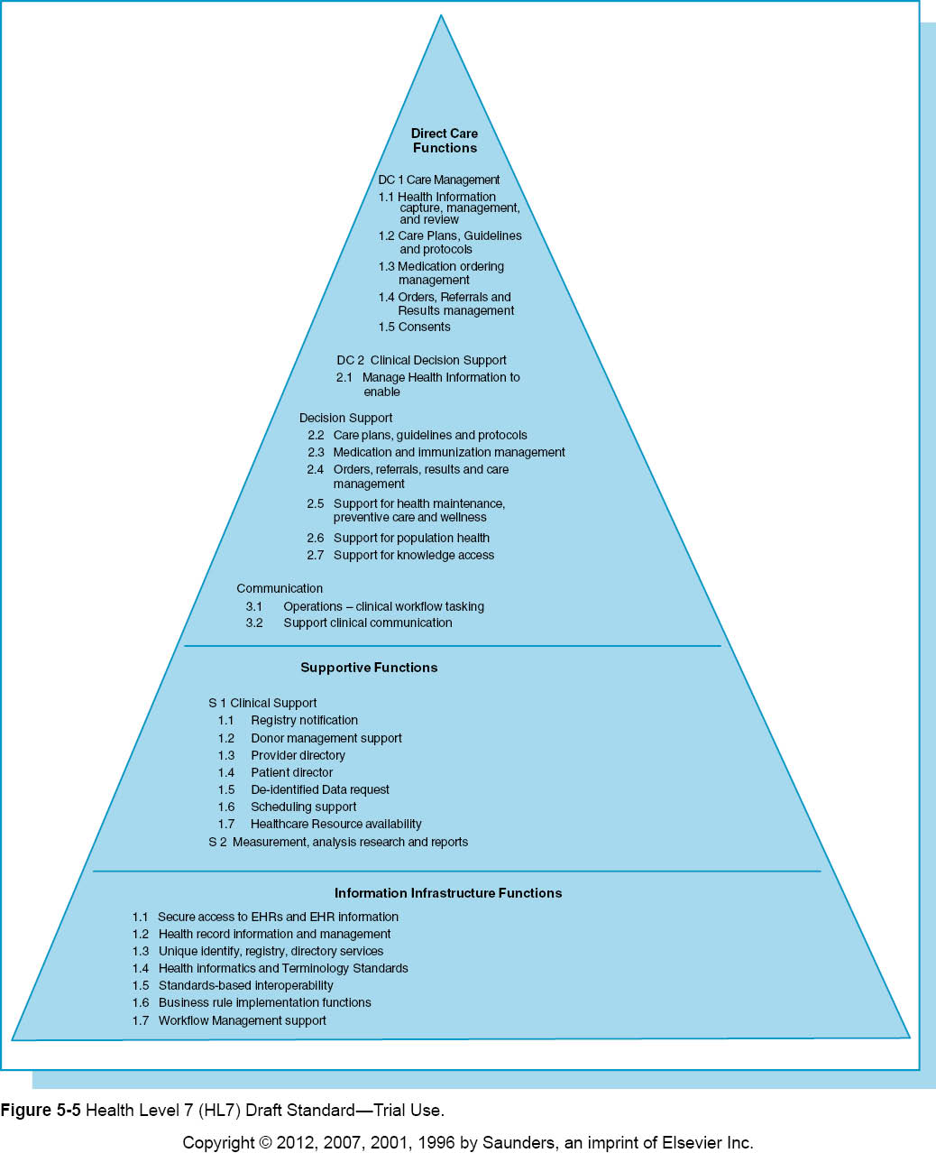

Slide 51
What Are Electronic Health Record Systems and How Do They Work? HL-7 Standard
HL7 standard identifies health record information and management:
“Manage EHR information across EHR-S applications by ensuring that clinical information entered by providers is a valid representation of clinical notes, and is accurate and complete according to clinical rules and tracking amendments to clinical documents. Ensure that information entered by or on behalf of the patient is accurately represented.”

Slide 52
What Are Electronic Health Record Systems and How Do They Work? HL-7 Standard
Reinforces objective for validity, accuracy, and completion of the clinical content.
Describes a series of lists that should be routine components of an EHR.
Provides explanation of technical capabilities to guide system developers on specific features
Provides the foundation for the Commission on Certification of Health Information Technology (CCHIT).
CCHIT publishes standards for ambulatory care practice and inpatient EHRs.
CCHIT reviews vendor EHR packages to certify how well the package meets standards.

Slide 53
What Are Electronic Health Record Systems and How Do They Work? ASTM and Collaborative Work with HL7
ASTM developed a Continuity of Care Record (CCR) standard that called for exchanging information to support coordination of care
In collaboration with the Massachusetts Medical Society, the Healthcare Information and Management Systems Society (HIMSS), the American Academy of Family Physicians (AAFP) and the American Academy of Pediatrics (AAP)
Later mapped to the HL7’s Clinical Document Architecture and renamed – Continuity of Care Document

Slide 54
What Are Electronic Health Record Systems and How Do They Work? ASTM and Collaborative Work with HL7
Continuity of Care Document
Designed for transmission of referral information between healthcare providers
Health and Human Services adopted the standard in 2008
Provides a standard format for exchanging
Demographics
Problem list
Medications
Laboratory information
Allergies

Slide 55
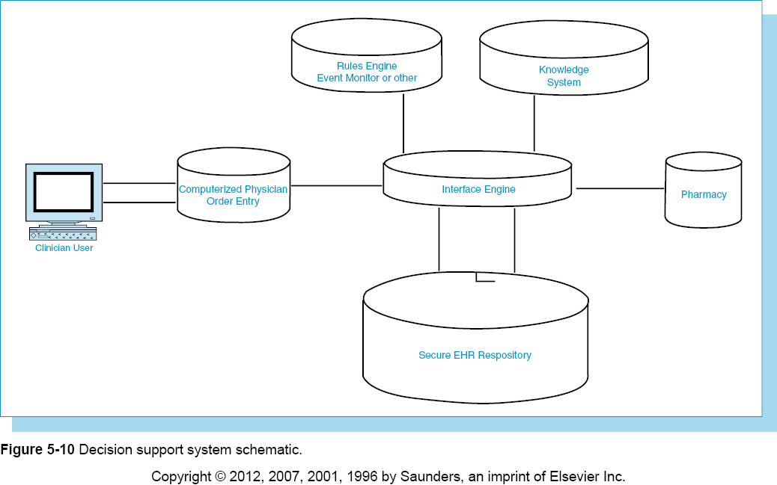

Slide 56
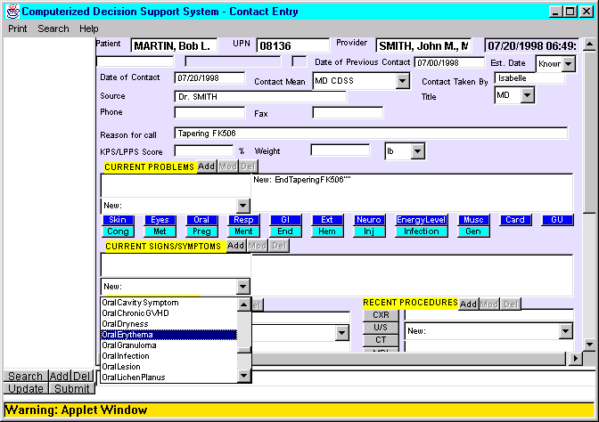
Reasoner

Slide 57
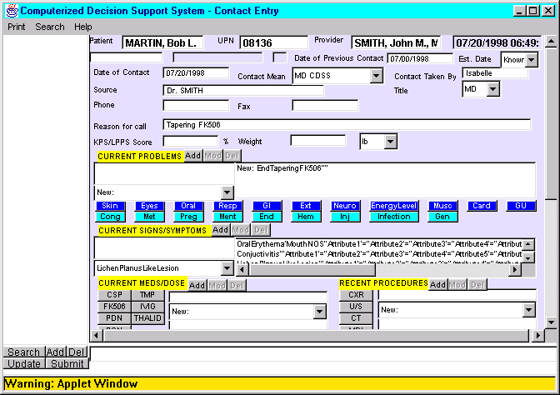
Reasoner

Slide 58
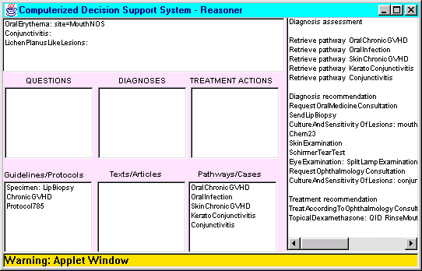
Reasoner

Slide 59
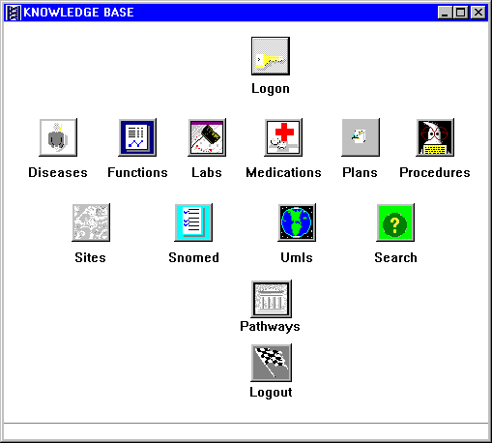

Slide 60
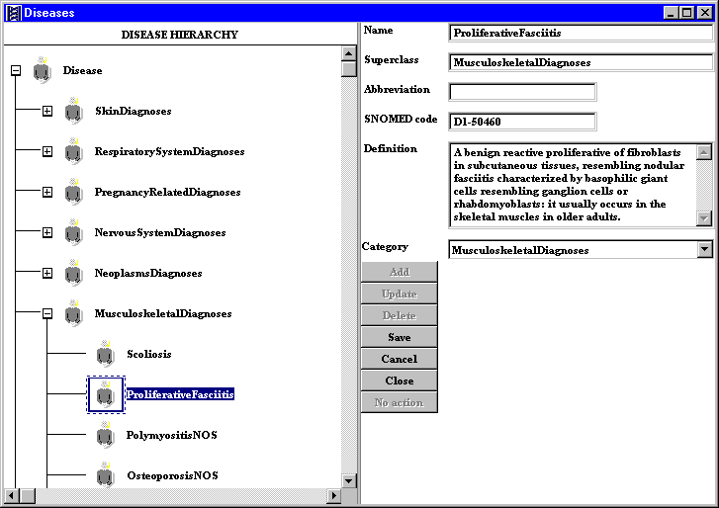

Slide 61
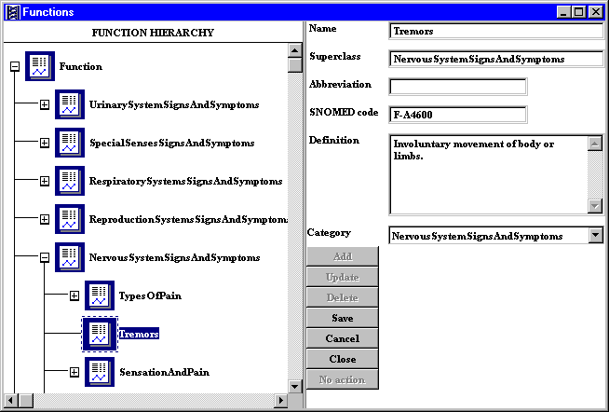

Slide 62
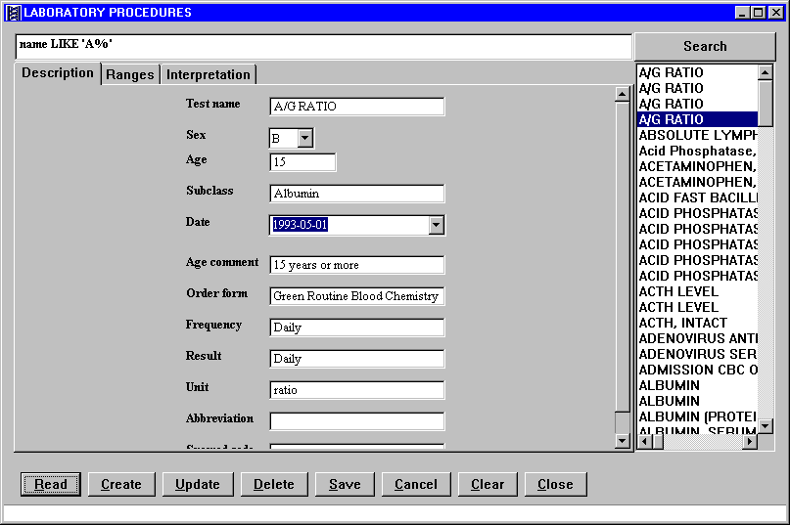

Slide 63
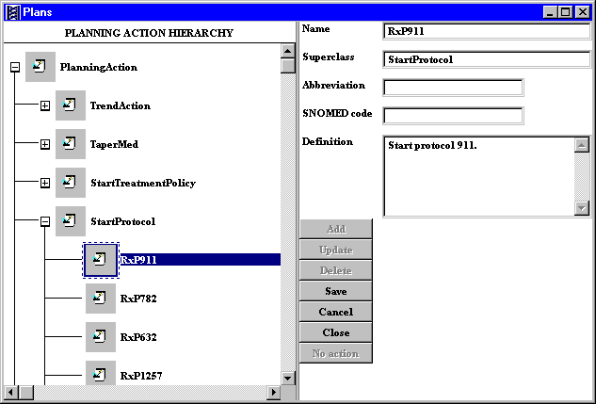

Slide 64
Summary
Current state of patient record system: it is in transition.
Job of the HIM professional is to recognize the pathway to future reality and to understand how the future may function.
Must consider the issues and barriers that will arise.

