Slide 1
Clinical Terminologies

Slide 2
Learning Objectives
Contrast unstructured and structured data entry in the electronic health record. Give examples of each.
List the characteristics of a standardized terminology.
Contrast a vocabulary and a terminology.
Describe a controlled vocabulary.
Explain what is meant by “granularity and specificity” as it relates to classification systems.
Describe why classifications are used to support statistical analysis and reporting.

Slide 3
Learning Objectives
Contrast administrative versus clinical terminologies.
Compare and contrast clinical terminologies.
Explain how UMLS (Unified Medical Language Systems) supports clinical terminologies.
Explain the relationship between LOINC, RELMA and HL7.
Trace the evolution of the International Classification of Diseases.

Slide 4
Learning Objectives
Explain the shortcomings of ICD-9-CM and the strengths of ICD-10 as its replacement.
Identify primary purpose and organization of ICD-1O.
Discuss how Diagnosis-Related Groups (DRGs) have been restructured into the new Medicare Severity-Adjusted DRG system.
Explain what is needed to exchange information captured at the point of care across disparate systems while conveying an understanding of its intended meaning and purpose.

Slide 5
The Challenge of Clinical Communications and Information Exchange
True longitudinal patient record still far off
Must be able to create and exchange information with ease and flexibility
Must do so as demanded by clinicians while still
managing costs
maximizing benefits
protecting security

Slide 6
The Challenge of Clinical Communications and Information Exchange Interoperability and Shared Terminologies
Interoperability – the ability to communicate and exchange data:
Accurately
Effectively
Securely
Consistently
The ability to communicate and exchange data with different:
Information technology systems
Software applications
Networks

Slide 7
The Challenge of Clinical Communications and Information Exchange Interoperability and Shared Terminologies
Exchange data such that clinical or operational purpose and meaning of the data are preserved and unaltered

Slide 8
The Challenge of Clinical Communications and Information Exchange Interoperability and Shared Terminologies
Three levels of interoperability:
Basic interoperability allows a message from one computer to be received by another.
Functional interoperability allows data to pass from a structured field in one system to a comparably structured field in another.
Semantic interoperability allows information to be understood by shared systems. It is dependent on the degree of agreement of data terminology and its quality.

Slide 9
The Challenge of Clinical Communications and Information Exchange Interoperability and Shared Terminologies
Health Level 7 (HL7) EHR Interoperability Work Group: “Interoperability is not a quality or qualification, but rather a noun describing a relationship between systems.”
It is not simply a transfer of information from one system to another in the correct format.
Interoperability is one of the most critical concepts confronting the adoption and implementation of enhanced electronic information technologies.

Slide 10
The Challenge of Clinical Communications and Information Exchange Interoperability and Shared Terminologies
Semantic operability, or shared terminology
as important as system interoperability
must occur to achieve the maximum benefit to use the exchanged information
Clinical data must be recorded at the appropriate level of detail.
Level of detail must be consistent over time and across boundaries.

Slide 11
The Challenge of Clinical Communications and Information Exchange Putting Terminologies in a Framework Structured versus Unstructured Text
Unstructured text: data that is entered directly online
Structured data: allows users to draw from standard phrases or pick lists and pull down menus
Help guide the entry and ensure that complete information is included
Use predefined text scripts, lists and terminology
Template: constructed like an electronic form; guides the user to enter specific content
Combination of drop-down lists and areas for entering free text
Visible to the person documenting the note

Slide 12
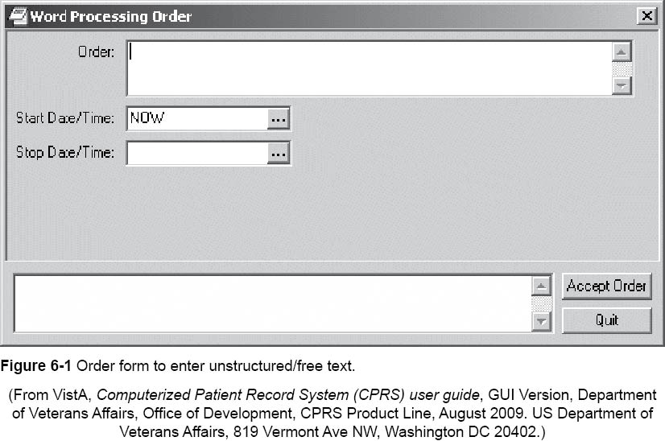

Slide 13
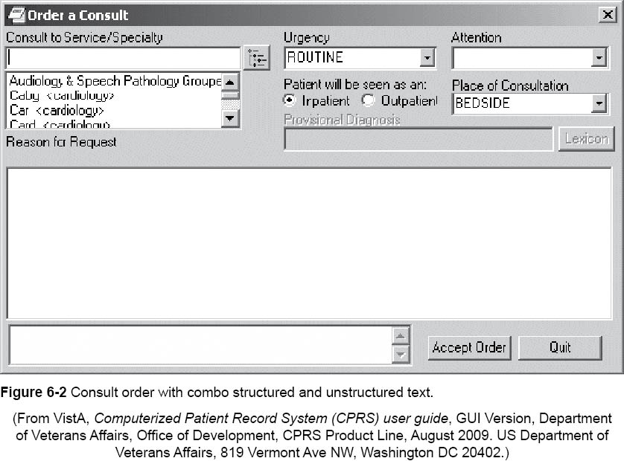

Slide 14
The Challenge of Clinical Communications and Information Exchange Putting Terminologies in a Framework Standardized Terminology
To produce predictable data, EHR systems require standardized terminologies to:
Represent concepts
Communicate them effectively in the manner intended
Needed to represent concepts and to communicate them accurately

Slide 15
The Challenge of Clinical Communications and Information Exchange Putting Terminologies in a Framework Standardized Terminology
Specifically need to have standard terms and concepts – a controlelled vocabulary - to create documentation for:
Symptoms
Diagnoses
Procedures
Test findings
Health status
Problem lists
Plans

Slide 16
The Challenge of Clinical Communications and Information Exchange Putting Terminologies in a Framework Standardized Terminology
Terminologies must be interoperable with subsystems (example, the laboratory or pharmacy).
Standardized terminology and structured clinical data are a prerequisite for
Interoperability
Sharing
Exchanging healthcare information

Slide 17
The Challenge of Clinical Communications and Information Exchange eHealth Standardized Terminology Basic Understanding of Terms
HIM professionals must understand the uses and limitations of different health care terminologies.
They must be able to assist in the selection of appropriate terminologies for EHR use.

Slide 18
The Challenge of Clinical Communications and Information Exchange eHealth Standardized Terminology Vocabulary
Most standard controlled medical vocabularies for coding patient information:
ICD-9-CM ICD-10
SNOMED
LOINC
UMLS
READ

Slide 19
The Challenge of Clinical Communications and Information Exchange eHealth Standardized Terminology Terminology
Terminology: set of terms representing the system of concepts of a particular subject or field
In health care – a set of terms that describe health concepts
Contrast to vocabulary – terminology includes a prescribed set of terms authorized for a specific use
Notes:
An example of a terminology is CPT, the Common Procedural Terminology.

Slide 20
The Challenge of Clinical Communications and Information Exchange eHealth Standardized Terminology Terminology
Record with sufficient detail to support:
Clinical care
Decision support
Outcomes research
Quality improvement

Slide 21
The Challenge of Clinical Communications and Information Exchange eHealth Standardized Terminology Terminology
Terminologies include:
Classifications - A scheme for grouping similar things in a logical way on the basis of common characteristics
Code sets - Unique identifier assigned to a specific term, description, or concept
Vocabularies
Nomenclatures - A naming convention or systematic listing of names that have been assigned according to preestablished rules

Slide 22
The Challenge of Clinical Communications and Information Exchange eHealth Standardized Terminology Codes
Classifications and terminologies used with code sets to define and classify individual health terms
Classifications arrange related terms for easy retrieval.
Vocabularies are sets of specialized terms that facilitate precise communication by eliminating ambiguity.
In HIM: coding refers to selection of alphanumeric codes to represent diseases, procedures, and supplies used in the delivery of health care and the assessment of the quality of care.

Slide 23
Mapping
Data mapping is: the process of creating data element mappings between semantic and representational terms residing in two distinct models.
It is a first step in data integration.
It involves combining terms residing in different sources.
Provides users with a unified view of data.
Semantic mapping is: analogous to auto-connect feature that looks up a term and synonyms.

Slide 24
Mapping General Equivalency Mappings (GEMS)
Comprehensive translation dictionary that can be used to convert ICD-9-CM-based applications or data to ICD-10-CM/PCS
Includes
Data for tracking quality
Data for recording morbidity/mortality
Data for calculating reimbursement

Slide 25
Mapping General Equivalency Mappings (GEMS)
National version created by the Centers for Medicare and Medicaid Services (CMS) and the Centers for Disease Control and Prevention (CDC).
Purpose is to ensure that consistency in national data is maintained.
Can be used to convert large applications while preserving the logic of the application.

Slide 26
Mapping The Role of the Unified Medical Language System and Mapping
Unified Medical Language System (UMLS) developed by the U.S. National Library of Medicine (NLM) to bring together diverse coding schemes with multiple terminologies
Mapping:
valuable for retaining the value of historical data when migrating to newer data-base formats and terminology versions
enables use of data for multiple purposes without having to capture the data in multiple formats

Slide 27
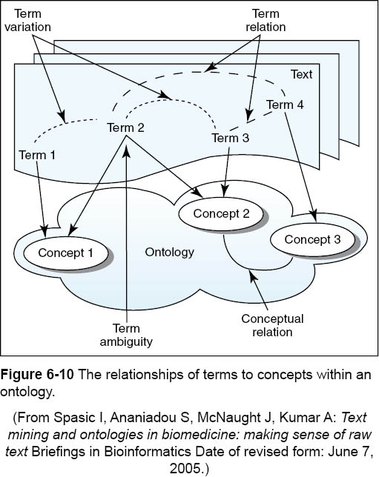

Slide 28
Mapping The Role of the Unified Medical Language System and Mapping
UMLS:
Supports mappings and cross-references among interrelating terminologies
Connects scores of vocabularies, classifications and other sources by concept
Allows users to map data from one terminology to another
Large, multipurpose and multilingual vocabulary database
Contains information about biomedical and health-related concepts, their various names, and the relationships among them

Slide 29
Mapping The Role of the Unified Medical Language System and Mapping
UMLS Purpose
To facilitate development of computer systems that behave as if they understand the meaning of the language of biomedicine and health

Slide 30
Mapping The Role of the Unified Medical Language System and Mapping
UMLS
Contains more than 1 million biomedical concepts
Contains more than 5 million terms organized into concepts
A compendium of more than 100 controlled vocabularies and classifications in the biomedical sciences
Uses one identification code to represent the same concept from different vocabulary sources
Supports the conversion of terms from one controlled vocabulary to another to enable information exchange among different clinical databases and systems

Slide 31
Mapping The Role of the Unified Medical Language System and Mapping
Components of the UMLS:
Metathesaurus
Core database
Collection of concepts and terms from the controlled vocabularies and their relationships
Organized by concepts
Semantic Network
Set of categories and relationships used to classify and relate the entries in the metathesaurus
Catalog of semantic types and relationships

Slide 32
Mapping The Role of the Unified Medical Language System and Mapping
Components of the UMLS:
SPECIALIST Lexicon
Database of lexicographic information for use in natural language processing
Includes more than 200,000 items
Identifies spelling, form, and structure
Identifies how the items are put together to create meaning
Used in natural language processing applications
Supporting software tools

Slide 33
Understanding Terminologies Exploring the Core Set of Terminologies
Core set includes:
SNOMED-CT
Works to code the content of the electronic record
LOINC
Logical Observation Identifiers, Names, and Codes used for representing laboratory data for ordering and naming specific test results
RxNorm
For communication to retail pharmacies and for e-prescribing
Also includes several federal drug terminologies

Slide 34
Understanding Terminologies Exploring the Core Set of Terminologies
National Drug File Reference Terminology
Representations of the mechanism of action and physiologic effect of drugs
National Drug Codes (NDCs)
From the Food and Drug Administration
Ingredient name, manufactured dosage form ,and package type
Accredited Standards Committee (ASC) X 12N standards
For claims attachments
Universal Medical Device Nomenclature System (UMDNS)

Slide 35
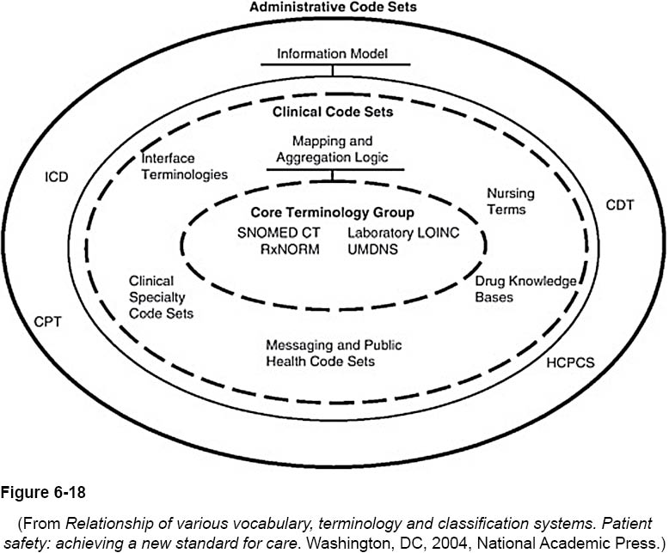

Slide 36
Understanding Terminologies The Role of SNOMED-CT
SNOMED-CT
considered to be the most comprehensive, multilingual clinical healthcare terminology in the world
is a:
coding system
controlled vocabulary
classifications system
clinical reference terminology

Slide 37
Understanding Terminologies The Role of SNOMED-CT
SNOMED-CT
aims to improve patient care by
developing systems to record healthcare encounters accurately
building and facilitating communication and interoperability in electronic health data exchange
an example of a standardized terminology that can be used as the foundation for electronic health records and other applications
contains 310,000+ unique concepts
contains 1.3 million+ links or relationships between them
ensure that information is captured consistently, accurately, and reliably

Slide 38
Understanding Terminologies The Role of SNOMED-CT
SNOMED-CT
offers a consistent language for dealing with health data including:
capturing
sharing
aggregating
based on concepts with hierarchical relationships
each concept is labeled with a unique identifier
provides a rich set of logical interrelationships between concepts

Slide 40
Understanding Terminologies Logical Observation Identifiers Names and Codes
System of 36,000 concepts used to represent:
laboratory and clinical measurements
survey questions
clinical documents
diagnostic reports
Concepts include:
names
codes
synonyms

Slide 41
Understanding Terminologies Logical Observation Identifiers Names and Codes
Regenstrief LOINC Mapping Assistant: tool used to view and search LOINC database
Purpose of database: facilitate the exchange of results for:
Clinical care
Outcomes management
Research

Slide 42
Understanding Terminologies RxNorm
Standardized nomenclature for clinical drugs and drug delivery devices produced by the NLM
Standard names for clinical drugs and drug delivery devices are linked to the various names of drugs present in many different controlled vocabularies within the Unified Medical Language System (UMLS) Metathesaurus

Slide 43
Understanding Terminologies National Drug Code, RxNorm, and UMLS Metathesaurus
National Drug Code system (NDC) was originally part of out-of-hospital drug reimbursement program under Medicare.
HIPAA mandates NDC system as standard medical data code set for reporting drugs and biologics for retail pharmacies.
NDC is owned by the FDA.
NDC is distributed by the Department of Health and Human Services.
Notes:
NDC is now expanded beyond the Medicare system.

Slide 44
Understanding Terminologies Drug Coding Systems Working Together
Differences between NDC codes and RxNorm forms because there is not a one-to-one relationship between them.
One RxNorm form may have many different NDC codes.
Conflict resolution process resolves issues when they appear.
In case of conflict, may use other means to obtain. information and determine the correct NDC.
Conflict resolution important to avoid patient safety problems.

Slide 45
Understanding Terminologies RxNorm and the UMLS Metathesaurus
UMLS Metathesaurus includes the full set of RxNorm files.
Is updated 2 to 3 times per year.
RxNorm is updated monthly.

Slide 46
Understanding Terminologies Nursing Terminologies
It is necessary for nurses to document on EHRs their effect on patient care.
Use of a standardized nursing terminology is still minimal.
Standardized nursing language and advances in technology can:
enhance nursing efficiency
enhance accuracy
significantly improve patient care

Slide 47
Understanding Terminologies Nursing Terminologies
The American Nursing Association developed nursing classification themes to:
describe the nursing process
document nursing care
facilitate aggregation of data for comparisons at the local, regional, national and international levels

Slide 48
Understanding Terminologies Nursing Terminologies
Two notable nursing classification systems:
Nursing Interventions Classification (NIC)
Nursing Outcomes Classifications (NOC)
Comprehensive, research-based, standardized systems
NIC and NOC are used to classify:
the interventions that nurses perform
outcome evaluations based on those interventions

Slide 49
Understanding Terminologies Terminologies Used at Point of Care
Also known as clinical terminologies
Terminologies designed to:
facilitate data collection at the point of care
capture the detail of:
diagnostic studies
history and physicals
visit notes
ancillary department information
nursing notes
allow the sending and receiving of medical data in an understandable, predictable manner

Slide 50
Understanding Terminologies Terminologies Used at Point of Care
Clinical terminologies that use codes provide a way to combine the expressiveness and flexibility of free text information with the clarity and computability of encoded information
Example: SNOMED-CT
Identified as having the greatest potential to handle the complex data representation required in the HER.
Encoded data allows display in a form that humans can understand and storage in a form that computers can exchange and manipulate.

Slide 51
Understanding Terminologies Transaction and Code Set Standards
Employers must have standard national numbers that identify them on transactions.
HIPAA mandates specific code sets for electronic transactions for diagnoses and procedures:
ICD-9-CM for inpatient diagnoses and procedures (ICD-10-CM to replace by October 1, 2013
CPT-4 for physicians’ procedures
HCPCS for ancillary services and procedures
NDC to identify the vendor, product and package size of all FDA recognized medications
CDT for dental services
NDC to code procedures, diagnoses and drug services

Slide 52
Understanding Terminologies HIM and AdministrativeTerminologies
Some administrative terminologies commonly used for administrative purposes:
ICD-9-CM
Current Procedural Terminology (CPT)
Healthcare Common Procedure Coding (HCPCS)
Diagnosis Related Groups (DRGs)

Slide 53
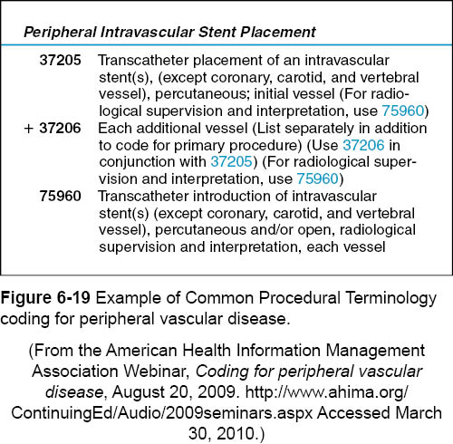

Slide 54
Understanding Terminologies Derivations of the International Classification of Diseases Diagnostic and Statistical Manual of Mental Disorders
Derivation of the ICD used in behavioral health settings
Most recent revision DSM-IV published in 1994
Next revision scheduled in 2013
DSM-IV includes definitions and diagnostic criteria for mental disorders with code numbers for each diagnosis
All diagnostic codes in DSM-IV are valid ICD-9-CM codes
Notes:
Diagnostic and Statistical Manual of Mental Disorders also known as DSM-IV. Next revision will be retitled as DSM-5.

Slide 55
Understanding Terminologies Derivations of the International Classification of Diseases Diagnostic and Statistical Manual of Mental Disorders
Five axes for psychiatric diagnosis:
Axis I – Major mental disorders, developmental disorders and learning disabilities
Axis II – Underlying pervasive or personality conditions and mental retardation
Axis III – Any nonpsychiatric medical condition (“somatic”)
Axis IV – Social functioning and impact of symptoms
Axis V – Global Assessment of Functioning (GAF) on scale from 100 to 0

Slide 56
Understanding Terminologies Derivations of the International Classification of Diseases Diagnostic and Statistical Manual of Mental Disorders
DSM-5 will be different
Some axes may be collapsed into one
Reflect new and existing mental disorders
Will include each diagnostic category
Will include a section on structural, cross cutting, and general classification issues
Will include dimensional assessments that can be used to establish a baseline measure of severity and track changes over time

Slide 57
Understanding Terminologies Derivations of the International Classification of Diseases Diagnosis-Related Groups and MS-DRGs
Diagnosis-Related Groups (DRGs) were used to categorize patients on the basis of:
Principal diagnoses
Secondary diagnoses
Principal procedures
Secondary procedures
Age
Sex
Complications
Discharge status
Comorbitities

Slide 58
Understanding Terminologies Derivations of the International Classification of Diseases Diagnosis-Related Groups and MS-DRGs
DRGs designed as a way, under Medicare, to:
Group services
Estimate costs
Support prospective payment
Basic DRG method used by CMS for hospital payment for Medicare beneficiaries

Slide 59
Understanding Terminologies Derivations of the International Classification of Diseases Diagnosis-Related Groups and MS-DRGs
October 2007 saw a dramatic restructuring of DRGs – Medicare Severity-Adjusted DRG (MS-DRG).
A new in-patient prospective payment system (IPPS) brought number of MS-DRGs to 745.
Replaced the previous schedule of 538 DRGs.
It adjusted DRG weights based on severity of patient’s condition.
It correlates more closely with resource consumption.

Slide 60
Going Forward
Desirable characteristics of controlled terminologies:
They should support capturing what is known about the patient.
They should support information retrieval and allow someone returning to the information later to understand its meaning as intended by the author.
They should allow storage, retrieval, and transfer of information with as little information loss as possible as terminologies change over time.
They should support aggregation of data.
They should support the reuse of data.
They should support inferencing.

