Slide 1
Technologies Applications Security

Slide 2
Learning Objectives
Define key words.
Define and describe the overall scope of health information systems.
Discuss the evolution of information technology in health care.
Explain the fundamental concepts of database models
Understand the functionality of structured query language (SQL).

Slide 3
Learning Objectives
Define and explain scenarios for the use of major technologies in health information system, among which:
Wireless networks and devices
Three-tier architectures
Network protocols
User interfaces (for Web pages in particular)
Bar code technology
Telehealth
Datamarts …

Slide 4
Learning Objectives
Illustrate some examples of how admission, discharge, and transfer is used in a health information system.
Provide the advantages of computerized provider order entry systems.
Define and explain various techniques used to address security of health information systems.
Understand how data collected in a health information system can be used for research.

Slide 5
Goals
More information is needed in health care than ever before.
Need to achieve better health care quality outcomes.
Need cost-efficiencies in providing health services.
Need to extend access to larger patient populations.
Need to extend access to health care information to more users.
Notes:
The ideal scenario is for better access to information and better communication between patients, health care providers, specialists, insurers and all others involved in patient care.

Slide 6
Meeting the Goals
Health care industry traditionally not as invested in new technology as other industries
Health care information technology investment growing from $17 billion to $42 billion annually
Applying new technology in information systems and communications
Applied to multiple business processes within the industry
Notes:
Other industries, such as banking and retail, have typically invested more into information technology than the health care industry. Investment in new technology by the health care industry is on the rise.

Slide 7
Meeting the Goals
Rising interest in health information systems (HISs) due to several factors:
Office of the National Coordinator for Health Information Technology created in 2003
American Recovery and Reinvestment Act of 2009 – government allocated $2 billion to accelerate adoption of health information technology in US
Increasing consumer demand for more efficient, higher quality health care
Notes:
Several factors have contributed to the rapid increase in HIS technology including government initiatives and health care consumer demands.

Slide 8
Health Information Management Systems
Term serves as alias for many types of information systems
Includes:
Hospital information systems
Clinical information systems
Decision support systems
Medical information systems
Management information systems
And others
Notes:
Health Information Management Systems refers to a variety of information systems used in hospitals, clinics, and even in homes.

Slide 9
Scope of Health Information Systems
It is important to determine scope of an HIS as well as its component.
Components can be applied to almost any type of HIS.

Slide 10
Scope of Health Information Systems
Scope of HIS
Departmental – limited to a specific clinical or financial domain to serve functions of a department
Intradepartmental – primarily serves business function of one department, shares information with other departments
Hospital-wide - focuses on integration of various departmental systems
Notes:
Systems are listed in order of range of scope from departmental (narrowest range) to external (widest range).

Slide 11
Scope of Health Information Systems
Scope of HIS (cont’d)
Enterprise-wide – encompasses all departmental systems throughout health system
External – primarily exists to report information required by regulatory agencies, shared among different health systems

Slide 12
Components
Comprehensive HIS contains seven components:
Core applications – patient scheduling, admission, discharge – serve as central base of information
Business and financial systems – patient accounting, billing, payroll – provide data management functions
Communications and networking applications – email, Web applications – transmit and manage communications both inside and outside the hospital

Slide 13
Components
Departmental systems – pharmacy, radiology, lab – designed to manage clinical operations and share data
Documentation systems – EMR, point-of-care bedside devices – collect, store, and retrieve patient data
Reminder and advice functions – test result alerts, drug interactions – assist clinicians in performing patient care activities
Syndromic surveillance system – designed to detect patterns of disease in a population
Notes:
The number of components found in any given HIS can vary with the first three components (core applications, business functions, communications) being the most universal, and the remaining components being acquired as an HIS becomes more advanced.

Slide 14
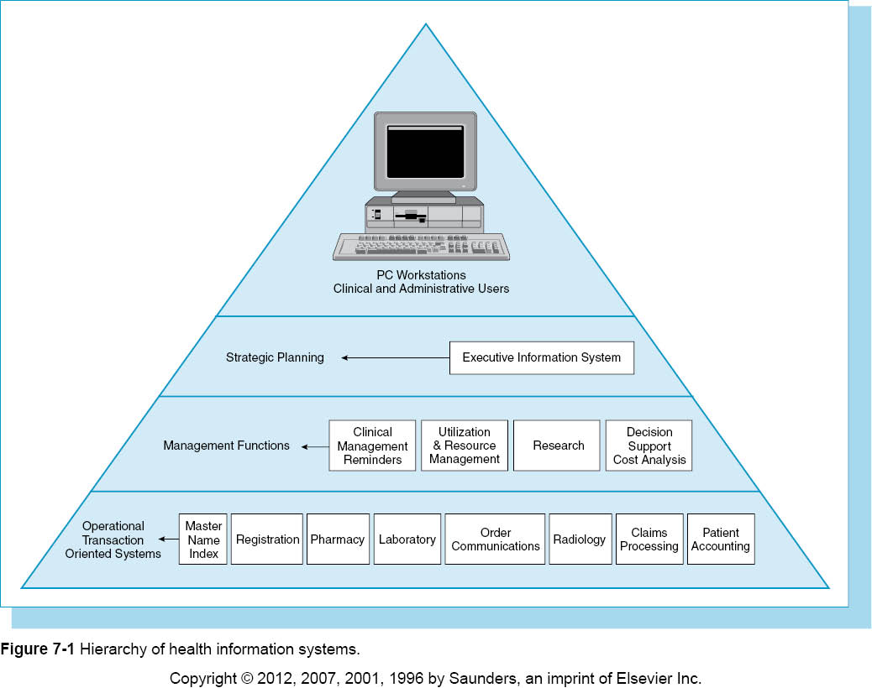

Slide 15
Early Efforts (1960s to 1980s)
Computers were introduced into health care arena through punch-card data processing.
Early activities focused on decision-making for physicians.
COSTAR (computer stored ambulatory record system) – developed by Octo Barnett at Massachusetts General Hospital (1960s-1970s).
IBM Medical Information Systems Program was first patient care system claiming to automate patient record, sold until 1972.
Notes:
Early computer work also included statistical analysis on the incidence, distribution, and causes of diseases in society.

Slide 16
Early Efforts (1960s to 1980s)
Technicon Data System (TDS)
Patient care information system designed by Lockheed survived next 30 years
Redesigned and rebranded as electronic health record software used for improving clinical outcomes

Slide 17
Early Efforts (1960s to 1980s)
1970s – HISs developed in different ways
Financial information systems modified for clinical applications
One large database designed to share its resources among departments
Department applications, such as a clinical laboratory system, enhanced with customized features
Database structures and tools still immature during 1970s.
Notes:
The intention was to create common data to be shared through an integrated database.

Slide 18
Early Efforts (1960s to 1980s)
CPHA – Commission on Professional Hospital Activities
Worked with computerized data in new ways
Introduced more computer power and better data retrieval
Introduction of microcomputers in 1970s generated more specific department systems
New software tools made computers more accessible to clinicians and other users.
Notes:
The 1970s introduced smaller computers as powerful as the earlier, larger mainframe computers. Individual departments could use new software tools to tailor systems to meet their specific needs.

Slide 19
Early Efforts (1960s to 1980s)
1970s-1980s – introduction of the personal computer (PC)
Improved reliability and computing power of hardware
Increased availability of functional software
Reduced cost of ownership
Notes:
The introduction of the PC also brought about an increase in the need for software developers and engineers to write programs designed to meet the specific needs of individuals and departments as well as the whole industry.

Slide 20
Evolution of Hospital Information Systems (1980s to Late 1990s)
Introduction of network technology:
Enabled department systems to communicate and share information with other systems.
Improved ability to link diverse applications.
1980 – HISs described at three levels
Level I – included ADT application, order entry, and billing functions
Level II – systems included part or most of the patient record
Level III – data linked to knowledge bases providing diagnostic support and patient care intervention
Notes:
Network technology was essential for making it possible for diverse software applications, databases, and hardware configurations to communicate with each other.

Slide 21
Evolution of Hospital Information Systems (Late 1990s to Present)
Prospect for developing effective, affordable HISs improving with advances in technology:
Introduction of Internet and World Wide Web
Development of reliable, scalable servers
Availability of low cost PCs, mobile devices
Introduction of object-oriented software (JAVA)
Availability of free Internet browsers and utilities
Data management tools available to end users
Government effort to promote a national health care IT program
Notes:
As technology continues to advance, the possibilities for creating effective HISs increase. All of the advances listed here lead to greater communication options between systems.

Slide 22
Health Information Systems as a Critical Discipline
Medical informatics is - study of medical computing.
National Library of Medicine sponsors post-graduate training programs for physicians and other health care professionals.
Notes:
Understanding computerized health care information and systems is critical for physicians and health care professionals at all levels from clinicians to administrative staff.

Slide 23
Health Information Systems as a Critical Discipline
Professional organizations actively advancing the study of medical informatics
CHIME - College of Health Information Management Executives
HIMSS - Health Information Management Systems Society
AMIA - American Medical Informatics Association
AHIMA - American Health Information Management Association
NeHC – government sponsored public-private collaboration
Notes:
NeHC draws from the public and private sectors to make recommendations to HHS on how to share EHR data while maintaining security and patient privacy.

Slide 24
Hardware
Cloud computing
Processing power shared across many computers
Hardware housed by a commercial vendor
Amazon Elastic Computer Service (EC2) – large, popular cloud computing platform offered by Amazon.com.

Slide 25
Smart Phones and Mobile Devices
Mobile device or PDA – hand-held device combining computing, fax, and networking features
PC Tablet – another type of mobile device; handwriting recognition capabilities
Notes:
Mobile and hand-held devices are popular among doctors, nurses, and home health care workers for use at bedside to input information directly from a patient and to access reference information such as drug tables and drug interactions.

Slide 26
Voice Recognition
Consists of both hardware and software
Primarily an alternative to a data input device
Recognizes spoken words and records the information
Often used in EDs and radiology where fast turnaround on transcription is required
Notes:
It is important to note that voice recognition recognizes words as data, but cannot interpret the meaning behind the words.

Slide 27
Programming Languages
Fourth generation
Determines the lower level instructions necessary to generate the ouput
Commonly known as 4GI
Often proprietary to one vendor
MUMPS – Massachusetts General Hospital Utility Multi-Programming System
Third generation programming language specifically used in health care applications
Used by both Department of Defense and Veterans Affairs

Slide 28
Databases
Collection of stored data typically organized into records, fields, files
DBMS – database management system
Integrated set of programs managing access to the database
Notes:
Databases allow users to retrieve and manipulate data as they need it.

Slide 29
Database Models
Collection of logical constructs representing the data structure and data relationships
Four major database models
Relational
Hierarchical
Network
Object oriented

Slide 30
Relational Model
Most popular database model
All data are stored in tables with relationships between the tables
Relation created by sharing a common data element, such as Patient ID
SQL – Structured Query Language
Provides a method of retrieving data

Slide 31
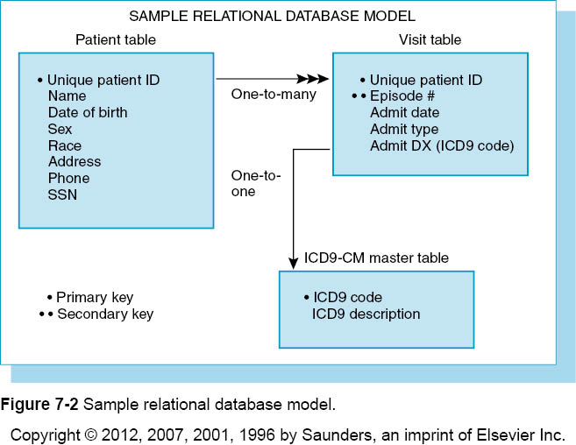

Slide 32
Hierarchical Model
Supports a treelike structure consisting of parent (root) and child segments.
Each parent segment has one or more child segments.
Each child segment can only have one parent.
Answers to queries found by searching downward through the tree.
Hospital patient accounting system one example of a hierarchical model.

Slide 33
Network Model
Similar to hierarchical model
Parent referred to as “owner”
Child referred to as “member”
Child or member segment can have more than one parent or owner.

Slide 34
Object Oriented Model
Data is stored as a collection of objects
Encapsulation – object is defined with a set of certain characteristics
Inheritance – one object can inherit the characteristics of another object
Access to data can be faster because objects can be retrieved directly

Slide 35
Network Technology
Wi-fi – wireless network
Enables communication with the Internet and other network servers without being physically connected to the network
WEP – Wired Equivalent Privacy
Encrypts data to protect it during wireless transmission
WPA – Wi-fi protected access
Most popular method of securing wireless networks

Slide 36
Client-Server Platforms
These are also referred to as two-tier architecture.
Most processing occurs on the serve.r
Reduces network traffic by providing query response rather than total file transfer.
Are found in smaller environments with less than 50 users.
Notes:
One disadvantage to the two-tier client-server architecture is that the client software needs to be replicated on every PC connected to the network. This makes it expensive, difficult to maintain, and difficult to scale up to accommodate more users.

Slide 37
Client-Server Platforms
Three-tier architecture becoming popular
Three components
User interface
Application server
Database server
Application server processes the data
Changes to the application server do not have to affect whole system.
Notes:
Developers are discovering health care systems require large amounts of application processing and having three distinct layers makes it easier to maintain and adjust according to client needs.

Slide 38
Interface Engine
Middleware – software and hardware that serve as a bridge between applications
Allows two applications to exchange information without building a customized interface for each application

Slide 39
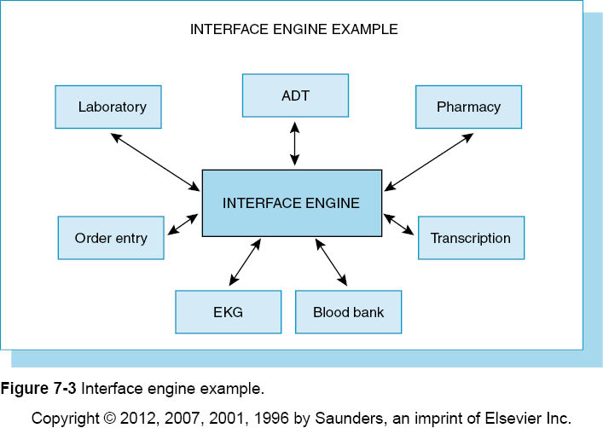

Slide 40
Clinical Applications
Clinical Decision Support Systems (CDSS)
CDSS provides diagnostic investigation tools and clinical guideline advice to patient care providers.
Basic support provides computerized advice regarding drug dosages, routes, and frequencies.
More sophisticated support can perform drug allergy checks, drug-laboratory values, and drug interaction checks.
Automated alert system notifies providers of potential adverse events.

Slide 41
Clinical Applications
Point-of-Care Systems
Captures data at the place where care is provided
Bedside devices
Mobile devices
Prompts users to enter information needed for documentation and coding
Incorporates data received from bedside monitoring devices such as ventilators and vital signs monitors

Slide 42
Bar Coding
Replacement for traditional keyboard data entry
Common health care uses:
Medication administration
Materials management
Forms processing

Slide 43
Bar Coding
Format of bar code determined by symbology.
Printed bars and intervening spaces define the output.
Two most common symbologies in health care are:
Code 39 – produces a long bar code
Code 128 – producers a shorter, denser bar code for smaller spaces; favored for patient wristbands and laboratory specimens
FDA requires all medications to have a bar code.
Notes:
Symbology refers to the font in which machine-readable code is written.

Slide 44
Radio Frequency Identification Device (RFID)
A chip embedded in a plastic wristband or card
Stores large amounts of information that can travel with a patient
RFID tags contain antennas enabling them to receive and respond to radiofrequency queries
Three types of RFID tags:
Passive – draws its power from RFID reader’s radio waves
Semiactive – uses a battery to run the microchip’s circuitry; does not communicate with RFID reader
Active – powered entirely by battery to send/receive RFID information

Slide 45
Internet and Web Services
A “network of networks”, the Internet links computers through telephone or cable lines.
Internet Engineering Task Force (IETF) is nonprofit organization defining the standards for how the network should function.
Internet browser is example of client software giving users access to the Internet/
Browsers can run on almost any type of operating system.

Slide 46
Internet and Web Services
Internet adheres to TCP/IP protocol for transmitting data.
IP address is unique network address assigned to each computer on the Internet.
HTTP – Hypertext Transfer Protocol – determines how information is formatted and transmitted.

Slide 47
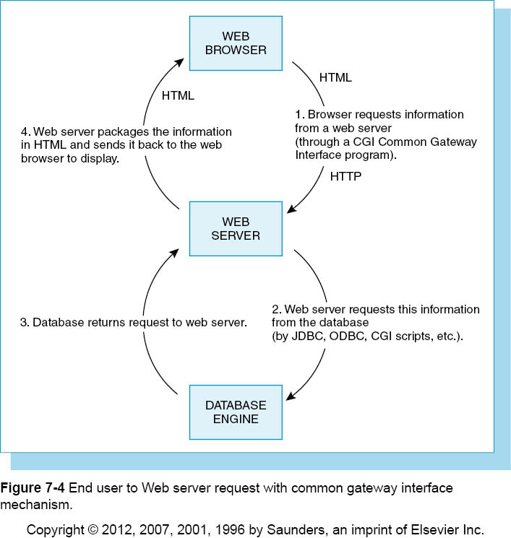

Slide 48
Internet and Web Services
Three types of Internet tools:
HTML – Hypertext Markup Language
SGML – Standardized General Markup Language
XML – Extensible Markup Language

Slide 49
Internet and Web Services
HTML
MHTML is most common format used for structuring documents on the Web.
It is designed to make content easy to read.
Makes use of tags to define the text.
Limited set of tags identify text and images.

Slide 50
Internet and Web Services
SGML
SGML is frequently used to manage large documents.
Built with DTD – document type definition.
Is suited for documents that may be formatted for different purposes.

Slide 51
Internet and Web Services
XML
XML is growing in popularity because of its advanced features.
Uses many HTML conventions, but includes additional capabilities.
It allows users to define new tags and attribute names.

Slide 52
Internet and Web Services
JAVA
JAVA is programming language introduced by Sun Microsystems in late 1995.
It allows applications to be built as stand-alones that can be transferred across the Web.
JAVA often referred to as “write once, run anywhere.”
Notes:
Any computer can run a JAVA based program as long as it has a JAVA compiler that is often included in browser software.

Slide 53
Internet and Web Services
Intranet
Intranet runs exclusively within a network.
Is accessible only to authenticated users.
Virtual Private Network (VPN)
VPN allows users outside the network to gain access through use of a password.
Web 2.0
Web 2.0 allows users to interact with other users and to change Web content.
RSS – Really Simple Syndication – allows content to appear on sites beyond author’s control.
Notes:
Wikipedia is an example of Web 2.0 because registered users can add, delete, or edit existing content.

Slide 54
Fundamentals
Uses telecommunications technologies to deliver health-related services and information
Generally used as an umbrella term to describe all possible variations of health care services using telecommunications
Telemedicine – describes the direct provision of clinical care via telecommunications

Slide 55
Telehealth
Telemedicine requires appropriate bandwith.
Bandwith – a measure of how much information can be transmitted simultaneously through a communication channel
The more complex the transmission, the higher the bandwith that will be needed.

Slide 56
Implementation
Are still a few technical and administrative issues to be resolved for successful implementation.
Large image files such as x-rays and CT scans need large amounts of bandwith and can take a long time to transmit.
Data compression – reduces the size of the file being transmitted.
Most telemedicine applications need fiber optic networks in place to transmit data efficiently.

Slide 57
Implementation
Administrative issues:
Telemedicine reimbursement
Physician licensing and liability
Physicians licensed by the state in which they practice
Defining “practicing”
Patient confidentiality and security

Slide 58
Computer Security
Increased use of HISs
Increase in amounts of electronically available data
Goal to guard against inappropriate use without compromising the caregivers “need to know”
Constant struggle to balance protecting patient confidentiality and the cost of security mechanisms

Slide 59
Costs of Security
Direct and indirect costs:
Direct costs – purchasing and installing security hardware and/or software
Cost of training staff and employees
Indirect costs – user training and operating system modifications

Slide 60
Costs of Security
Computer Science and Telecommunications Board of the National Research Council
Examined ways to protect electronic health information
Individual authentication of users
Access controls
Audit trails
Disaster recovery
Protection of remote access points
Protection of electronic external communication

Slide 61
HIPAA
Health Insurance Portability and Accountability Act
Four general rules for security:
Ensure the confidentiality, integrity, and availability of all electronic protected health information the covered entity creates, receives, maintains, or transmits.
Protect against any reasonably anticipated threats or hazards to the security or integrity of such information.

Slide 62
HIPAA
Protect against any reasonably anticipated uses or disclosures of such information that are not permitted or required.
Ensure compliance with this regulation by its workforce.

Slide 63
Authentication Tools
Process of verifying or confirming identity of user accessing information
Usually based on various criteria:
Something that you know (password)
Something you have (a key, credit card)
Something that is a part of you (your fingerprint, DNA sequence
Something indicating where you are located

Slide 64
Authentication Tools
Passwords - Users tend to use common words or phrases for passwords
Technology can assist with certain steps to enforce proper use of passwords to keep them secure:
Photo ID to obtain or retrieve a password
Require a change of password at a specific frequency (30, 90 days) – password aging
Install a password history file
Allow only one login per user identification at a time
Disable accounts after a maximum number of login attempts
Implement an automatic logout policy

Slide 65
Authentication Tools
Single Sign-on - Enables user to have one password to access multiple systems
Tokens or Cards – displays a number that changes every minute
Biometric Devices – fingerprints, retinal patterns, speech scans
Access Controls – controls which users can access the system and what information can be viewed

Slide 66
Reporting Capabilities
System generated reports of user activity helps monitor and protect system security.
Reports can show
All users who logged in and from what domain or location
Users who have not logged into the system for 3 months
Users who tried to access deleted records
All users who have tried to login unsuccessfully more than once

Slide 67
Physical Security
Access to areas where servers, terminals, modems, and other equipment must be controlled
Logs can track which employees have entered secure areas
Discarded computers and data storage devices must be wiped clean of all data
Maintain inventory of all equipment

Slide 68
External Controls
Firewalls – prevents outside access to a private network using hardware, software, or both
Several types of firewall solutions
Proxy server —intercepts all messages entering and leaving the network so that the network address is hidden.
Packet filter —examines data entering or leaving and accepts or rejects the data on the basis of system-defined criteria.
Application gateway - allows only certain applications to run from outside the network.

Slide 69
External Controls
Encryption - changes readable text into a set of different characters and numbers based on a mathematical algorithm.
SSL – Secure Socket Layer – allows browser and server to authenticate identities and encrypt the data transfer
Malicious Software Protection – malware can by any unauthorized software found in an information system

Slide 70
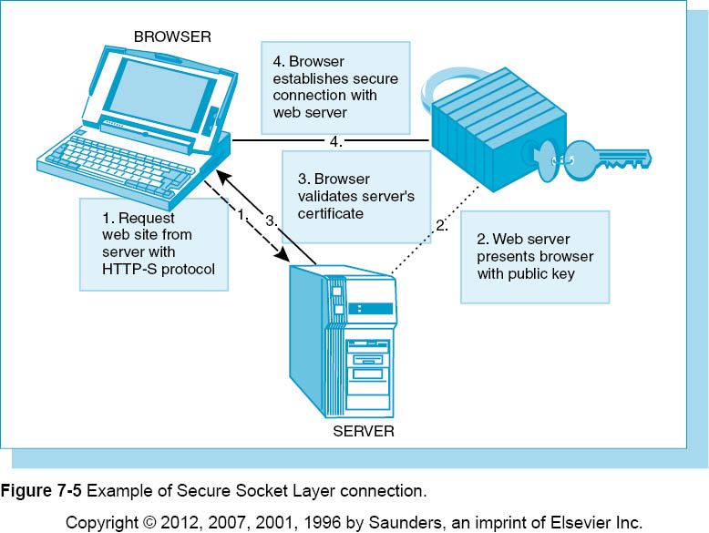

Slide 71
External Controls
Types of malware
Masqueraders – software appearing to be part of existing software but producing unwanted behavior
Incapacitation – attacker overloads targeted system until it no longer functions
Corruption – software changed to perform a malicious activity without the user’s knowledge
Misuse – computer worm that deliberately installed itself and extends to every computer on the network
Phishing – fools users into entering personal information into what appears to be a legitimate site
Notes:
A Trojan Horse is an example of a masquerader and a computer virus is an example of corruption malware. Computer worms most often arrive in the form of e-mail attachments that are activated when the attachment is opened.

Slide 72
Data Mart
Subset of data extracted from the larger database
Advantages:
Reduced unit cost of processing and storage
Selection of a database model and technology can be tailored to the needs of a department
Amount of historical data and level of granularity can be specific to the needs of a department.
Granularity - term given to the level of detail in the data

Slide 73
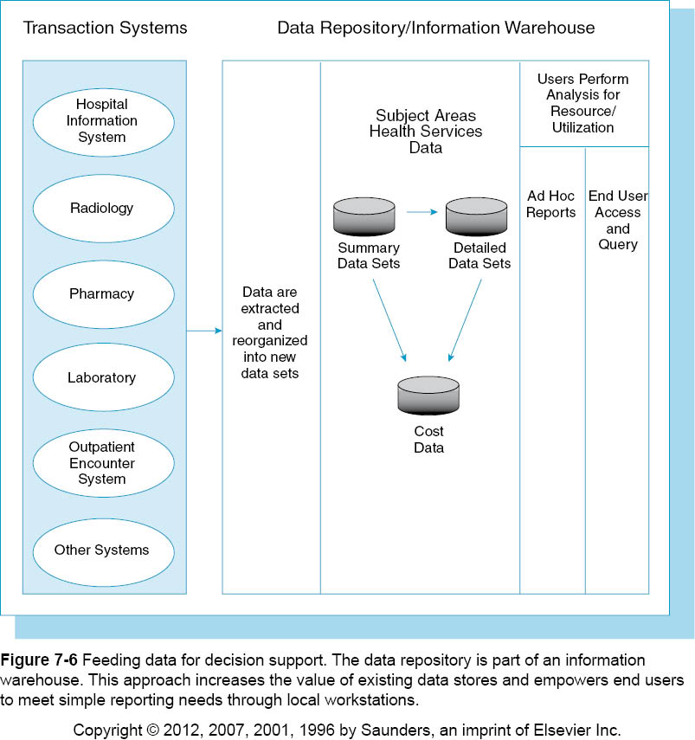

Slide 74
Data Modeling
Data modeling assists with identifying patient subgroups.
Researcher defines the criteria and a statistical model is then constructed and used to help locate all cases that meet the criteria.

