Slide 1
Technologies Databases

Slide 2
Learning Objectives
Explain how information relates to databases.
Define a database management system.
Write queries in Microsoft Access.
Design queries to solve problems using a database / a set of data.

Slide 3
In general, we are interested in
any element capable of decreasing or increasing the uncertainty of a system
Change in the state of « uncertainty" in a system
=
Information

Slide 4
Conclusion
A piece of information is some knowledge, some data processed so that it modifies the state of « uncertainty » about a system
Data
Processing
Information

Slide 5
Second viewpoint :
The different dimensions of « lnformation »

Slide 6
First
dimension
Technical Dimension
A stored or transmitted symbol
=
« The data"

Slide 7
Semantic Dimension
The meaning, the knowledge represented
Second
dimension
=
« The Information »
B. Lussato in « Theories about information and the human brain processor « »
« A message is a set of data which will only become information when the message is received and understood"

Slide 8
Third
dimension
=
The utility of information
Does information transform the representation of knowledge ?

Slide 9
Conclusion
1 Information
=
+
1 Datum
1 semantic dimension
=>
A change in the representation of knowledge
& /or
Which modifies the state of certainty about a system

Slide 10
Example :
1 Photocopy of the price of an article
=
Technical Dimension –
Data
Is the photocopy
readable ?
Do the symbols present on the photocopy have a meaning ?
Semantic Dimension : Information
=

Slide 11
Third dimension :
Utility of the information
For who knows the price of this article, these symbols do not modify the state of certainty about the system
=
The symbols are not information
For who does not know the price of an article, these symbols do modify the state of certainty about the system
These symbols are information
=

Slide 12
Tranforming Data into Information The DBMSs

Slide 13
Databases Definition
A database is a structured set of data recorded and stored on a digital media
A database translate physically into one or more files which will eventually be structured in tables (relational databases)

Slide 14
Types of Databases
Hierarchical databases
Network databases
Relational databases: A relational database is a set of logically related data organized in tables. Data manipulation is based on the concept of relational algebra.
Object-oriented database

Slide 15
Databases Characteristics
Structured data
Non redundancy
Coherence
Data accessible through different criteria
Independence data / programs
Data security

Slide 16
DBMS Database Management System
A database management system (DBMS) represents a coordinated set of software programs to describe, manipulate, process the set of data composing the database
It must be usable by non-computer scientists

Slide 17
Relational Database Management System (RDBMS)
A relational database management system (RDBMS) is specialized in the manipulation of data from the database using relational algebra
RDBMS examples: Access, Oracle, SQL Server, MySQL

Slide 18
RDBMS Origin
In 1970 Edgar Frank Codd (IBM) published un article where he proposed to store heterogeneous data in tables, with relationships between them
First prototype the following year

Slide 19
SQL Birth
In 1987 the SQL language was created based on relational algebra
It separates the WHAT (expressed in SQL) from the HOW

Slide 20
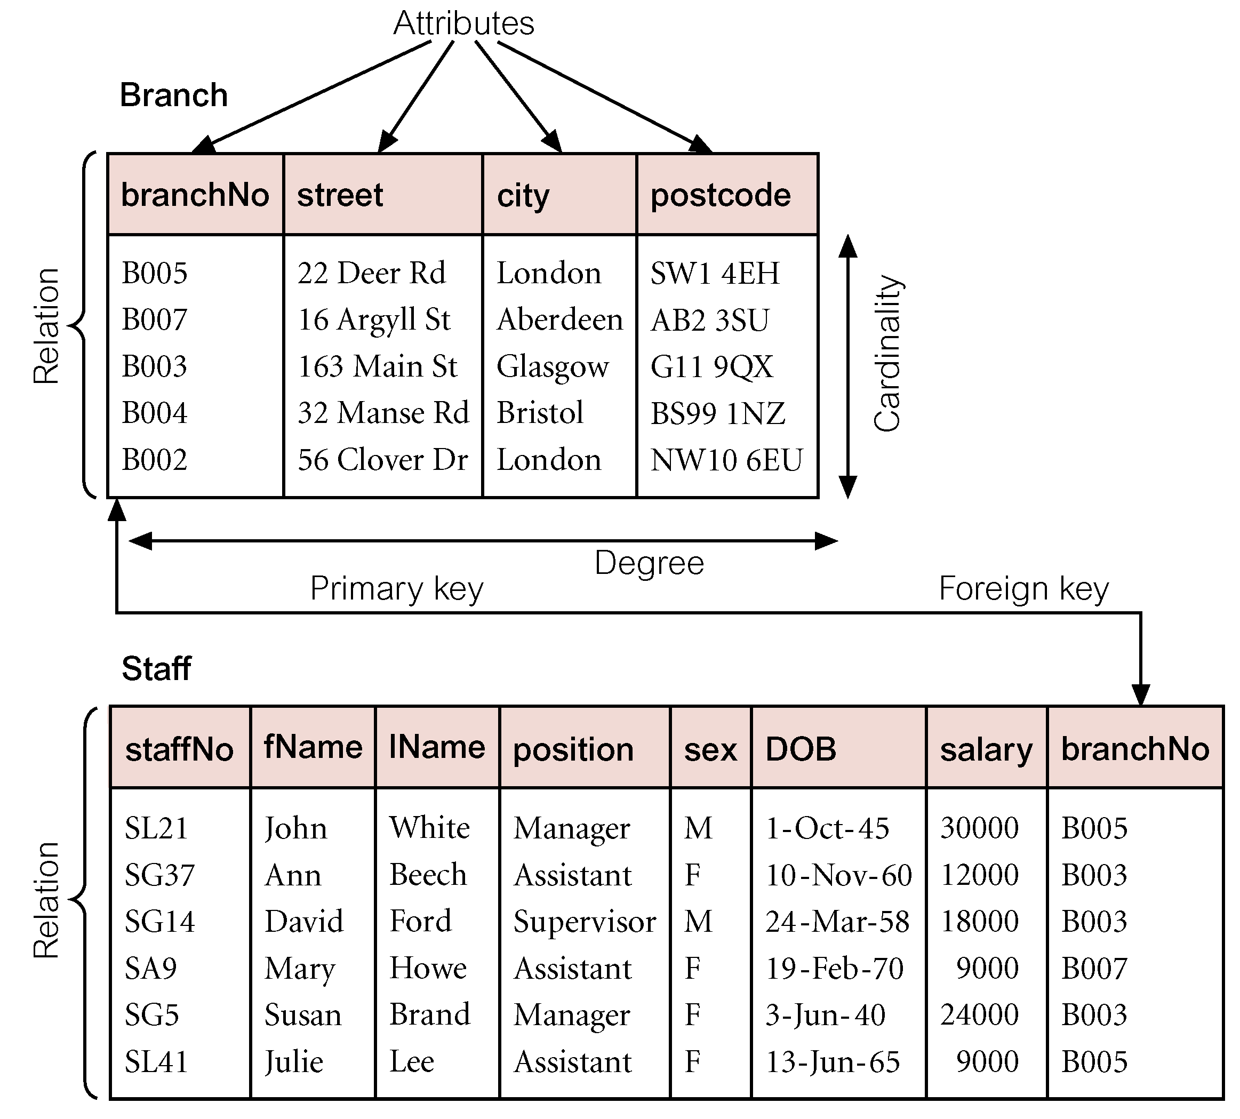
Relations and Attributes

Slide 21
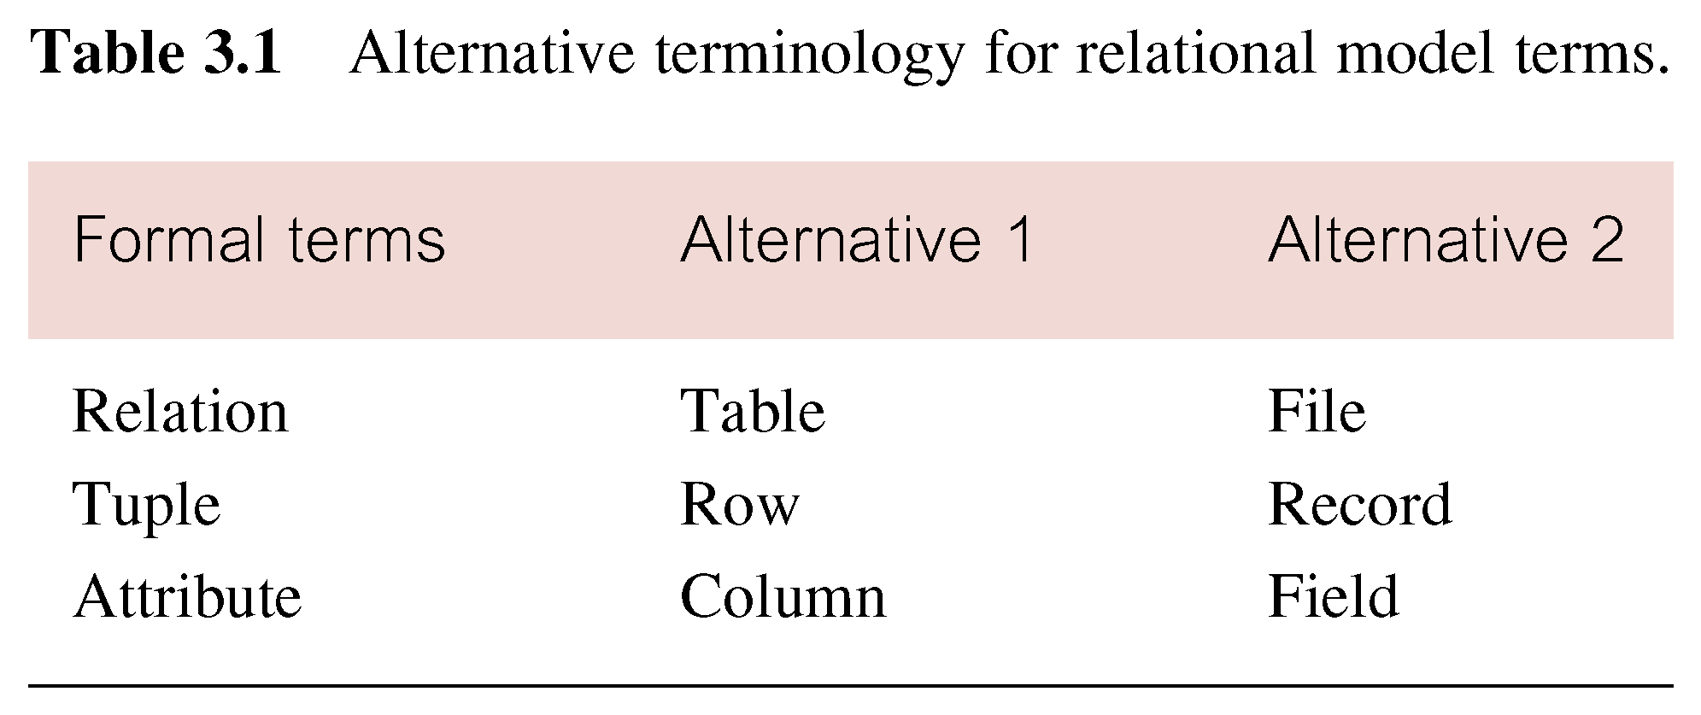
Alternative Terminology for Relational Model

Slide 22
Table Characteristics
Each RDBMS has its rules for table and column names. Example: Access Table names <= 64 (8 is classical) Column names <= 64 (10 is classical) Column names cannot start with digit, or contain special characters except underscore and a few others
Each RDBMS has its rules for associating a data type to an attribute, but there are classical ones: text, character, number, date, boolean

Slide 23
Table Characteristics

Slide 24
Relationship and Cardinality
Relationship : the fact that an Entity A (ex: EMPLOYEE) is connected with an Entity B (ex : DEPARTEMENT)
Cardinality of a Relationship: Ex : The number of entities in A [from 0 to n] (here from 1 to 2) that may be connected with en entity in B
B DEPARTEMENT
A EMPLOYEE

Slide 25
Representation Formalism of Cardinalities
CHENN :
EMPLOYEE
DEPARTEMENT
A n employee belongs to one and only one department
A department may have between 0 an n employees
UML:
EMPLOYEE
DEPARTEMENT
0,n
1,1

Slide 26
Representation Formalism of Cardinalities
Type CHENN simplified in Access:
CPT
Classification table
Service table
8
1
A service in the Service table has 1 and only one label in Classification table
A label in the Classification table may correspond to 0 to n services rendered

Slide 27
Relational Keys
Superkey
An attribute, or a set of attributes, that uniquely identifies a tuple within a relation.
Candidate Key
Superkey (K) such that no proper subset is a superkey within the relation.
In each tuple of R, values of K uniquely identify that tuple (uniqueness).
No proper subset of K has the uniqueness property (irreducibility).

Slide 28
Relational Keys
Primary Key
Candidate key selected to identify tuples uniquely within relation.
Alternate Keys
Candidate keys that are not selected to be primary key.
Foreign Key
Attribute, or set of attributes, within one relation that matches candidate key of some (possibly same) relation.

Slide 29
Primary Key (PK)
TABLE "EMPLOYEE" (Entity)
Employee ID +Name = Composite key (not minimal)

Slide 30
Foreign Key
Tables in relationship: Parent table (Table B) Dependent table (Table A)
Foreign key of a relation : Key in a dependent table ensuring the relationship with the parent table (FK)

Slide 31
Foreign Key (FK)
Table B Parent Table
Table A Dependent Table

Slide 32
Relational Integrity
Entity Integrity
In a base relation, no attribute of a primary key can be null.
Ensures that all entities are unique.
Referential Integrity
If foreign key exists in a relation, either foreign key value must match a candidate key value of some tuple in its home relation or foreign key value must be wholly null.

Slide 33
Integrity Constraints
Table B
Table A
A new Department Number can be inserted in Table A only if it exists in Table B

Slide 34
Integrity Constraints
Table B
Table A
A new Department Number can be inserted in Table A only if it exists in Table B

Slide 35
With Several Tables
Table A
Table B

Slide 36
SQL Structured Query Language

Slide 37
SQL Characteristics
This language for relational databases provides 4 types of functions:
Data Definition Language: DDL (CREATE; ALTER; DROP)
Data Control Language: DCL (GRANT; REVOKE)
Data Manipulation Language: DML (SELECT; INSERT…)
Aggregate Functions: (COUNT; DISTINCT; ORDER BY; GROUP BY….)

Slide 38
DML Examples
SQL query: SELECT FROM WHERE GROUP BY HAVING ORDER BY
SQL query example: SELECT Name FROM EMPLOYEE WHERE Grade=150 ORDER BY Name;

Slide 39
SELECT
SELECT provides a subset of rows in the table

Slide 40
Graphical Query Design
in Access

Slide 41
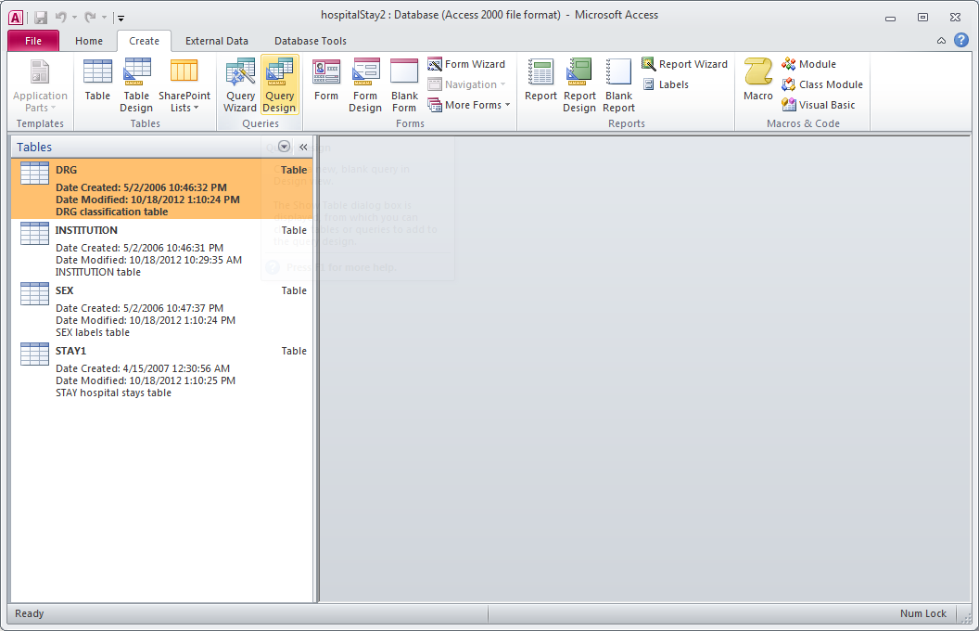
Query Design Opening

Slide 42
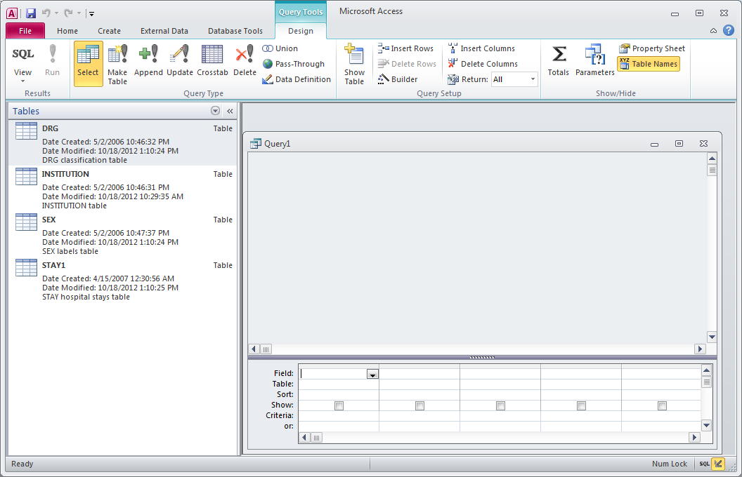
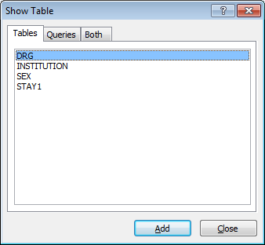

Slide 43
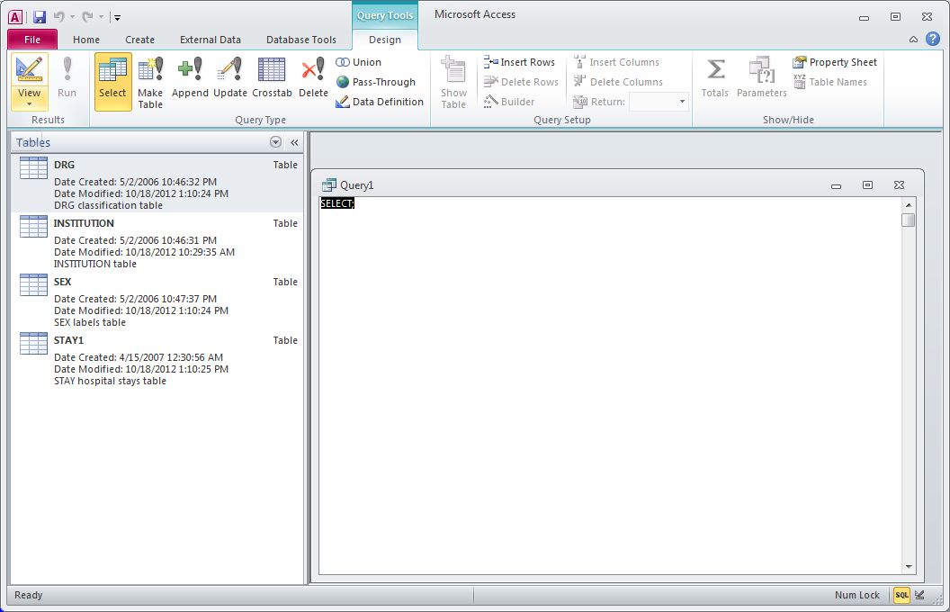

Slide 44
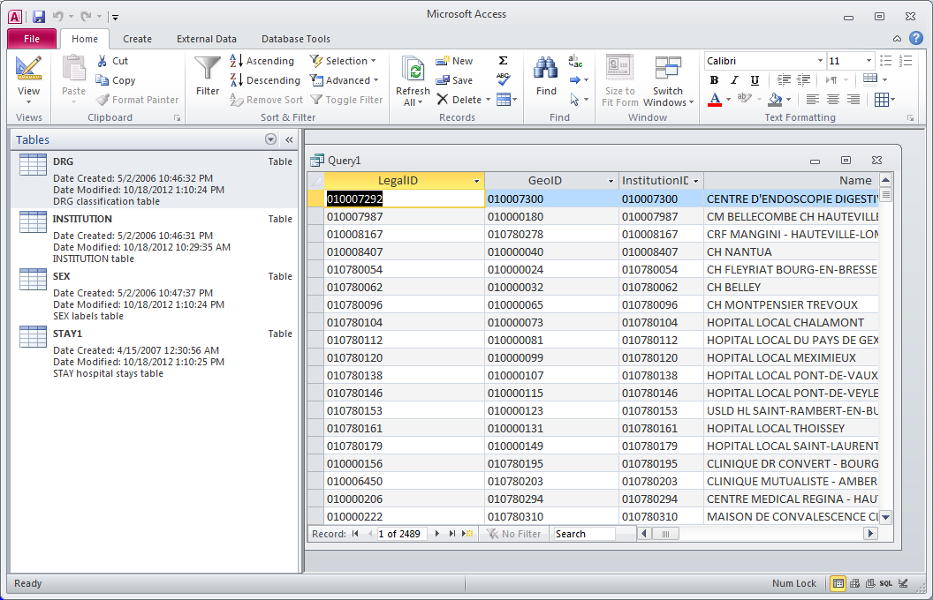

Slide 45
Query Design
Add tables
Create joins
Select fields
Sort order
Criteria
Totals (aggregate operations)

Slide 46
Adding tables
Right mouse button: add a table

Slide 47
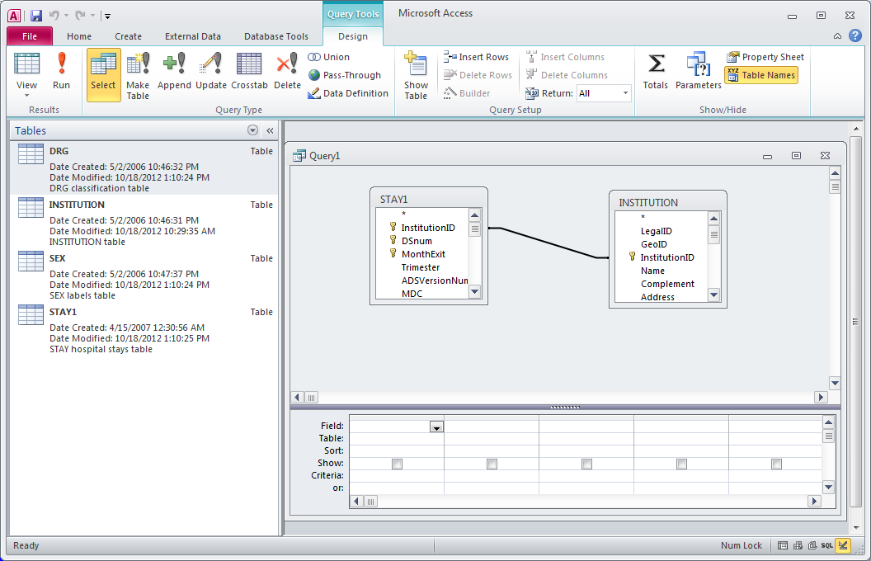
Creating joins
With the mouse create a join Ex : [Stay1].[InstitutionID] and [InstitutionID]

Slide 48
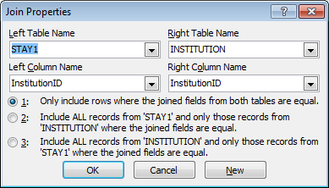
Creating joins

Slide 49
Selectng Fields
Name of selected field
Name of the table
Check to display field

Slide 50
Sort order, criteria
Sort order
Selection criteria

Slide 51
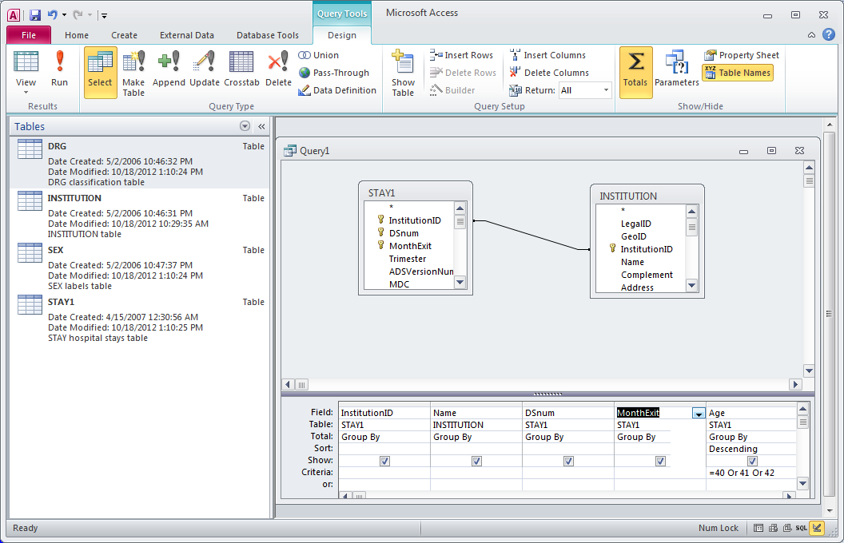
Totals
Right mouse button: Add one lign of work called totals

Slide 52
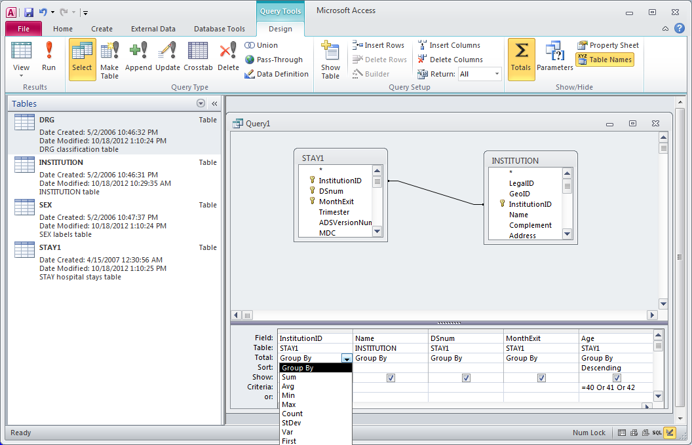
Group by
Totals row
Totals choice: Group by
Drop down list of totals

Slide 53
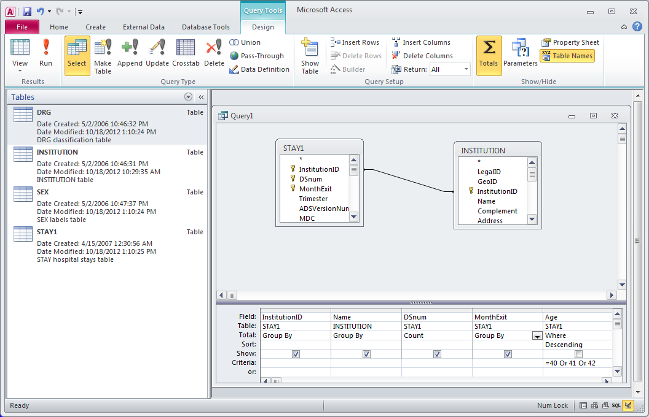
Count and where
Choice of total: Count
Choice of total: Where

