Slide 1
Statistics

Slide 2
Learning Objectives
Compute health care statistics, including mortality and morbidity rates.
Organize data generated from health care statistics into appropriate categories, including nominal, ordinal, discrete, and continuous.
Display data generated from health care statistics using the most appropriate tools (tables, graphs, and figures, histograms …)
Determine which tests of significance should be used to test specific hypotheses and which are most appropriate for certain types of data.

Slide 3
Overview of Statistics
and Data Presentation
Statistics and data presentation focus on answering users’ questions while complying with standards of health care facility.
Various methods used to calculate specific types of statistics.
Goal is to collect, organize, display, and interpret data to meet needs of users.

Slide 4
Role of the HIM Professional
HIM professional must
  choose appropriate methods of displaying and analyzing data.
  understand basic principles
  of sample size determination.
  be familiar with commonly used statistical tests.
  compare trends in incidence of disease, quality and outcomes of care, …
  conduct epidemiological research.

Slide 5
Role of the HIM Professional
Need broad base of knowledge.
It is necessary to understand health care
and vital and public health statistics.
Need knowledge of statistical analysis.

Slide 6
Role of the HIM Professional
HIM professional should assume lead in recommending and using statistical tests.
Fills diversified roles:
  Clinical vocabulary manager
  Data miner
  Clinical trials manager
Responsibilities may vary from person
to person.

Slide 7
Vital Statistics
Include data collected for vital events:
  Births and adoptions
  Marriages and divorces
  Deaths, including fetal deaths
National Center for Health Statistics (NCHS)
  Recommends standard forms for states
  National uniform reporting system of vital statistics
Accurate completion supervised by HIM department

Slide 8
Vital Statistics
Each state sends electronic files of birth and death statistics to NCHS.
Statistics compiled in National Death Index.
Natality, or birth, statistics compiled in monthly vital statistics reports.

Slide 9
Rates, Ratios, Proportions, and Percentages
Rates
  Defined as number of individuals with specific characteristic divided by total number of individuals
  Or, number of times an event did occur compared with number of times it could have occurred

Slide 10
Rates, Ratios, Proportions, and Percentages
Rates (cont’d.)
  Contains two major elements – numerator
  and denominator.
  Numerator – number of times event did occur.
  Denominator – number of times event could have occurred.
  Result is rate of occurrence.

Slide 11
Rates, Ratios, Proportions, and Percentages
Percentages:
  Percentages based on a whole divided into
  100 parts.
  Convert fraction into decimal – divide numerator by denominator.
  Convert decimal into percentage – multiply decimal by 100, move decimal two places to right.

Slide 12
Rates, Ratios, Proportions, and Percentages
Proportion – a part considered in relation to the whole normally expressed as a fraction
Ratio – comparison of one thing to another expressed numerically, e.g. 20:1000

Slide 13
Mortality Rates
Computed because they demonstrate outcome possibly related to quality of
health care.
There are many types of mortality rates.

Slide 14
Mortality Rates
Gross death rate: crude death rate for hospital inpatients.
Net death rate: does not include deaths occurring less than 24 hours after admission.
Anesthesia (cause specific) death rate: number of deaths due to administration of anesthetics for specified period of time.
Postoperative (cause specific) death rate: number of patients who die within 10 days of surgery divided by total number of surgical patients for same period.
Maternal death rate: number of maternal deaths (related to pregnancy) divided by total number of obstetric discharges.

Slide 15
Neonatal, Infant, and Fetal Death Rates
These are computed to examine deaths of the neonate and infant at different stages.
Neonatal death – occurs within first 27 days, 23 hours, and 59 minutes of life.
Infant death – from moment of birth to first year of life.

Slide 16
Neonatal, Infant, and Fetal Death Rates
Fetal death rates – computed to examine differences in rates of early, intermediate,
and late fetal deaths.
  Definition may vary from state to state.
  Distinguished by length of gestation or weight
  of fetus.
    Early (abortion) – less than 20 weeks gestation;
    weight 500 grams or less
    Intermediate – 20 completed weeks of gestation; less than 28 weeks; weight 501-1000 grams
    Late (stillborn) – 28 weeks completed gestation;
    weight more than 1001 grams

Slide 17
Using and Examining Mortality Rates
When examining trends, possible reasons
for differences in mortality rates should be considered.
Three variable influences:
  Time
  Place
  Person

Slide 18
Using and Examining Mortality Rates
Changes over time include:
  Revisions in ICD rules for coding death certificates
  Improvements in medical technology
  Earlier detection and diagnosis
Place
  Changes in environment
  International and regional differences in medical technology
  Diagnostic and treatment practices of physicians

Slide 19
Using and Examining Mortality Rates
Person
  Age
  Gender
  Race/ethnicity
  Social habits
  Genetic background
  Emotional and behavioral health characteristics

Slide 20
Using and Examining Mortality Rates
All factors must be taken into consideration when examining mortality trends.
With mortality rates within a specific population,
  Important to show age-specific rates or adjust
  for age.
  Age most important influence in relation to death.

Slide 21
Using and Examining Mortality Rates
Age adjustment – removes difference
in composition with respect to age.
Two methods:
  Direct – uses a standard population and applied age-specific rates available for each population.
    Determines expected number of deaths in standard population.
    Requires age-specific rates for both populations.
    Number of deaths per age category should be at least five.

Slide 22
Using and Examining Mortality Rates
Two methods (cont’d.)
  Indirect (SMR) – can be used without age-specific rates and less than five deaths per age category.
  Standard rates applied to the populations being compared.
  Calculates expected number of deaths and compared with observed number of deaths.
SMR used in most national and statewide mortality reports.

Slide 23
Using and Examining Mortality Rates
SMR of 1 - mortality rate equal to national norms
SMR of less than 1 - mortality rate lower than national norms
SMR greater than 1 – mortality rate higher than national norms

Slide 24
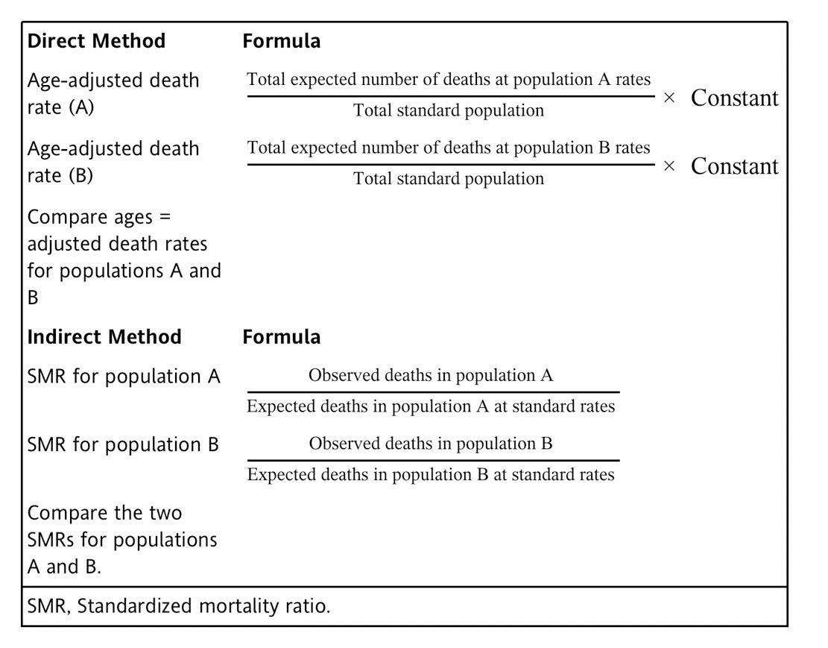
Example

Slide 25
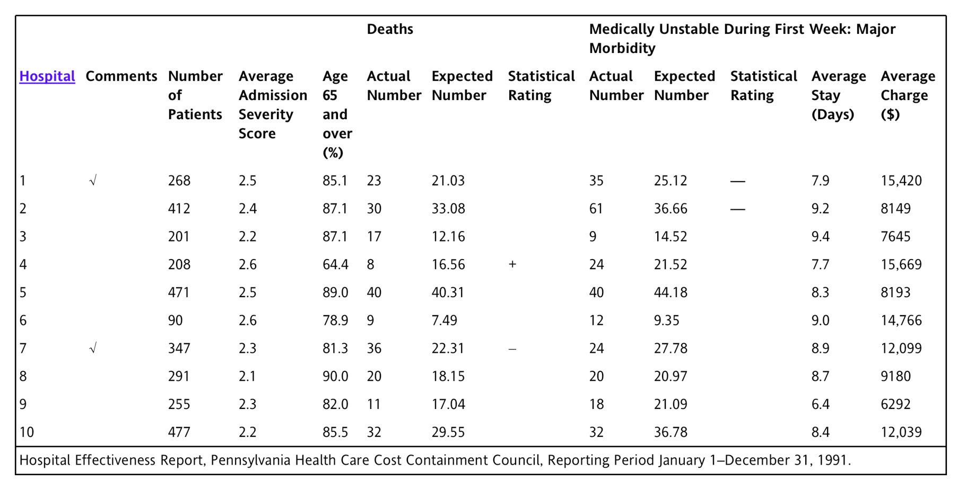
Example

Slide 26

Example
  Example Use of Standardized Mortality Ratio (SMR)
  For hospital 1, an SMR of 1.09 means that the hospital had a 9% higher mortality rate for DRG 127 than is expected from national norms. This is calculated as follows:
  SMR = $\frac{23 actual deaths}{21.03 expected deaths}$=1.09
  Example Use of Standardized Mortality Ratio
  For hospital 4, an SMR of 0.48 means that the hospital had a 52% lower mortality rate for DRG 127 than is expected from national norms. This is calculated as follows:
  SMR = $\frac{8 actual deaths}{16.56 expected deaths}$=0.48 (1-0.48 * 100 = 52%)

Slide 27
Autopsy Rates
Autopsy rates are computed to determine proportion of deaths in which an autopsy was performed.
This enables facility to examine changes
in autopsy rates from month to month.
Can be further broken down to show:
  Gross autopsy rate
  Total inpatient death autopsy rates
  Net autopsy rates
  Adjusted hospital autopsy rate

Slide 28
Morbidity Rates
Morbidity rates can include complication rates, comorbidity rates, prevalence and incidence rates of disease.
Are used to study the types of disease
or conditions present within the facility
and examine quality of care.
Can aid health care facilities in planning specific health care services and programs.

Slide 29
Morbidity Rates
Complications include infections, medication allergy reactions, transfusion reactions, decubitus ulcers, falls, burns, medical error.
Infections are most common complication.
Infection rates computed so facility can determine cause and prevention of infection.

Slide 30
Morbidity Rates
Nosocomial infection rate – facility acquired:
  Includes infections occurring more than 72 hours after admission.
  May show other risk factors contributing to patient’s susceptibility.
  Normally calculated to pinpoint how infection developed.

Slide 31
Morbidity Rates
Postoperative infection rate:
  Important to examine to determine which infections are probably result of surgical procedure.
Community-acquired infections:
  Typically present less than 72 hours before admission.
  High infection rate may require community-wide prevention programs.
Total infection rate analysis can help determine impact of infections on additional cost, length of stay, and quality of care.

Slide 32
Morbidity Rates
Comorbiditys are preexisting conditions such as diabetes, osteoporosis, hypertension.
Can increase length of stay and outcome
of care.
Includes some of the other risk factors affecting mortality and morbidity rates.

Slide 33
Incidence and Prevalence
Incidence – refers to number of new cases
of disease.
Prevalence rate:
  Number of existing cases of disease in a specified time period divided by population at same time
  Quotient multiplied by a constant
  (1000 or 100,000)

Slide 34
Incidence and Prevalence
HIM professionals should analyze prevalence and incidence rates of specific diseases prominent within particular region or state.
National Health Care Survey:
  Was originated in 1956.
  It is performed annually on representative sample of 40,000 persons.
  Results include incidence and prevalence rates
  of disease for specific geographic areas.

Slide 35
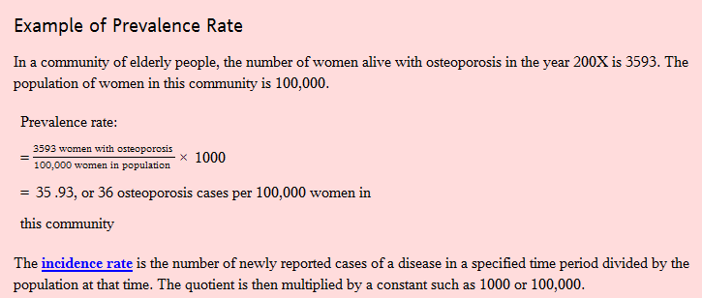
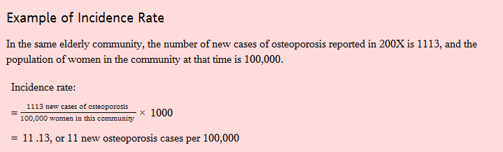
Example

Slide 36
Census Statistics
Ratios, percentages, and averages at a specified time within an institution can be used:
  To evaluate current status of health care facility
  To plan for future health care events
  To compare utilization of various units within health care organization
Census statistics useful in overall analysis how much, how long, and by whom a health care facility is being used.

Slide 37
Types of Data
Recognize different methods of display are appropriate for different types of data.
Variables or data can be grouped into four categories:
  Nominal
  Ordinal
  Interval
  Ratio

Slide 38
Nominal Data
Nominal data used to describe data collected on variables for qualitative (what kind) differences between individuals.
Nominal data also called categorical, qualitative, or named data.
Numerical values often assigned to categories of nominal variables.
Choice of numerical values is arbitrary as it is for labeling only.

Slide 39
Ordinal or Ranked Data
Ordinal or ranked data -data expressing rankings from lowest to highest, according to specified criterion.
Can be used to score severity of illness.
  0 = no or minimal risk of vital organ failure
  4 = presence of vital organ failure
Can also include responses to questionnaires or interviews.
  0 = strongly disagree
  5 = strongly agree

Slide 40
Ordinal or Ranked Data
Commonplace example is class rankings of students or ranking of sports teams within a league.
Key feature – equal distance between ranks do not necessarily correspond to equal distances on underlying criterion.

Slide 41
Interval Data
Conveys more precise quantitative information under assumption that equal distances between numbers corresponds to equal differences in measured trait or characteristic
Examples include scores on college exams, such as the SAT

Slide 42
Ratio Data
Shares the property of equal differences with interval data
Unique because value of 0 represents the total absence of measured trait or characteristic
Examples include height, weight, length
of hospital stay

Slide 43
Discrete Data
Quantitative variables that can assume
an infinite number of possible values
Examples include height, weight, temperature, cost, or charges

Slide 44
Frequency Distribution
Frequency distribution is table presenting number of times each category of a qualitative variable or value of a quantitative variable is observed within a sample.
Continuous variables with large number
of possible values commonly reported in ranges or intervals.
Table should be self-explanatory and clearly labeled.

Slide 45
Bar Graph
Normally used to illustrate nominal, ordinal, and discrete data
Discrete categories – shown on horizontal
or x axis
Frequency – shown on vertical or y axis
Purpose is to show frequency of each interval or category
Differently colored or patterned bars can show comparison between two or more categories or intervals

Slide 46
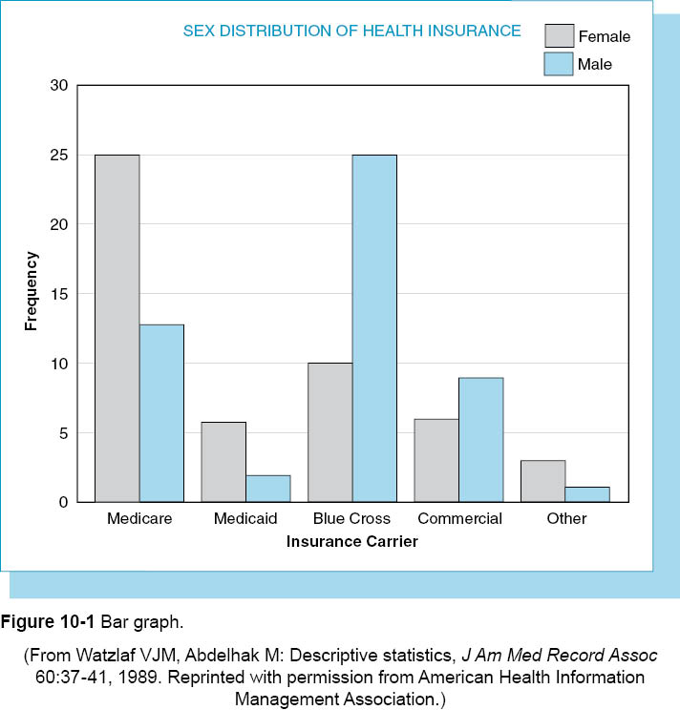

Slide 47
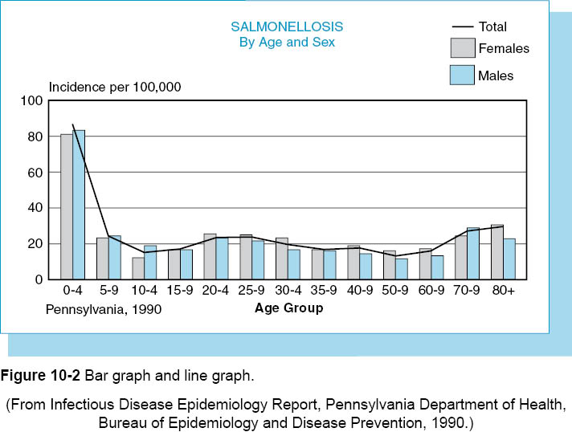

Slide 48
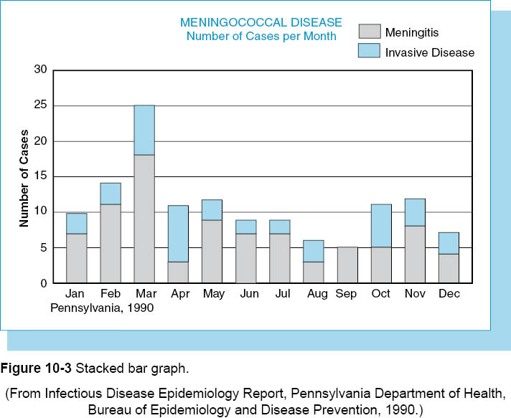

Slide 49
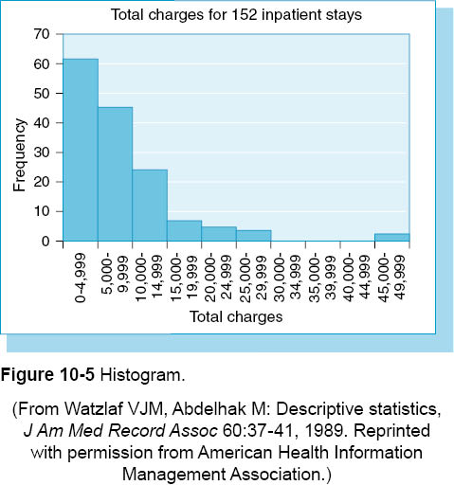

Slide 50
Pie Chart
Effective for representing relative frequency of categories or intervals
360 degree circle divided into sections corresponding to relative frequency in each category

Slide 51
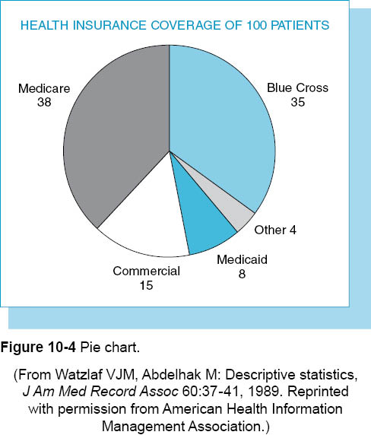

Slide 52
Frequency Polygon
Frequency polygon is another method for presenting frequency distribution with continuous data.
Is constructed by joining midpoints of tops
of bars of histogram with a straight line.
Effective when comparing distribution
of a variable in two or more data samples.

Slide 53
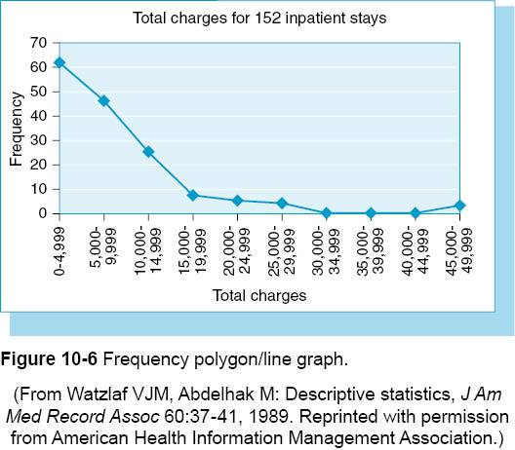

Slide 54
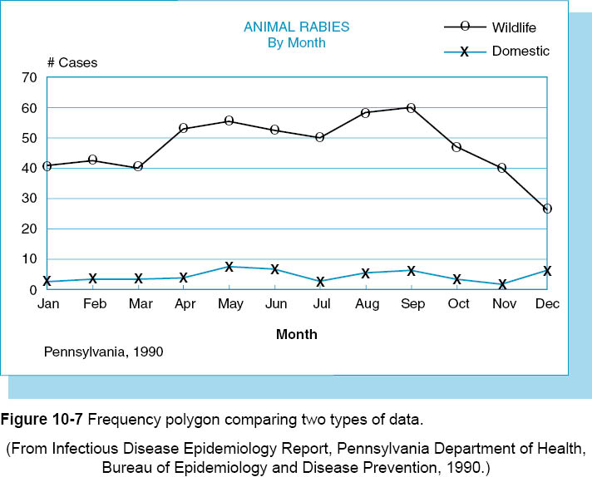

Slide 55
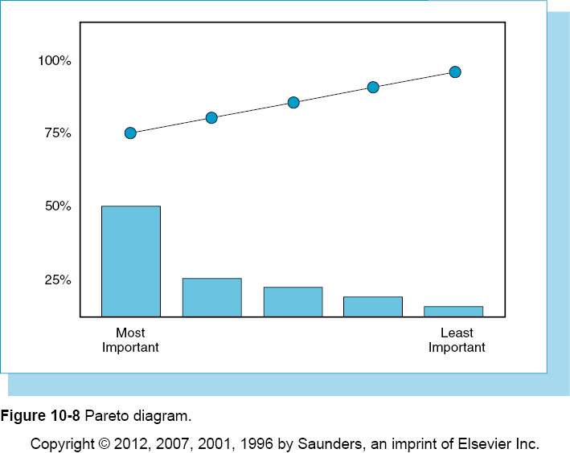

Slide 56
Descriptive Statistics
Objective is to summarize and describe significant characteristics of a set of data.

Slide 57
Measures of Central Tendency
Common measures of central tendency:
  Mean
  Median
  Mode
Aare used to locate middle, average,
or typical value in data set.
Selection of most suitable measure depends on type of data and purpose of measurement.

Slide 58
Mean
Mean is most common measure of central tendency.
It is step toward deriving other statistics.
Purpose is to summarize entire set of data
by means of a single representative value.
It is calculated by adding values of all observations and dividing by total number
of observations.
Weighted mean is overall mean for total sample when separate means reported
for different subdivisions.

Slide 59
Median
Median represents middle value within
a data set.
Number of values above median is equal
to number of values below median.
Is most appropriate statistic to use for describing ordinal or ranked data.
Is useful for interval or ratio data when
data set contains extreme values.

Slide 60
Mode
Value that occurs most frequently in given set of values
Only measure of central tendency that can be used with nominal data

Slide 61
Measures of Dispersion
Dispersion or variability refers to extent scores within a set vary from each other.
Describe the extent scores in a set are spread out or clustered together around
the mean.

Slide 62
Range
Range is one way to measure dispersion.
It is difference between highest and lowest values.
Major disadvantage – ignores all other values.
Highest and lowest values, and difference between them, should be reported with range.

Slide 63
Variance and Standard Deviation
Demonstrate how values are spread around the mean.
Calculation based on deviations (differences) between value of each score and value of
the mean.
Variance – computed by squaring each deviation from the mean divided by
sample size.

Slide 64
Variance and Standard Deviation
Standard deviation:
  square root of the variance
  most commonly reported measure of dispersion
The greater the deviations of the values from the mean, the greater the variance.

Slide 65
Coefficient of Variation
Comparison of standard deviations between two groups with very different means
Expressed as percentages of the mean
Also used to compare dispersion in variables that are measured in different units

Slide 66
Inferential Statistics
Inferential statistics used to make inferences or generalizations about a population based on data collected from a sample.
Subdivided into two main areas:
  Tests of significance
  Estimation of population parameters

Slide 67
Tests of Significance
Tests of significance used to determine reason for observed differences between groups or relationships between variables.
Sampling error - refers to the principle that the characteristics of a sample are not identical to the characteristics of the population from which sample is drawn.

Slide 68
Tests of Significance
Tests of significance all based on same underlying logic.
All involve similar series of steps.
State null and alternative hypotheses:
  Null hypothesis states there is no difference or relationship in population.
  Alternative hypothesis states there is a true difference or relationship in population.

Slide 69
Tests of Significance
Computation of test statistic measuring size of difference or relationship in the sample
p value
  probability that observed value of test statistic could occur if null hypothesis is true
  ranges from 0 to 1
  Determines if observed difference or relationship is due to chance or sampling error alone

Slide 70
Tests of Significance
Can researchers be totally certain they’ve made correct decision when accepting or rejecting null hypothesis?
Statistical decisions based on available statistical evidence.
True status of null hypothesis is inferred.
Always some degree of uncertainty.

Slide 71
Tests of Significance
Type I error: Reject the null hypothesis when it is true, alpha (α)
Type II error: Accept the null hypothesis when it is false, beta (β)
Probability of Type I error, α, set by researcher
Probability of Type II error, β
  Sample size – larger the sample, smaller the probability of Type II error
  Size of true difference or relationship in
  population – larger the true difference, smaller the probability of Type II error

Slide 72
Tests of Significance
Choosing applicable test of significance:
  What is the nature of the hypothesis? Does the hypothesis involve differences between groups, relationships between variables, or prediction?
  What is the design of the study? How many groups are involved? Are the groups independent or matched on certain characteristics? Are data collected only at one time point, or at two or more time points?

Slide 73
Tests of Significance
Choosing applicable test of significance: (cont’d.)
  Which type of data (nominal, ordinal, or continuous) has been collected to measure each of the variables being studied?
HIM professionals recommended to consult with statistician as part of research study planning process.

Slide 74
Independent Samples t Test
Applied when there are two independent
(not matched) groups
Examines difference between means of
two groups
Determines whether difference is large enough to justify rejection of null hypothesis
Decision based on p value associated with test statistic, t value.

Slide 75
Independent Samples t Test
First step is to compute the mean and standard deviation for each group.
Standard deviations for both groups are averaged or pooled.
Result is value of t.
Is p value associated with computed t value smaller than level of significance?

Slide 76
One-Way Analysis of Variance (ANOVA)
Is applied for three or more independent groups.
It tests for significant differences among group means.
Variability among subject’s scores analyzed by dividing into two components.
  Variability between groups reflected in differences among group means
  Variability within groups reflected in differences among subjects belonging to same group

Slide 77
One-Way Analysis of Variance (ANOVA)
Logical underlying principle is if true differences among group means exist, then between-group variability must be greater than within-group variability.
Are three main steps to procedure for carrying out one-way ANOVA.

Slide 78
One-Way Analysis of Variance (ANOVA)
Three main steps to procedure for carrying out one-way ANOVA:
  Step 1 – quantify amount of between-groups variability
    1a – compute measure known as sum of squares between groups (SSB)
    1b – compute between- groups’ degree of freedom
    1c – compute mean square within groups

Slide 79
One-Way Analysis of Variance (ANOVA)
Three main steps to procedure for carrying out one-way ANOVA: (cont’d.)
  Step 2 – Quantify amount of within-groups variability
    2a – compute sum of squares within groups
    2b – computer within-groups degrees of freedom
    2c – compute mean square within groups

Slide 80
One-Way Analysis of Variance (ANOVA)
Three main steps to procedure for carrying out one-way ANOVA: (cont’d.)
  Step 3 – Compute the F ratio
    Ratio of between-group variability to within-group variability
    F ratio must be large enough to reject null hypothesis
    The larger the F ratio, the small the associated p value

Slide 81
Pearson Correlation Coefficient
Statistic used to assess direction and degree of relationship between two continuous variables
Direction can be either positive or negative
  Positive – as X increases, Y increases
  Negative – as X increases, Y decreases
Positive relationships values can range from 0 to +1
Negative relationships values can range from 0 to -1

Slide 82
Pearson Correlation Coefficient
The closer the value is to 0, the weaker
the relationship
General interpretation guidelines suggest
  Values between 0.30 and 0.59 indicate moderate relationships
  0.6 or higher indicate strong relationships
When computed, related significance test performed

Slide 83
Pearson Correlation Coefficient
When computed, related significance test performed.
Determines probability that observed value could occur through sampling error alone.
Sample size has great influence on outcome of test for significance.
Essential to consider value of correlation coefficient as well as p value when interpreting results.

Slide 84
Regression Analysis
Statistical method used to learn to what extent one or more explanatory variables can predict an outcome variable
Predictor variables denoted by X; outcome variables denoted by Y

Slide 85
Regression Analysis
R-squared (R²⁾):
  Represents squared correlation between explanatory variable(s) and outcome variable.
  Can range from 0 to 1; can never be negative.
  Value indicates proportion of variability in outcome explained by predictor variable(s).
  Closer the value to 0, the stronger the prediction.
  Associated p value indicates probability that observed value could occur through sampling error alone.

Slide 86
Regression Analysis
Regression equation
  Formula for calculating a case’s predicted score(s) on the predictor variable(s)
  Can be useful in making decisions when data on outcome variables are not available
  Takes the form of the formula for a straight line when only one explanatory variable

Slide 87
Ch-Square Test
Ch-square test commonly used test of significance appropriate for qualitative data.
Assesses degree of relationship between two qualitative variables or to determine qualitative differences between two or more groups.
Contingency table – displays joint frequencies of the two variables.

Slide 88
Interval Estimation
Interval estimation used when researcher’s primary interest is in making use of data obtained from a sample to estimate the characteristics of a population.
Application of statistical theory makes it possible to construct a confidence interval
for the population mean based on the value of the sample mean.
Probability of error is 100% minus the level
of confidence.

Slide 89
Sampling and Sample Size
Results obtained by studying a sample can be generalized to the population from which the sample is drawn as long as sample is representative of population.
Best way to ensure a sample is representative is to apply random sampling.
  Every member of the population has same chance of being included in sample.
  Selection of one member has no effect on selection of another member-independent selection.

Slide 90
Types of Random Sampling
Simple random sampling:
  Usually carried out with randomization programs
  Can also be conducted using table of random numbers
Stratified random sample:
  Obtained by dividing population into groups
  or strata and taking random samples from
  each stratum

Slide 91
Types of Random Sampling
Systematic sampling:
  Research decides what fraction or proportion
  of population is to be sampled.
  Can only be considered random if population list itself is in random order.

Slide 92
Determining Sample Size
Approach depends on whether researcher’s purpose is interval estimation or hypothesis testing.
Interval estimation:
  What amount of error is researcher willing
  to accept?
  Larger sample size means smaller level of error and greater precision.

Slide 93
Determining Sample Size
Hypothesis testing:
  Sample size closely related to concept of power, defined as probability of correctly rejecting false null hypothesis.
  Power is equal to 1 minus probability of
  Type II error.

Slide 94
Determining Sample Size
Three factors determining power:
  Alpha – level of significance set by researcher
  Sample size
  Effect size – size of the difference between means or the strength of relationship between variables
Estimation of effect size necessary for finding appropriate sample size.

