Slide 1
Research and Epidemiology

Slide 2
Learning Objectives
Determine the most effective methods to use to test validity and reliability.
Compare and contrast different epidemiologic research study designs.
Given a specific hypothesis, design a research study to test the hypothesis.
Given examples of research studies conducted in health care settings and detect the different types of biases.
Recognize outcome measures and discuss how epidemiologic study designs can facilitate executing outcome studies.

Slide 3
Overview of Research & Epidemiology
Epidemiology:
Study of disease and determinants of disease in populations
Study of clinical and health care trends or patterns
Ability to recognize trends or patterns within large amounts of data
Health information management (HIM) professional:
Conducts clinically based research studies.
Studies specific HIM department functions.
Notes:
Epidemiologic techniques can be used not only for clinical research, but also for studying productivity standards and for maximizing coding benefits.

Slide 4
Overview of Research & Epidemiology
Research:
Provides knowledge
Provides new ideas, new methods
Answers questions
Question
Review related literature
Collect related data
Analyze data
Formulate answer based on collected data

Slide 5
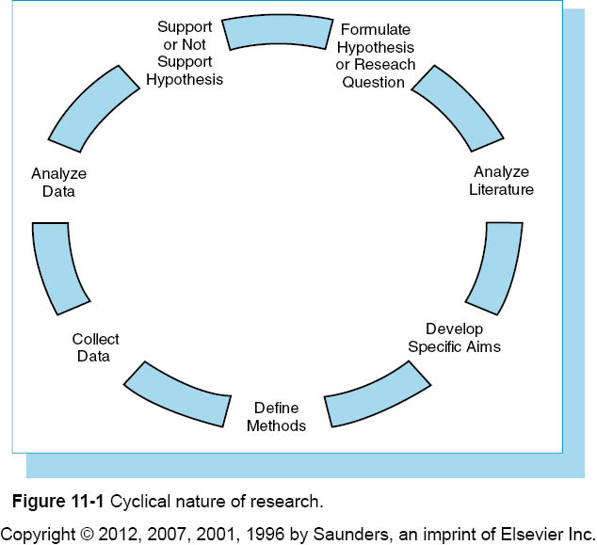

Slide 6
Role of the HIM Professional
Healthy People 2010:
Healthy People 2010 is nationwide prevention agenda.
It identifies most significant preventable issues related to health.
It focuses public and private sector efforts to address issues.
Two major goals:
467 objectives
28 focus areas
10 leading health indicators

Slide 7
Role of the HIM Professional
Example:
Goal 1: Eliminate health disparities – improve data collection methods
Objective 2: Determinants of health - examines biology, behaviors, social and physical environments
Health Indicator: Access to health care – identify barriers to access such as financial, structural, cultural, and personal barriers

Slide 8
Role of the HIM Professional
Research studies of these national priorities could affect the world.
Research provides avenue for advancement of the HIM professional.

Slide 9
Designing the Research Proposal
Steps for designing a research or grant proposal:
Identification of research hypothesis or question
Review of literature
Draft of research methods
Development of research plan or study design
Development of research budget
Design of appendix
Notes:
Working “together” is the key concept of collaboration.

Slide 10
Designing the Research Proposal
Hypothesis and Research Questions:
Identifies the goal of the research
Hypothesis – educated guess about outcome of study; not an opinion or value judgment
Research question – asks a question to be answered; used in new areas where knowledge is limited

Slide 11
Designing the Research Proposal
Variables – concepts within hypothesis:
Independent - causes change in the other variables
Dependent
Value dependent on one or more of the other variables
Cannot affect other variables by itself
Dependent variable is the variable to be explained.
Independent variable is the factor that may explain it.

Slide 12
Designing the Research Proposal
Review of literature:
Review of literature determines the research already performed on the topic of study.
This best accomplished by literature search using key words or phrases.
Key words and phrases used should be chosen with care.
Search options
Librarian
MEDLINE
Ovid

Slide 13
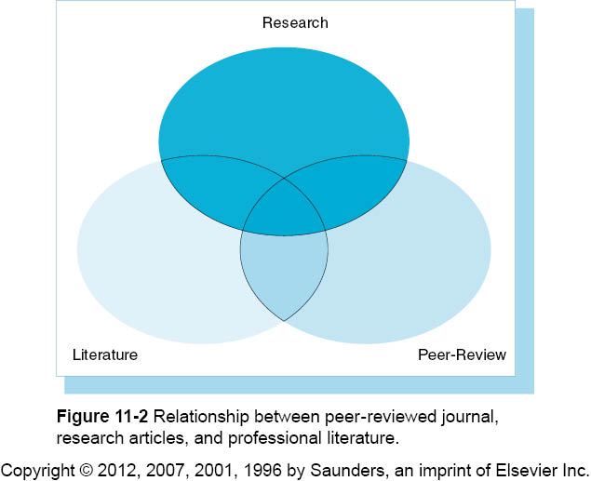

Slide 14
Designing the Research Proposal
Peer-reviewed journals
Peers within specific research area extensively reviewed articles
Provided comments and feedback for revision to authors

Slide 15
Designing the Research Proposal
Peer review process focuses on:
Value, interest, importance of content to reader
Clarity and appropriateness of hypothesis or research question
Literature review supports study
Appropriate study design
Appropriate methods

Slide 16
Designing the Research Proposal
Peer review process focuses on: (cont’d.)
Appropriate statistical analysis
Appropriate discussions and conclusions
Clarity of writing, illustrations, tables
Methods can be replicated
10. Qualitative comments and suggested revisions

Slide 17
Designing the Research Proposal
Purposes of literature review are:
Develop solid foundation in particular field through study.
Become an expert through reviewing past literature to determine uniqueness of hypothesis.
Determine what it is about one’s idea or hypothesis that makes it worth carrying out.
Identify gaps or problems with existing studies and begin thinking about how to design a study to fill those gaps.
Notes:
How is your hypothesis different from past hypotheses posed by others? Why is it important to follow through on this hypothesis?

Slide 18
Designing the Research Proposal
Organizing the literature:
Title of the article and journal, book, or report
Author(s)
Publisher, date, page numbers
Article summary
Advantages of the article specific to study design for your research topic
Disadvantages of the article specific to study design

Slide 19
Designing the Research Proposal
Methodology (Draft)
Methodology should include a step-by-step process of what is done in research study.
Why is this process necessary for proper testing of hypothesis?
Develop rough draft to determine feasibility of study.

Slide 20
Designing the Research Proposal
Research Plan should include:
Specific aims or objectives
Significance (review of literature or preliminary research)
Research design and method
Population under study-sample selection
Time-frame
Place of study

Slide 21
Designing the Research Proposal
Research Plan should include: (cont’d.)
Data collection process
Application to the IRB
Analysis of data
Human subjects (if applicable)
Literature cited

Slide 23
Designing the Research Proposal
Research Plan – Specific Aims:
Briefly describe the project’s goals or objectives.
Create list of goals, objectives, aims, or purposes.
List should include both short- and long-term goals.

Slide 24
Designing the Research Proposal
Research Plan – Significance:
Research plan details the importance of the research project.
It includes review of past research studies on same subject.
Includes preliminary research and pilot studies.
States why study must be performed.
States how study is unique from others.
Who benefits?
Demonstrates researcher’s knowledge.

Slide 25
Designing the Research Proposal
Research Plan – Methodology:
Time frame – states exactly when study will be conducted and for how long.
Place of study – where research will be conducted; description of facilities
Population under study:
Who are the subjects of study?
Why and how will they be included?
Is this a representative sample?
How will sample size be determined?

Slide 26
Designing the Research Proposal
Research Plan – Methodology: (cont’d.)
Procedures
How will data be collected and categorized?
Type of training provided, if necessary
How will data be stored?
How will data be accessed?
Confidentiality protection
Application to IRB – ensures protection of human subjects from research risks and privacy invasion.
Data analysis – how will data be analyzed?

Slide 27
Designing the Research Proposal
Research Plan – Human Subjects:
Demographic description of subject population
Obtaining informed consent
Confidentiality protections
Potential risks and benefits to subjects
Include letters of validation from IRB

Slide 28
Designing the Research Proposal
Research Plan – Literature Referenced:
Complete list of all literature discussed or reviewed in any section of research proposal
Formatted according to preferences of funding agency

Slide 29
Designing the Research Proposal
Research Plan – Budget Development:
Necessary to determine actual costs of study:
Salary and benefits
Equipment and supplies
Travel
Patient care costs
Contractual and consulting costs
Operating costs – phone, internet, paper, postage, etc.
All costs must be justified.

Slide 30
Designing the Research Proposal
Research Plan – Additional Documentation:
Appendices – tables, figures, lab tests, letters of support, and any other documentation supporting the stated goals
Follow proposal guidelines
Adhere to page limits, formatting, and other instructions

Slide 31
Validity
Assesses relevance, completeness, accuracy, and completeness.
Assesses accuracy of measurement tools.
Verifies information gained from different sources.

Slide 32
Sensitivity and Specificity
Used to assess testing methods:
True positives (TP) correctly categorize true cases as cases – valid labeling
False negatives (FN) incorrectly label true cases as noncases – not valid
True negatives (TN) correctly label noncases as noncases – valid
False positives (FP) incorrectly label noncases as cases – not valid

Slide 33
Sensitivity and Specificity
Sensitivity - percentage of all true cases correctly identified—TP/(TP + FN) or TP/Total positives (or total cases)
Specificity - percentage of all true noncases correctly identified—TN/(TN + FP) or TN/Total negatives (or total noncases)

Slide 34
Sensitivity and Specificity
Analysis and Discussion:
Each researcher must determine when sensitivity and specificity levels are accurate enough to use test.
Specific factors such as inexperience or lack of knowledge of topic can cause incorrect or inaccurate labeling.

Slide 35
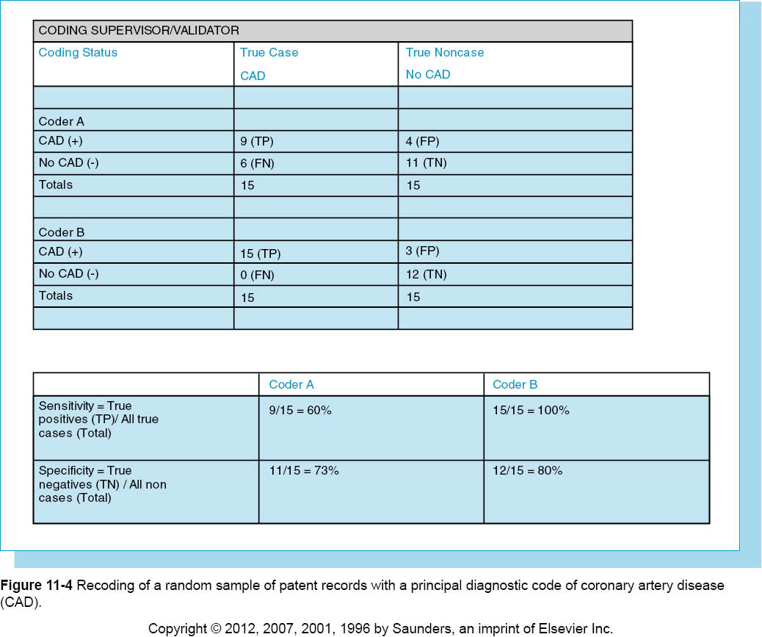

Slide 36
Reliability
Reliability refers to consistency between users of a given instrument or method.
Interobserver reliability is reproducibility or reliability between more than one research assistant or observer.
Intraobserver reliablity is reliability within one research assistant or observer.
Correlation coefficient is statistic that shows strength of relationship between two variables.

Slide 37
Biases
Biases are factors that may affect the results of a research study or cause errors in data analysis.
Researchers must be aware of types of biases and methods to diminish their effect or correct errors.

Slide 38
Confounding Variables
Characteristics such as age or sex are known to be associated with both the independent and dependent variables.
Should be controlled so they are not reason for an association.

Slide 39
Sampling Variability
It is important to obtain effective sample for generalizing results.
Sample must be large enough, random enough, and truly representative of subject population.

Slide 40
Ascertainment or Selection Bias
Subject selection can be influenced by a patient’s health status.
Researchers may select people who are already under medical care.
Volunteers and paid subjects may be different from general population.

Slide 41
Diagnosis Bias
Different health professionals may offer differing opinions.
Blind reviews of slides or results by different professionals can help obtain good cases or controls for a study.

Slide 42
Nonresponse Bias
Subjects who refuse to participate may be different from subjects who do participate.
Collecting basic demographics on nonparticipants as well as participants can help ensure participants represent general population.

Slide 43
Survival Bias
Survival bias occurs with cross-sectional studies.
Only those who have lived long enough to participate are examined.
Use incident or new cases to relieve this bias.

Slide 44
Recall Bias
Recall bias is attributed to faulty memory or selective memory based on personal experience.
Use subjects with similar experiences to collect and compare data.

Slide 45
Interviewer Bias
Interviewers tend to ask questions differently.
May probe more with subjects known to have characteristics of interest.
Standardize the interview form.
Provide intensive training stressing consistency in interview techniques.

Slide 46
Prevarication Bias
Prevarication bias occurs when an individual tends to exaggerate interview or questionnaire responses.
Use several independent raters and several sources of data to validate collected information.

Slide 47
Epidemiologic/Research Study Design
Choose the most appropriate study design to test hypothesis.
Epidemiology is study of distribution and determinants of disease or events in populations.
Results are used to control or prevent public health problems.

Slide 48
Descriptive Study
Descriptive study describes frequency and distribution of diseases in populations.
Usually first study design chosen when little is known about disease or health characteristics.

Slide 49
Descriptive Study
Cross-sectional or Prevalence Study:
This is one type of descriptive study.
Concurrently describes characteristics and health outcomes at one specific point or period in time.
This study cannot answer questions about cause and effect.
It is used to generate hypotheses, not test them.

Slide 50
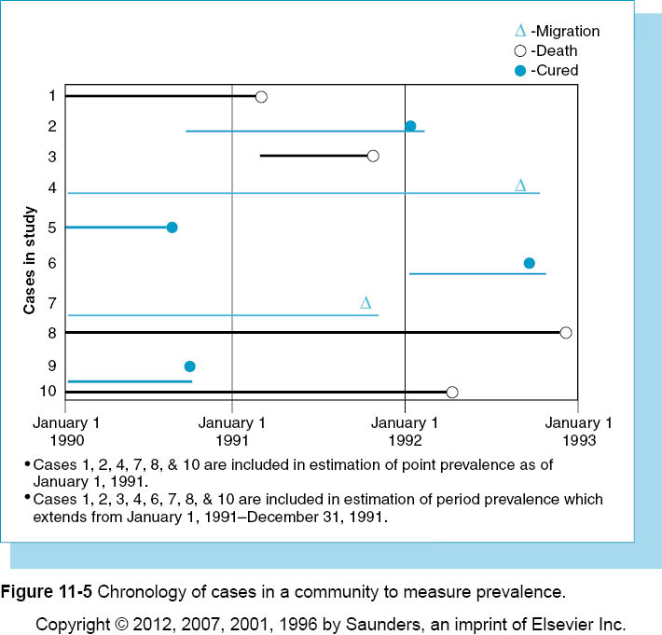

Slide 51
Descriptive Study
Cross-sectional or Prevalence Study: (cont’d.)
Prevalence rates can facilitate case finding.
Categorized into two types:
Point prevalence rates – evaluating health condition at a specific point in time
Period prevalence rates – evaluating health condition over a specific period of time

Slide 52
Descriptive Study
Cross-sectional or Prevalence Study: (cont’d.)
Advantages –
Useful when time and resources are limited
Appropriate when little is known about health condition or characteristic.
Can provide new or beginning information for further studies.
Disadvantages -
Cannot assess cause and effect.
Not effective for studying rare conditions.

Slide 53
Descriptive Study
Survey Research:
Focuses on collecting data with research instruments such as questionnaire or interview guide.
Pay attention to:
Framing of questions
Wording
Cover letter to briefly describe study, sponsor, researcher qualifications
Delivery and response method – fax, email, Internet, phone

Slide 54
Descriptive Study
Survey Research: (cont’d.)
Pay attention to:
Survey length – maximum 2 to 3 pages
Question ordering
Open versus closed questions
Pilot testing
Sample size
Response rate
Data collection and coding

Slide 55
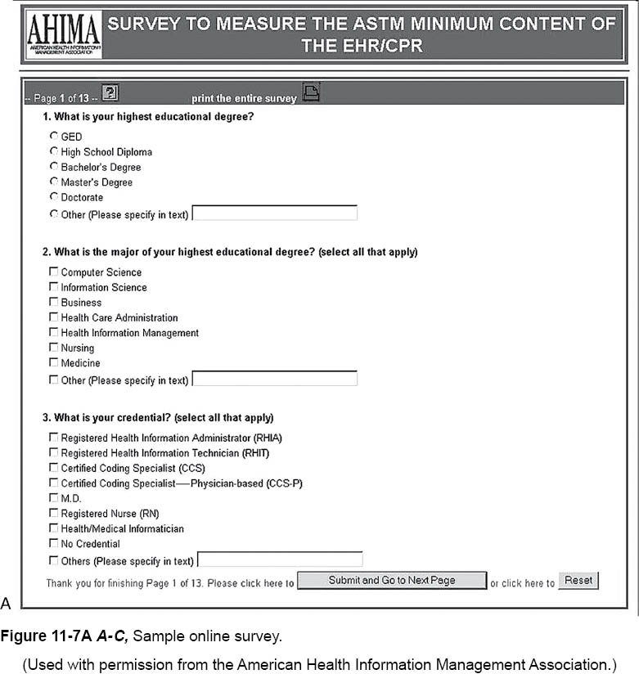

Slide 56
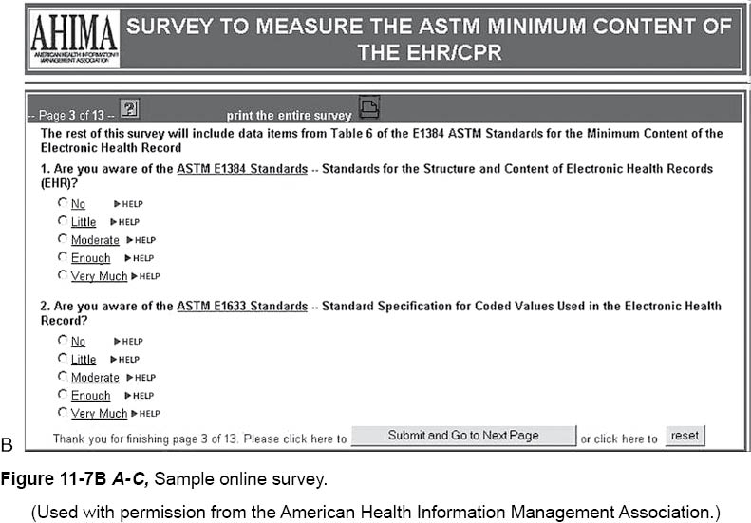

Slide 57
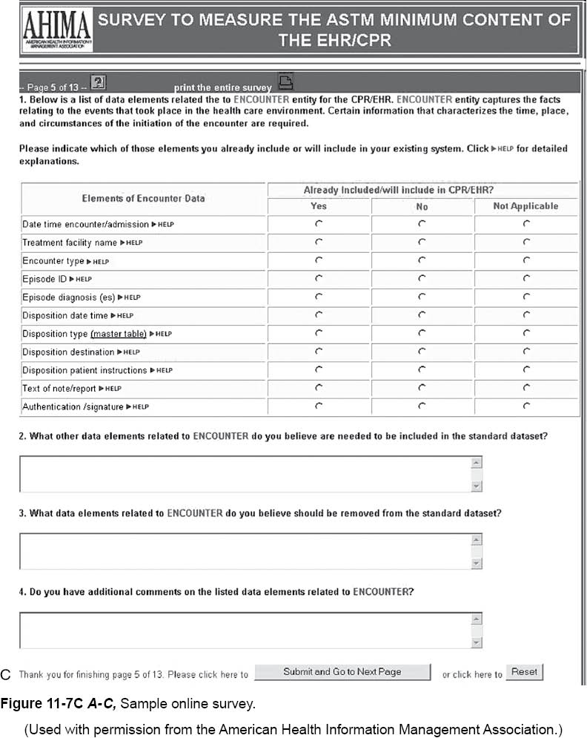

Slide 58
Qualitative Research
Qualitative research is also used when little is known about a specific topic.
Provides foundation for larger quantitative studies.
It is most appropriate for examining attitudes, feelings, perceptions, or relationships.

Slide 59
Qualitative Research
Three main types:
Participant observation
Researcher is immersed into subject’s environment to learn firsthand.
Pays special attention to physical, social, and human environment – formally and informally.
Researcher can choose to be disguised or undisguised.
Describe problem to outsiders from an insider’s perspective.

Slide 60
Qualitative Research
Three main types: (cont’d.)
Focus groups
Small group of people brought together to discuss and answer specific questions
Usually experts in topic of study
Enables researcher to learn more about topic
Case studies
Provide richly detailed portrait of individual, program, event, department, time period, culture, or community

Slide 61
Qualitative Research
Making sense of collected data can be difficult.
Effective questions for analyzing qualitative research data:
What patterns and common themes emerge from the data collected?
Can these patterns or themes be narrowed to three or four basic themes in which data can be categorized?
Can data matrices be developed to answer the research questions?

Slide 62
Qualitative Research
Major weakness is lack of generalizability.
Results cannot be extrapolated due to usually small sample size.
Results can be unreliable due to differences in collection and analysis.

Slide 63
Analytic Study Design
Case Control or Retrospective Study Design:
Disease or health condition is examined to determine possible causes.
This requires intensive research into disease characteristics.
Researcher collects data on cases and controls from the past to identify possible exposure characteristics and risk factors.

Slide 64
Analytic Study Design
Case Control or Retrospective Study Design:
Design issues to consider:
Random case selection based on incidence or prevalence rates
Random controls selection from similar populations
Use of variables matching
Research instrument development and design
Notes:
Cases – those that have the disease.
Controls – similar to cases in demographics and environment, but do not have disease.

Slide 65
Analytic Study Design
Case Control or Retrospective Study Design:
Determining odds ratio:
Estimate of relative risk if person is exposed to a certain characteristic.
Used only with case-control studies when disease is rare.
Cases and controls must be truly representative.

Slide 66
Analytic Study Design
Case Control or Retrospective Study Design:
Advantages –
Is useful when time and resources are limited.
Intent is to establish association between disease and exposure characteristics.
Disadvantages –
Relies on subject’s recall or past information.
It is difficult to obtain valid control group.
Relative risk can only be determined using odds ratio.

Slide 67
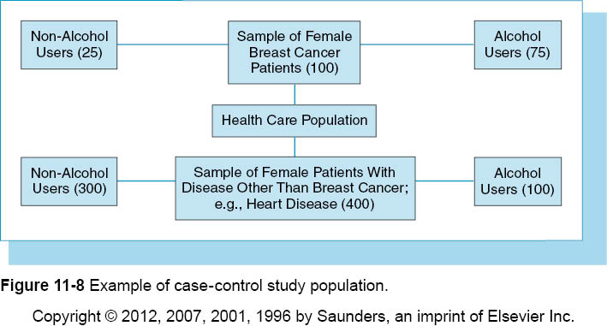

Slide 68
Prospective, Cohort, or Incidence Study Design
Determines whether characteristic or suspected risk truly preceded disease or health condition
Best method for determining magnitude of risk in the affected population

Slide 69
Prospective, Cohort, or Incidence Study Design
Steps typically include:
Identify subjects with the characteristic under study who are free from the disease.
Identify subjects without the characteristic under study who are free from the disease (comparison group).
Follow both groups forward in time to determine if and when they develop the studied disease or health condition.

Slide 70
Prospective, Cohort, or Incidence Study Design
Researcher identifies appropriate cases and noncases.
When disease under study begins to develop in subjects, incident cases or new cases are collected.
Participants are usually volunteers.

Slide 71
Prospective, Cohort, or Incidence Study Design
Some prospective or cohort studies begin in a community, industrial setting, or hospital.
Subjects separated into two groups on basis of exposure.
Followed forward to determine if disease develops.

Slide 72
Prospective, Cohort, or Incidence Study Design
To determine risk, incidence rates must be determined.
To determine which group has greater risk, relative rates must be determined.
Major benefit - accurately determines whether characteristic was present before disease developed.
Researchers can determine number of cases that can be prevented by controlling characteristic or exposure.

Slide 73
Historical-Prospective Study Design
Past records are used to collect information regarding exposure characteristic or risk factor.
Monitoring continues over extended period of time to determine development of new cases.
Actual study and follow-up period happen sometime in the future.
Major advantage – requires less time, effort, cost.

Slide 74
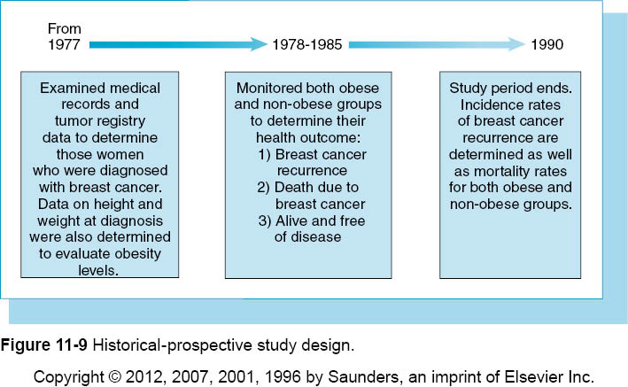

Slide 75
Clinical and Community Trials
Clinical and community trials are similar to prospective study.
Uses two groups with different exposures
Followed over time to determine outcomes
Certain medications or treatment given to one group and compared to a control group.

Slide 76
Clinical and Community Trials
Researcher provides exposure in controlled environment.
Researcher decides the type of intervention and which subjects will or will not receive it.
Researcher must obtain informed consent and IRB approval.

Slide 77
Community and Clinical Trial
Other considerations:
How will adverse reactions and other complications be recorded and addressed?
What criteria will be used to exclude and include subjects?
Will the study be:
a) Single blind - subject blind as to which group he or she is in? b) Double blind – neither subject nor observer know which group?
c) Triple blind – subject, observer, statistician all blind to which group?
Ethical considerations

Slide 78
Community and Clinical Trial
Difference between clinical trial and community trial:
Clinical trial – begins in clinical setting using selected subjects.
Community trial – outside a clinical setting using subjects from a particular community.

Slide 79
Community and Clinical Trial
Life-Table Analysis:
This is most appropriate when researcher has loss of subjects resulting from follow-up, death of subject, end of study, or before recurrence.
It examines survival times of individual subjects.
Survival time includes time subjects are free from disease or time to recovery or improvement.
It operates on premise called person-time denominator.
Special denominator is used in calculating rates for small study groups when subjects are not all observed.

Slide 80
Community and Clinical Trial
Assumptions for use of the life table analysis are:
Risk of the outcome event (death) should not be different if a patient enters the study during the first year of the study versus the second or third year.
Rate of the outcome event should not be higher at the end of 2 years of observation than at the end of 1 year.
Rate of the outcome event is as similar among subjects lost to follow-up and among subjects who remain under observation.

Slide 81
Use of Computer Software in Research
Variety of computer software is required to sort and analyze data generated by research studies.
HIM professional should know types of software available to perform certain statistical tests.
Statisticians should be consulted to aid in the interpretation and explanation of data.
Software or statistical analysis performed is only as good as the data collected and entered.

Slide 82
Outcome Studies and Epidemiology
Outcome studies may focus on causation, efficiency (cost), treatment.
More generic measures include morbidity, mortality, satisfaction, physical function, pain, emotional function, and overall quality of life.
Disease-specific measures are also common and require intense design and analysis to find accurate results.
Notes:
Review the description of the Good Health Study on pp. 11-31 to 11-36 for an example of an outcome study using medical record and financial data.

Slide 83
