Slide 1
Data Preprocessing

Slide 2
Learning Objectives
Why do we need to preprocess data?
Descriptive data summarization
Data preprocessing methods and techniques

Slide 3
Learning Objectives
Understand motivations for cleaning the data
Understand how to summarize the data
Understand how to clean the data
Understand how to integrate and transform the data
Understand how to reduce the data
Understand how to discretize the data

Slide 4
Why Data Preprocessing?
Data mining aims at discovering relationships and other forms of knowledge from data in the real world.
Data map entities in the application domain to symbolic representation through a measurement function.
Data in the real world is dirty
  incomplete: missing data, lacking attribute values, lacking certain attributes of interest, or containing only aggregate data
  noisy: containing errors, such as measurement errors, or outliers
  inconsistent: containing discrepancies in codes or names
  distorted: sampling distortion
No quality data, no quality mining results! (GIGO)
  Quality decisions must be based on quality data
  Data warehouse needs consistent integration of quality data

Slide 5
Major Tasks in Data Preprocessing
Data cleaning
  Fill in missing values, smooth noisy data, identify or remove outliers, and resolve inconsistencies and errors
Data integration
  Integration of multiple databases, data cubes, or files
Data transformation
  Normalization and aggregation
Data reduction
  Obtains reduced representation in volume but produces the same or similar analytical results
Data discretization
  Part of data reduction but with particular importance, especially for numerical data

Slide 6
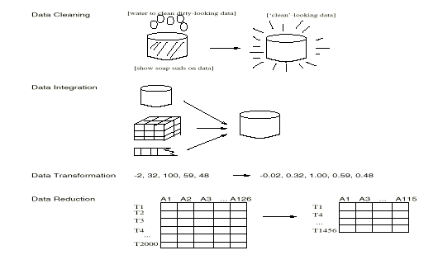
Forms of data preprocessing
from Han & Kamber

Slide 7
Learning Objectives
Understand motivations for cleaning the data
Understand how to summarize the data
Understand how to clean the data
Understand how to integrate and transform the data.
Understand how to reduce the data
Understand how to discretize the data

Slide 8
Mining Data Descriptive Characteristics
Motivation
  To better understand the data: central tendency, variation and spread
Data dispersion characteristics
  median, max, min, quantiles, outliers, variance, etc.
Numerical dimensions correspond to sorted intervals
  Data dispersion: analyzed with multiple granularities of precision
  Boxplot or quantile analysis on sorted intervals
Dispersion analysis on computed measures
  Folding measures into numerical dimensions
  Boxplot or quantile analysis on the transformed cube

Slide 9
Measuring the Central Tendency
Mean (algebraic measure) (sample vs. population):
  Weighted arithmetic mean:
  Trimmed mean: chopping extreme values
Median: A holistic measure
  Middle value if odd number of values, or average of the middle two values otherwise
  Estimated by interpolation (for grouped data):
Mode
  Value that occurs most frequently in the data
  Unimodal, bimodal, trimodal
  Empirical formula:

Slide 10
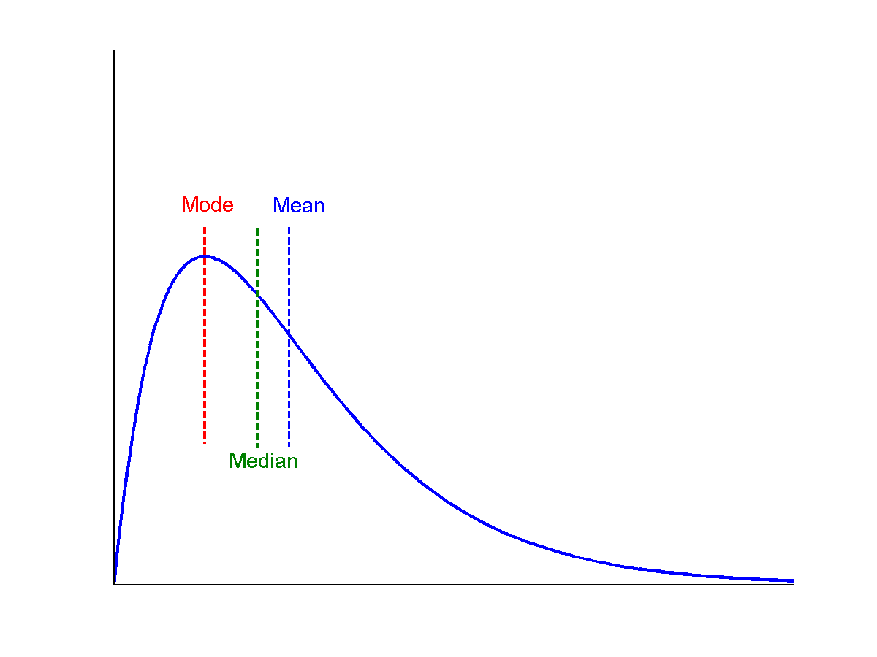
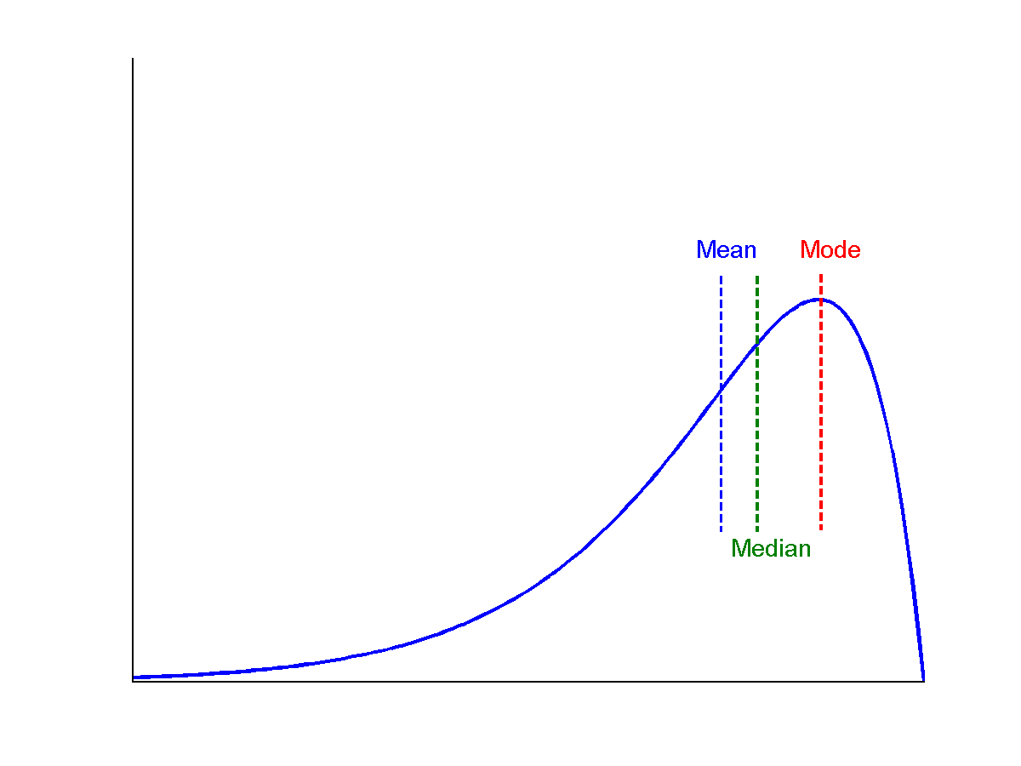
Symmetric vs. Skewed Data
Median, mean and mode of symmetric, positively and negatively skewed data
symmetric
positively skewed
negatively skewed
from Han & Kamber

Slide 11
Measuring the Dispersion of Data
Quartiles, outliers and boxplots
  Quartiles: Q₁ (25th percentile), Q₃ (75th percentile)
  Inter-quartile range: IQR = Q₃ – Q₁
  Five number summary: min, Q₁, M, Q₃, max
  Boxplot: ends of the box are the quartiles, median is marked, whiskers, and plot outlier individually
  Outlier: usually, a value higher/lower than 1.5 x IQR
Variance and standard deviation (sample: s, population: σ)
  Variance: (algebraic, scalable computation)
  Standard deviation s (or σ) is the square root of variance s² ⁽or σ²⁾

Slide 12
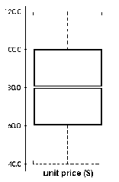
Boxplot Analysis
Five-number summary of a distribution:
  Minimum, Q1, M, Q3, Maximum
Boxplot
  Data is represented with a box
  The ends of the box are at the first and third quartiles, i.e., the height of the box is IQR
  The median is marked by a line within the box
  Whiskers: two lines outside the box extend to Minimum and Maximum

Slide 13
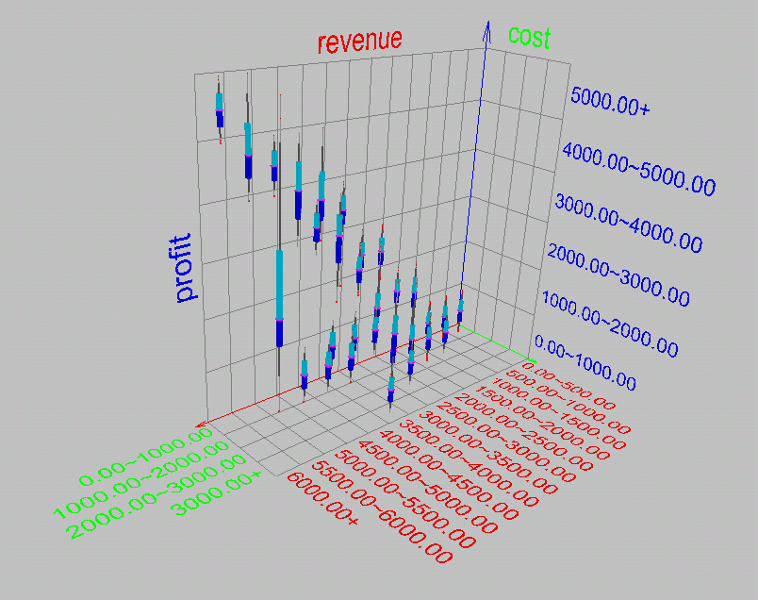
Visualization of Data Dispersion: 3-D Boxplots

Slide 14
Properties of Normal Distribution Curve
The normal (distribution) curve
  From μ–σ to μ+σ: contains about 68% of the measurements (μ: mean, σ: standard deviation)
  From μ–2σ to μ+2σ: contains about 95% of it
  From μ–3σ to μ+3σ: contains about 99.7% of it

Slide 15
Graphic Displays of Basic Statistical Descriptions
Boxplot: graphic display of five-number summary
Histogram: x-axis are values, y-axis repres. frequencies
Quantile plot: each value x_{i} is paired with f_{i} indicating that approximately 100 f_{i} % of data are ≤ x_{i}
Quantile-quantile (q-q) plot: graphs the quantiles of one univariant distribution against the corresponding quantiles of another
Scatter plot: each pair of values is a pair of coordinates and plotted as points in the plane
Loess (local regression) curve: add a smooth curve to a scatter plot to provide better perception of the pattern of dependence

Slide 16
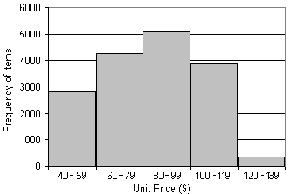
Histogram Analysis
Graph displays of basic statistical class descriptions
  Frequency histograms
    A univariate graphical method
    Consists of a set of rectangles that reflect the counts or frequencies of the classes present in the given data

Slide 17
Histograms Often Tell More than Boxplots
The two histograms shown in the left may have the same boxplot representation
  The same values for: min, Q1, median, Q3, max
But they have rather different data distributions

Slide 18
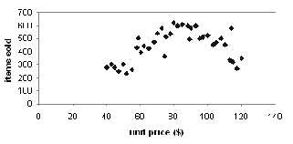
Scatter plot
Provides a first look at bivariate data to see clusters of points, outliers, etc
Each pair of values is treated as a pair of coordinates and plotted as points in the plane

Slide 19
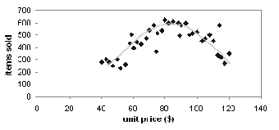
Loess Curve
Adds a smooth curve to a scatter plot in order to provide better perception of the pattern of dependence
Loess curve is fitted by setting two parameters: a smoothing parameter, and the degree of the polynomials that are fitted by the regression

Slide 20
Positively and Negatively Correlated Data
The left half fragment is positively correlated
The right half is negative correlated

Slide 21
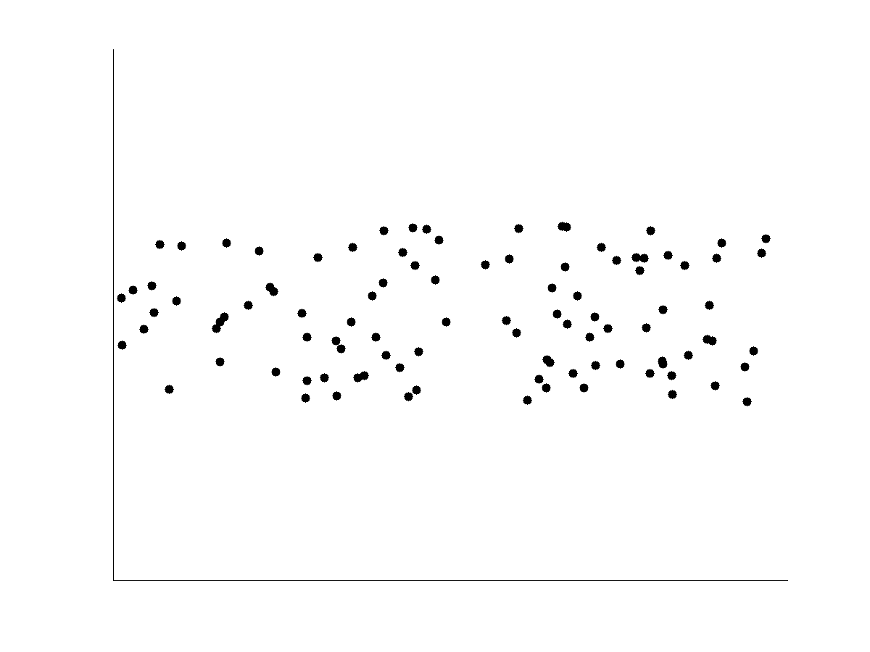
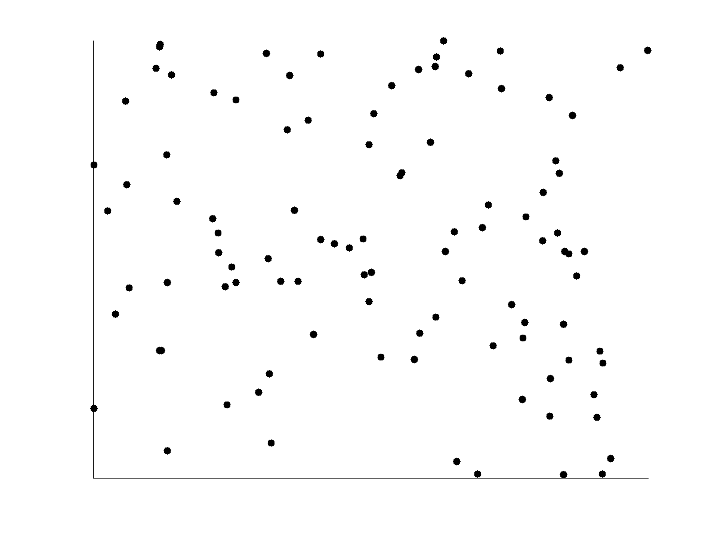
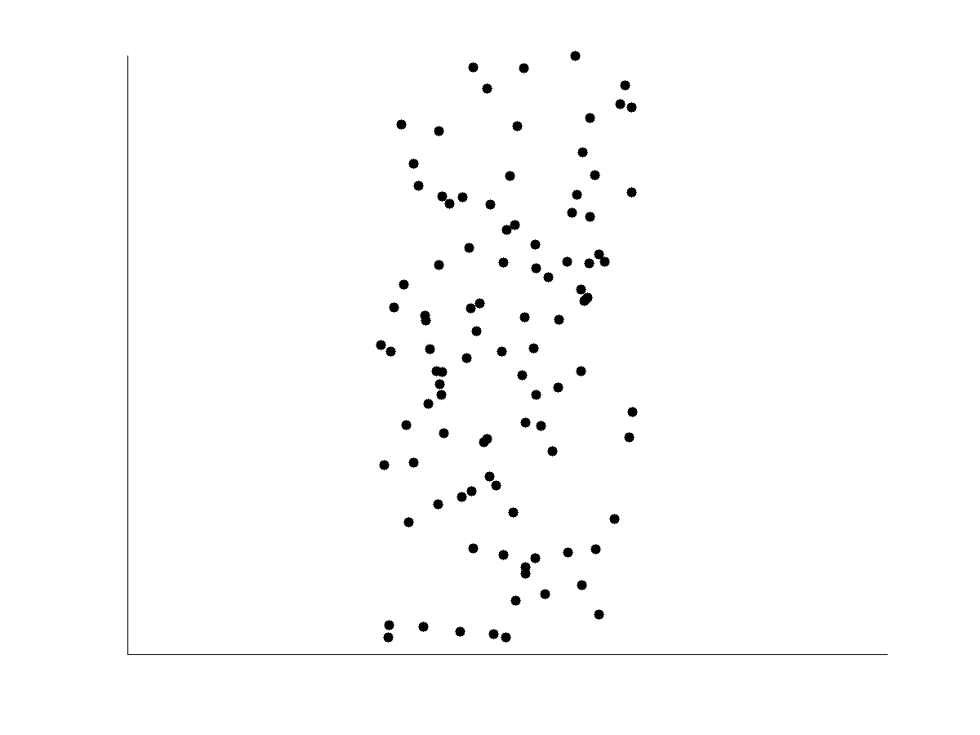
Not Correlated Data

Slide 22
Data Visualization and Its Methods
Why data visualization?
  Gain insight into an information space by mapping data onto graphical primitives
  Provide qualitative overview of large data sets
  Search for patterns, trends, structure, irregularities, relationships among data
  Help find interesting regions and suitable parameters for further quantitative analysis
  Provide a visual proof of computer representations derived
Typical visualization methods:
  Geometric techniques
  Icon-based techniques
  Hierarchical techniques

Slide 23
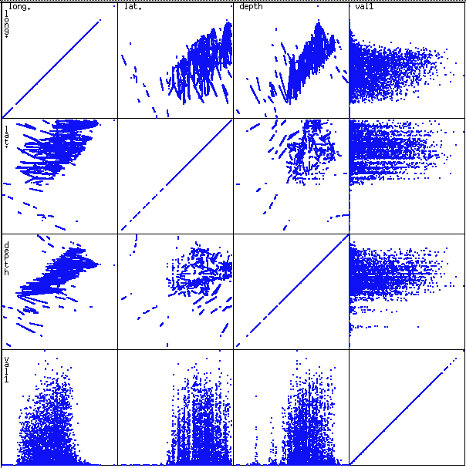
Scatterplot Matrices
Used by ermission of M. Ward, Worcester Polytechnic Institute
Matrix of scatterplots (x-y-diagrams) of the k-dim. data [total of (k2/2-k) scatterplots]

Slide 24
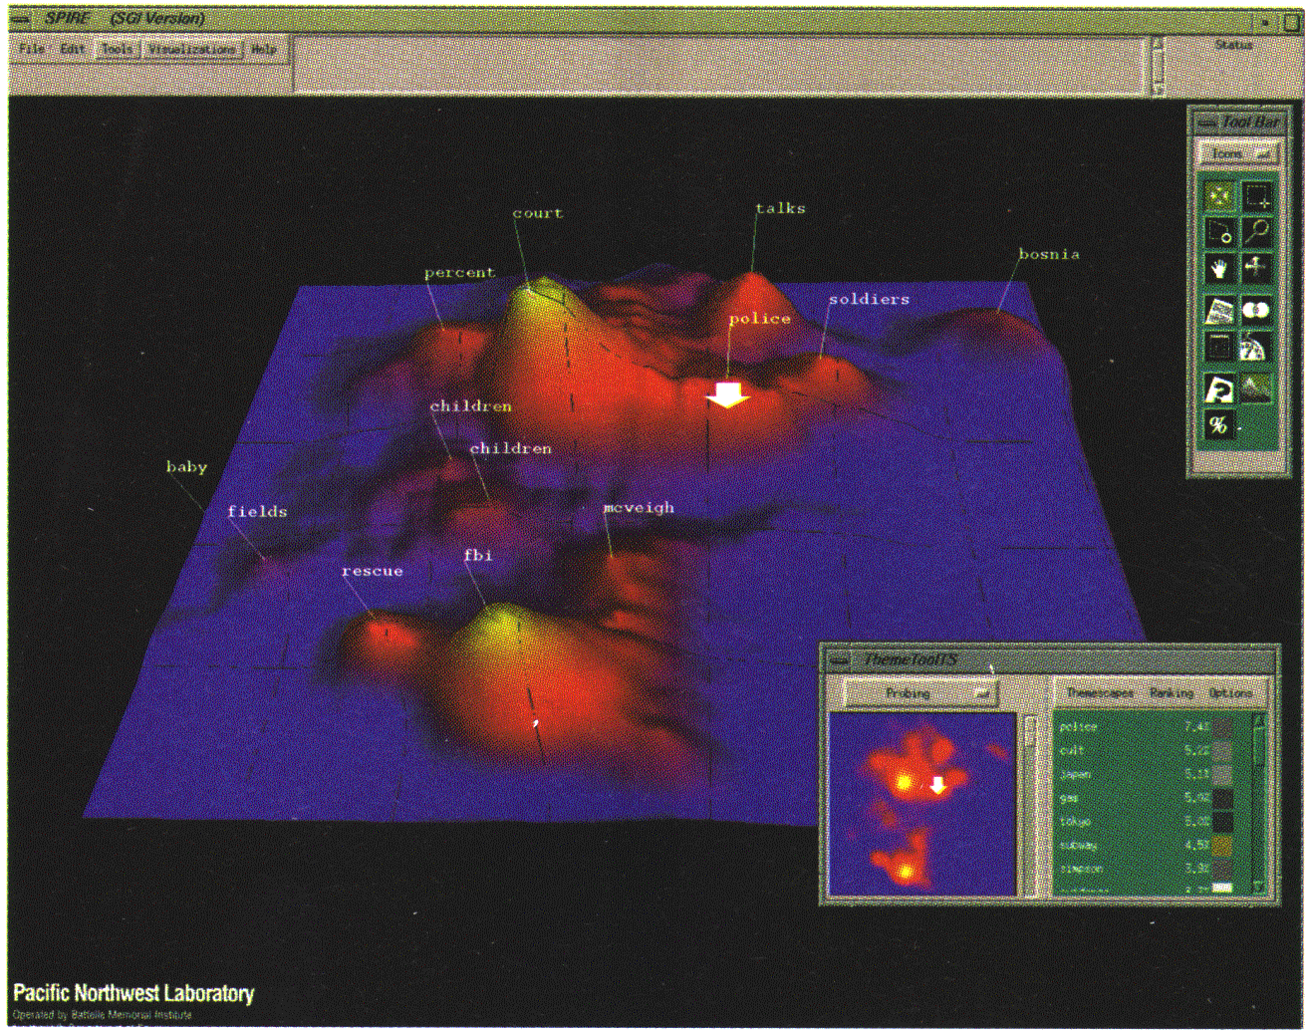
Landscapes
news articles
visualized as
a landscape
Used by permission of B. Wright, Visible Decisions Inc.
Visualization of the data as perspective landscape
The data needs to be transformed into a (possibly artificial) 2D spatial representation which preserves the characteristics of the data

Slide 25
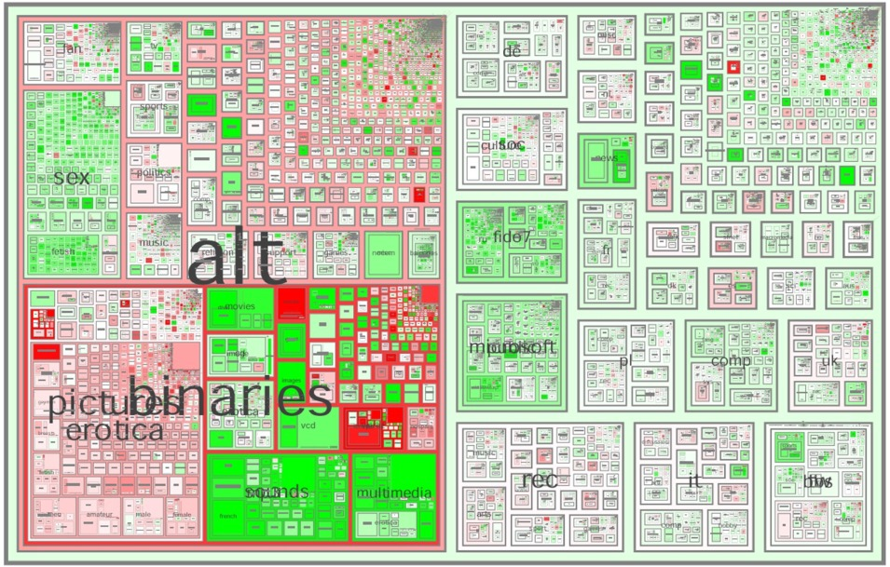
Tree-Map
Screen-filling method which uses a hierarchical partitioning of the screen into regions depending on the attribute values
The x- and y-dimension of the screen are partitioned alternately according to the attribute values (classes)
MSR Netscan Image
from Han & Kamber
Notes:
Picture: http://www.cs.umd.edu/hcil/treemap-history/all102001.jpg

Slide 26
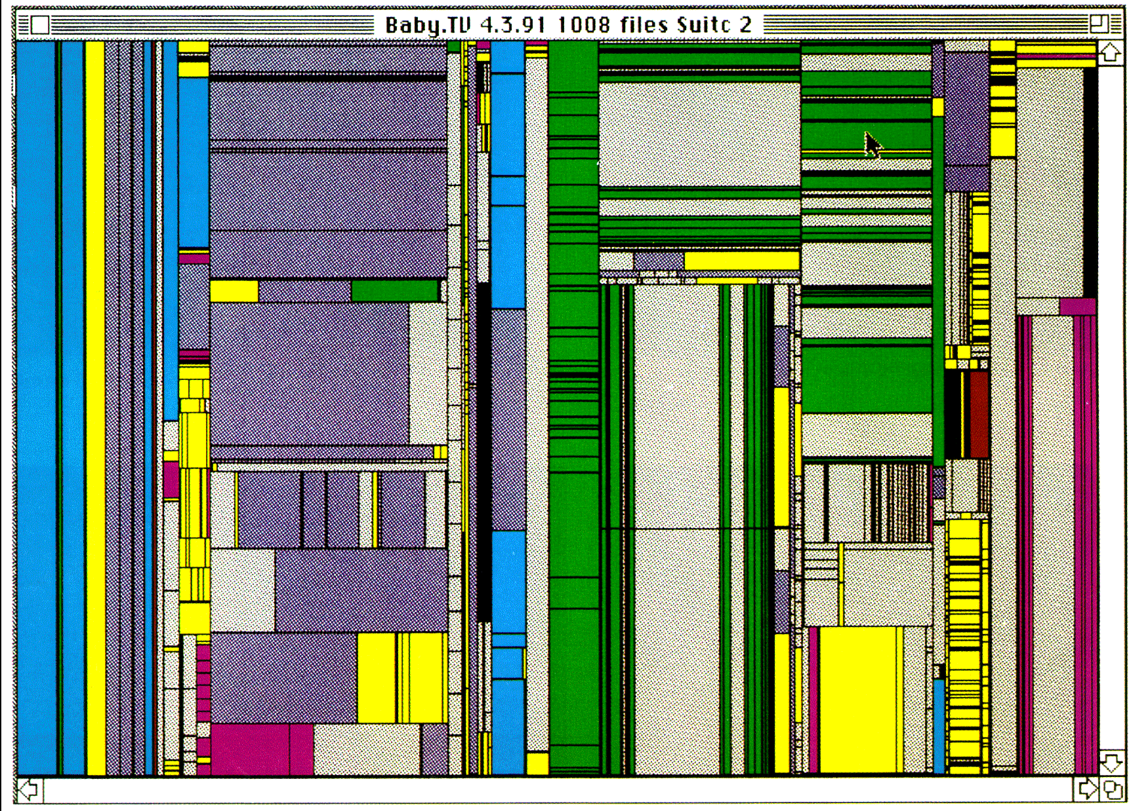
Tree-Map of a File System (Schneiderman)

Slide 27
Learning Objectives
Understand motivations for cleaning the data
Understand how to summarize the data
Understand how to clean the data
Understand how to integrate and transform the data.
Understand how to reduce the data
Understand how to discretize the data

Slide 28
Data Cleaning
No quality data, no quality mining results!
  Quality decisions must be based on quality data
    e.g., duplicate or missing data may cause incorrect or even misleading statistics
  “Data cleaning is the number one problem in data warehousing”—DCI survey
  Data extraction, cleaning, and transformation comprises the majority of the work of building a data warehouse
Data cleaning tasks
  Fill in missing values
  Identify outliers and smooth out noisy data
  Correct inconsistent data
  Resolve redundancy caused by data integration

Slide 29
Data in the Real World Is Dirty
incomplete: lacking attribute values, lacking certain attributes of interest, or containing only aggregate data
  e.g., occupation=“ ” (missing data)
noisy: containing noise, errors, or outliers
  e.g., Salary=“−10” (an error)
inconsistent: containing discrepancies in codes or names, e.g.,
  Age=“42” Birthday=“03/07/1997”
  Was rating “1,2,3”, now rating “A, B, C”
  discrepancy between duplicate records

Slide 30
Why Is Data Dirty?
Incomplete data may come from
  “Not applicable” data value when collected
  Different considerations between the time when the data was collected and when it is analyzed.
  Human/hardware/software problems
Noisy data (incorrect values) may come from
  Faulty data collection instruments
  Human or computer error at data entry
  Errors in data transmission
Inconsistent data may come from
  Different data sources
  Functional dependency violation (e.g., modify some linked data)
Duplicate records also need data cleaning

Slide 31
Multi-Dimensional Measure of Data Quality
A well-accepted multidimensional view:
  Accuracy
  Completeness
  Consistency
  Timeliness
  Believability
  Value added
  Interpretability
  Accessibility
Broad categories:
  Intrinsic, contextual, representational, and accessibility

Slide 32
Missing Data
Data is not always available
  E.g., many tuples have no recorded value for several attributes, such as customer income in sales data
Missing data may be due to
  equipment malfunction
  inconsistent with other recorded data and thus deleted
  data not entered due to misunderstanding
  certain data may not be considered important at the time of entry
  not register history or changes of the data
Missing data may need to be inferred

Slide 33
How to Handle Missing Data?
Ignore the tuple: usually done when class label is missing (when doing classification)—not effective when the % of missing values per attribute varies considerably
Fill in the missing value manually: tedious + infeasible?
Fill in it automatically with
  a global constant : e.g., “unknown”, a new class?!
  the attribute mean
  the attribute mean for all samples belonging to the same class: smarter
  the most probable value: inference-based such as Bayesian formula or decision tree

Slide 34
Noisy Data
Noise: random error or variance in a measured variable
Incorrect attribute values may due to
  faulty data collection instruments
  data entry problems
  data transmission problems
  technology limitation
  inconsistency in naming convention
Other data problems which requires data cleaning
  duplicate records
  incomplete data
  inconsistent data

Slide 35
How to Handle Noisy Data?
Binning
  first sort data and partition into (equal-frequency) bins
  then one can smooth by bin means, smooth by bin median, smooth by bin boundaries, etc.
Regression
  smooth by fitting the data into regression functions
Clustering
  detect and remove outliers
Combined computer and human inspection
  detect suspicious values and check by human (e.g., deal with possible outliers)

Slide 36
Simple Discretization Methods: Binning
Equal-width (distance) partitioning
  Divides the range into N intervals of equal size: uniform grid
  if A and B are the lowest and highest values of the attribute, the width of intervals will be: W = (B –A)/N.
  The most straightforward, but outliers may dominate presentation
  Skewed data is not handled well
Equal-depth (frequency) partitioning
  Divides the range into N intervals, each containing approximately same number of samples
  Good data scaling
  Managing categorical attributes can be tricky

Slide 37
Binning Methods for Data Smoothing
Sorted data for price (in dollars): 4, 8, 9, 15, 21, 21, 24, 25, 26, 28, 29, 34
* Partition into equal-frequency (equi-depth) bins:
- Bin 1: 4, 8, 9, 15
- Bin 2: 21, 21, 24, 25
- Bin 3: 26, 28, 29, 34
* Smoothing by bin means:
- Bin 1: 9, 9, 9, 9
- Bin 2: 23, 23, 23, 23
- Bin 3: 29, 29, 29, 29
* Smoothing by bin boundaries:
- Bin 1: 4, 4, 4, 15
- Bin 2: 21, 21, 25, 25
- Bin 3: 26, 26, 26, 34

Slide 38
Regression
y
Y1
Y1’
y = x + 1
X1
x

Slide 39
Cluster Analysis

Slide 40
Learning Objectives
Understand motivations for cleaning the data
Understand how to summarize the data
Understand how to clean the data
Understand how to integrate and transform the data
Understand how to reduce the data
Understand how to discretize the data

Slide 41
Data Integration
Data integration:
  Combines data from multiple sources into a coherent store
Schema integration: e.g., A.cust-id ≡ B.cust-#
  Integrate metadata from different sources
Entity identification problem:
  Identify real world entities from multiple data sources, e.g., Bill Clinton = William Clinton
Detecting and resolving data value conflicts
  For the same real world entity, attribute values from different sources are different
  Possible reasons: different representations, different scales, e.g., metric vs. British units

Slide 42
Handling Redundancy in Data Integration
Redundant data occur often when integration of multiple databases
  Object identification: The same attribute or object may have different names in different databases
  Derivable data: One attribute may be a “derived” attribute in another table, e.g., annual revenue
Redundant attributes may be able to be detected by correlation analysis
Careful integration of the data from multiple sources may help reduce/avoid redundancies and inconsistencies and improve mining speed and quality

Slide 43
Correlation Analysis (Numerical Data)
Correlation coefficient (also called Pearson’s product moment coefficient)
  where n is the number of tuples, and are the respective means of p and q, σ_{p} and σ_{q} are the respective standard deviation of p and q, and Σ(pq) is the sum of the pq cross-product.
If r_{p,q} > 0, p and q are positively correlated (p’s values increase as q’s). The higher, the stronger correlation.
r_{p,q} = 0: independent; r_{pq} < 0: negatively correlated

Slide 44
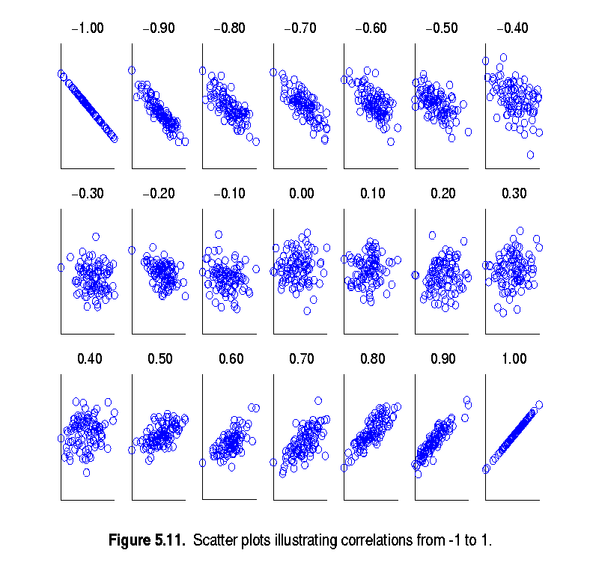
Visually Evaluating Correlation
Scatter plots showing the similarity from –1 to 1.
from Han & Kamber

Slide 45
Correlation Analysis (Categorical Data)
Χ² (chi-square) test
The larger the Χ² value, the more likely the variables are related
The cells that contribute the most to the Χ² value are those whose actual count is very different from the expected count
Correlation does not imply causality
  # of hospitals and # of car-theft in a city are correlated
  Both are causally linked to the third variable: population

Slide 46
Chi-Square Calculation: An Example
Χ² (chi-square) calculation (numbers in parenthesis are expected counts calculated based on the data distribution in the two categories – row * column / total)
It shows that like_science_fiction and play_chess are correlated in the group
 | Play chess | Not play chess | Sum (row)
Like science fiction | 250(90) | 200(360) | 450
Not like science fiction | 50(210) | 1000(840) | 1050
Sum(col.) | 300 | 1200 | 1500

Slide 47
Data Transformation
A function that maps the entire set of values of a given attribute to a new set of replacement values s.t. each old value can be identified with one of the new values
Methods
  Smoothing: Remove noise from data
  Aggregation: Summarization, data cube construction
  Generalization: Concept hierarchy climbing
  Normalization: Scaled to fall within a small, specified range
    min-max normalization
    z-score normalization
    normalization by decimal scaling
  Attribute/feature construction
    New attributes constructed from the given ones

Slide 48
Data Transformation: Normalization
Min-max normalization: to [new_min_{A}, new_max_{A}]
  Ex. Let income range $12,000 to $98,000 normalized to [0.0, 1.0]. Then $73,000 is mapped to
Z-score normalization (μ: mean, σ: standard deviation):
  Ex. Let μ = 54,000, σ = 16,000. Then
Normalization by decimal scaling
Where j is the smallest integer such that Max(|ν’|) < 1

Slide 49
Learning Objectives
Understand motivations for cleaning the data
Understand how to summarize the data
Understand how to clean the data
Understand how to integrate and transform the data
Understand how to reduce the data
Understand how to discretize the data

Slide 50
Data Reduction Strategies
Why data reduction?
  A database/data warehouse may store terabytes of data
  Complex data analysis/mining may take a very long time to run on the complete data set
Data reduction: Obtain a reduced representation of the data set that is much smaller in volume but yet produce the same (or almost the same) analytical results
Data reduction strategies
  Dimensionality reduction — e.g., remove unimportant attributes
  Numerosity reduction (some simply call it: Data Reduction)
    Data cub aggregation
    Data compression
    Regression
    Discretization (and concept hierarchy generation)

Slide 51
Dimensionality Reduction
Curse of dimensionality
  When dimensionality increases, data becomes increasingly sparse
  Density and distance between points, which is critical to clustering, outlier analysis, becomes less meaningful
  The possible combinations of subspaces will grow exponentially
Dimensionality reduction
  Avoid the curse of dimensionality
  Help eliminate irrelevant features and reduce noise
  Reduce time and space required in data mining
  Allow easier visualization
Dimensionality reduction techniques
  Principal component analysis
  Singular value decomposition
  Supervised and nonlinear techniques (e.g., feature selection)

Slide 52
Dimensionality Reduction
Principal Component Analysis (PCA): find a projection that captures the largest amount of variation in data
Feature selection: select most relevant features / remove redundant and irrelevant features
Feature creation : create new attributes that can capture the important information in a data set much more efficiently than the original attributes (Discrete Fourier / Wavelet Transform)

Slide 53
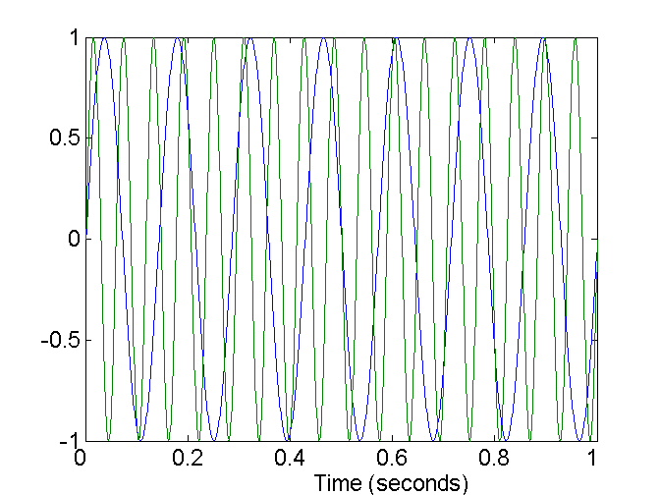
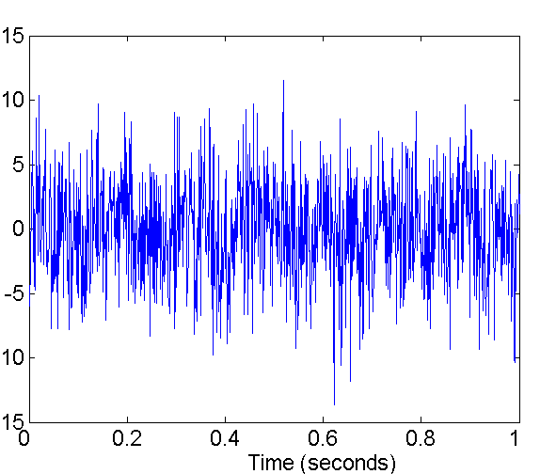
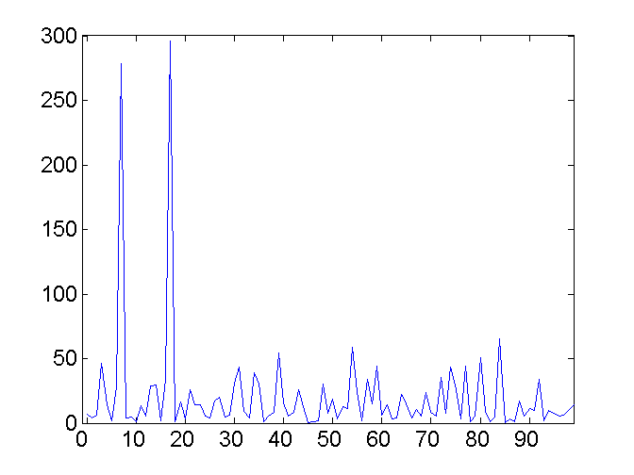
Mapping Data to a New Space
Fourier transform
Wavelet transform
Two Sine Waves
Two Sine Waves + Noise
Frequency
from Han & Kamber

Slide 54
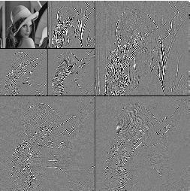
DWT for Image Compression
Image
Low Pass High Pass
Low Pass High Pass
Low Pass High Pass

Slide 55
Data Reduction: Regression Analysis
Linear regression: Y = w X + b
  Data are modeled to fit a straight line
  Two regression coefficients, w and b, specify the line and are to be estimated by using the data at hand
  Using the least squares criterion to the known values of Y1, Y2, …, X1, X2, ….
Multiple regression: Y = b₀ + b₁ X₁ + b₂ X₂.
  Many nonlinear functions can be transformed into the above

Slide 56
Data Reduction: Data Compression
Original Data
Compressed
Data
lossless
Original Data
Approximated
lossy

Slide 57
Data Reduction: Clustering
Partition data set into clusters based on similarity, and store cluster representation (e.g., centroid and diameter) only
Can be very effective if data is clustered but not if data is “smeared”
Can have hierarchical clustering and be stored in multi-dimensional index tree structures
There are many choices of clustering definitions and clustering algorithms
Cluster analysis will be studied in depth in Chapter 7

Slide 58
Data Reduction: Sampling
Sampling: obtaining a small sample s to represent the whole data set N
Allow a mining algorithm to run in complexity that is potentially sub-linear to the size of the data
Key principle: Choose a representative subset of the data
  Simple random sampling may have very poor performance in the presence of skew
  Develop adaptive sampling methods, e.g., stratified sampling:
Note: Sampling may not reduce database I/Os (page at a time)

Slide 59
Types of Sampling
Simple random sampling
  There is an equal probability of selecting any particular item
Sampling without replacement
  Once an object is selected, it is removed from the population
Sampling with replacement
  A selected object is not removed from the population
Stratified sampling:
  Partition the data set, and draw samples from each partition (proportionally, i.e., approximately the same percentage of the data)
  Used in conjunction with skewed data

Slide 60
Sampling: With or without Replacement
SRSWOR
(simple random
sample without
replacement)
SRSWR
Raw Data

Slide 61
Sampling: Cluster or Stratified Sampling
Raw Data
Cluster/Stratified Sample

Slide 62
Learning Objectives
Understand motivations for cleaning the data
Understand how to summarize the data
Understand how to clean the data
Understand how to integrate and transform the data
Understand how to reduce the data
Understand how to discretize the data

Slide 63
Data Reduction: Discretization
Three types of attributes:
  Nominal — values from an unordered set, e.g., color, profession
  Ordinal — values from an ordered set, e.g., military or academic rank
  Continuous — real numbers, e.g., integer or real numbers
Discretization:
  Divide the range of a continuous attribute into intervals
  Some classification algorithms only accept categorical attributes.
  Reduce data size by discretization
  Prepare for further analysis

Slide 64
Discretization Generation for Numeric Data
Typical methods: All the methods can be applied recursively
  Binning (covered above)
    Top-down split, unsupervised,
  Histogram analysis (covered above)
    Top-down split, unsupervised
  Clustering analysis (covered above)
    Either top-down split or bottom-up merge, unsupervised
  Segmentation by natural partitioning: top-down split, unsupervised
  Other methods: entropy-based discretization, interval merging by χ² analysis

Slide 65
Why preprocess the data?
Data cleaning
Data integration and transformation
Data reduction
Discretization and concept hierarchy generation
Summary

Slide 66
Summary
Data preparation/preprocessing: A big issue for data mining
Data description, data exploration, and summarization set the base for quality data preprocessing
Data preparation includes
  Data cleaning
  Data integration and data transformation
  Data reduction (dimensionality and numerosity reduction)
A lot a methods have been developed but data preprocessing still an active area of research

