Slide 1
Operations Management

Slide 2
Learning Objectives
Define and characterize work organization and operations management
Describe systems analysis and design methods
Define principles of strategy management
Define re-engineering

Slide 3
Work Organization
The health information manager function requires the ability to analyze the processes that create and handle health information to ensure they are
efficient - use as few resources as possible
effective – meet patients and staff requirements
Some methods and tools are well-known to analyze and improve the methods used in health information systems.

Slide 4
Work Organization
Work organization refers to the process of allocating the work among the employees. It depends on the type of the organization and the nature of the work to accomplish.
Methods:
Serial work division
Parallel work division
Unit assembly work division.

Slide 5
Work Organization
Tools:
Employee task list
Activity list (prepared by a supervisor)
Work distribution chart , which records for future analysis:
the work activities performed,
the time it takes to perform the work,
the individual performing the work, and
the amount of time each individual spends on each activity.
Number of units produced can be added

Slide 6
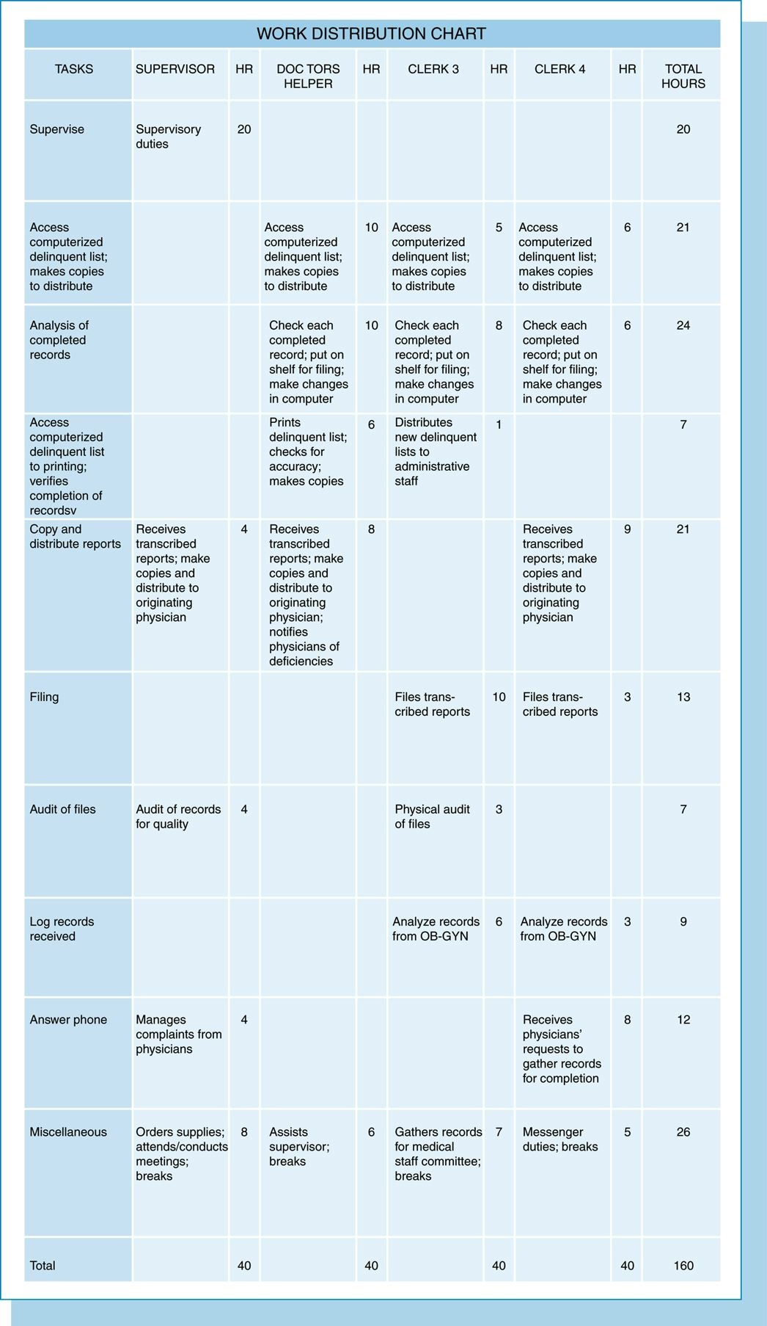

Slide 7
Work Organization
Productivity
Process of converting resources (labor, capital. Materials, technologies) into products and services
Organization goal is to produce quality products or services with the least expenditure of resources
Productivity ratio
$$\frac{Output (services or products)}{Input (resources consumed)}$$
$$\frac{Quantity and quality}{Staff hours}$$

Slide 8
Work Organization
Work simplification or methods improvement
Identify a problem area or select a work process or function to improve
Gather data on the problem
Organize, analyze, and challenge the data
Formulate alternative solution or improvements
Select or develop the improved method
Implement the improved method and evaluate the effectiveness of the improvement

Slide 9
Work Organization
Operations management is an area of management concerned with overseeing, designing, controlling the process of production and redesigning business operations in the production of goods and/or services.
Work improvement – simplify, eliminate, combine, improve
It can be applied in healthcare settings.
Ex: solution to staff scheduling challenges at cancer institute

Slide 10
Work Organization
Answer the following questions after watching the video:
Which problem area or work process or function needs improvement ?
How was data gathered on the problem ?
What do we know about how was data analyzed ?
What alternative solution or improvements are proposed ?
Has the improved method been developed ?
What are the results of the improvement on effectiveness ?

Slide 11
Work Organization
The process of improving the flow of information in a healthcare setting takes several steps:
Model the information flow (with flowcharts such as transcription flowchart, flow process chart, decision tree …) – system analysis
Identify areas to improve
Propose a solution, often involving technology and software systems
Evaluate, refine

Slide 12
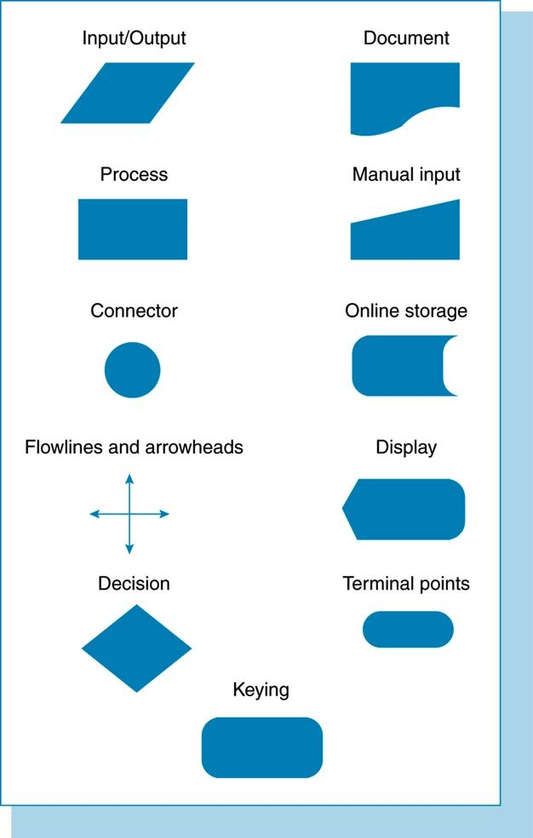

Slide 13
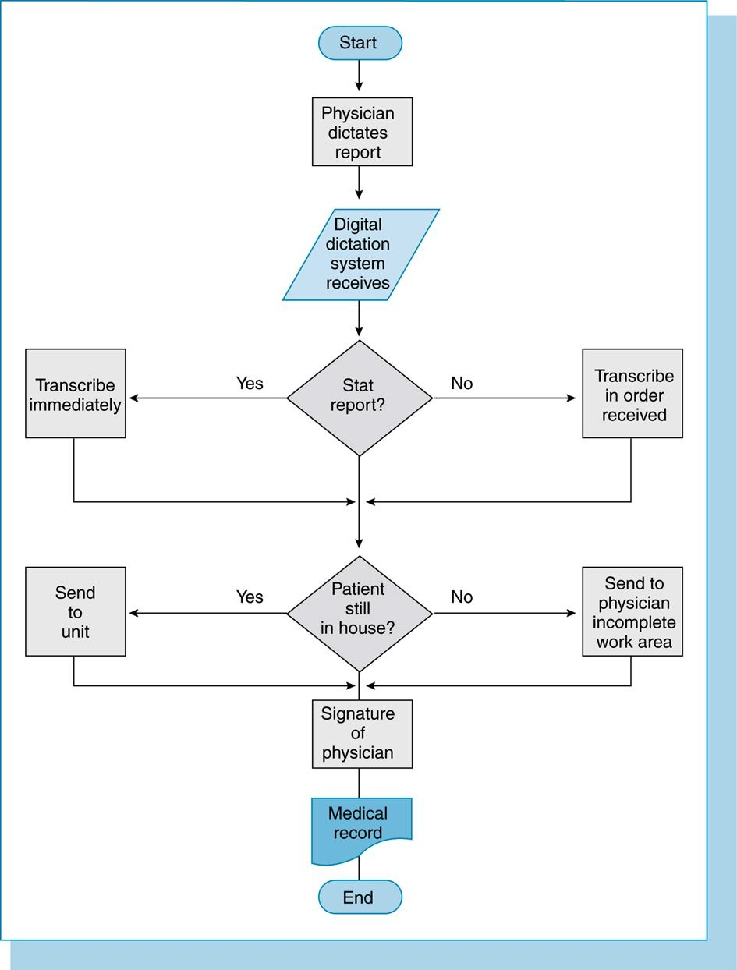

Slide 14
Systems Analysis and Design
Software development
Describes the development of a computer-based information systems.
Describes a process by which we can develop computer-based information systems useful for organizations.
Business-oriented process (constraints and goals).
Organizational improvement process.
Information system = application software
+ hardware
+ system software

Slide 15
Systems Analysis and Design
Process of software development:
Who is doing what ?
When and how to reach a certain goal ?
Goal: build a software product or improve one.
Process must follow state-of-the-art practice.
Evolving process.
State-of-the-art methodologies describe SD process.
Means available:
Technologies, techniques (visual modeling, ...)
Tools (support software)
People (skills)
Organizational patterns (virtual organization, ...)

Slide 16
Systems Analysis and Design
Software Development Principles:
Separation of Data and Processes
Data: raw facts about people, objects and events in an organization
Process: steps by which data are transformed or moved and of events that triggered these steps
Algorithm: sequence of elementary steps ordered to perform a given task

Slide 17
Systems Analysis and Design
Software Development Methodologies:
Structured analysis (‘80s)
Object-Oriented analysis (‘90s)
OMT (James Rumbaugh)
BOOCH (Grady Booch)
COAD/YOURDON
Rational Unified Process (end ‘90s)
Booch, Rumbaugh, Jacobson
Unified Modeling Language (UML)
Extreme Programming (end 2000’s)
Agile Methodologies (’10s)

Slide 18
Systems Analysis and Design
Software Development Life Cycle (SDLC):
Project identification and selection
Project initiation and planning
Analysis
Design (logical and physical)
Implementation
Testing
Maintenance

Slide 19
Systems Analysis and Design
SDLC Characteristics:
Incremental.
Iterative.
Model systems (not just software) using concepts (such as OO concepts).
Issue of scale.
Constraints.
Users importance.
Human factors importance.

Slide 20
Software Methodologies
Code and Fix
Waterfall
Iterative
Agile

Slide 21
Methodologies – Code and Fix
Really, lack of a methodology
And all too common
Little or no planning, diving straight into implementation
Reactive, no proactive
End with bugs. If bugs faster than can fix, “death spiral” and may be cancelled
Even those that make it, must have “crunch time”
viewed after as badge of honor, but results in burnout
Based on Chapter 3.1, Introduction to Game Development

Slide 22
Methodologies - Waterfall
Plan ahead
Proceed through various planning steps before implementation
requirements analysis, design, implementation, testing (validation), integration, and maintenance
The waterfall loops back as fixes required
Can be brittle to changing functionality, unexpected problems in implementation
Going back to beginning
Based on Chapter 3.1, Introduction to Game Development

Slide 23
Methodologies - Iterative
Develop for a period of time (1-2 months), get working game, add features
Periods can coincide with publisher milestones
Allows for some planning
Time period can have design before implementation
Allows for some flexibility
Can adjust (to new technical challenges or producer demands)
Based on Chapter 3.1, Introduction to Game Development

Slide 24
Methodologies - Agile
Admit things will change, avoid looking too far in the future
Value simplicity and the ability to change
Can scale, add new features, adjust
Relatively new for game development
Big challenge is hard to convince publishers
Based on Chapter 3.1, Introduction to Game Development

Slide 25
Systems Analysis and Design
Analysis:
Starts from a problem statement.
Build an analysis model.
The analysis model is an abstraction of what the desired system must do.
The data and objects in the model are from the real world.
No implementation decisions.
Prototypes a plus.
Object-oriented analysis.
Results in requirements/specification document.

Slide 26
Systems Analysis and Design
Software Development Team:
Team leader.
Software engineers.
Developers?
Others: IS manager, systems analyst, systems designer, systems programmer, end user, business manager, database administrator, tester, network specialist, internal auditor ...

Slide 27
Project Identification and Selection
Project Identification and Selection:
Identify the needs for a computer-based system (new or improved).
May be part of an organization plan.
Or personal plan.

Slide 28
Analysis Model
UML = Unified Modeling Language
Representation language and methodology for object-oriented SDLC
Analysis model:
use-case model
class diagram
sequence diagrams (process model)

Slide 29
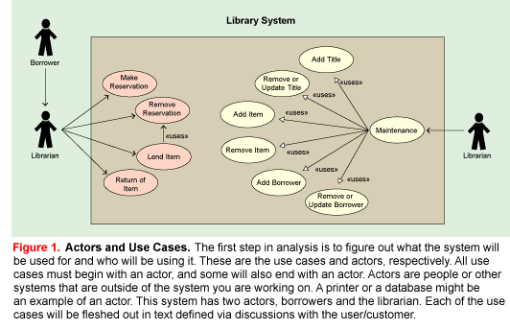
Analysis: Use-case model

Slide 30
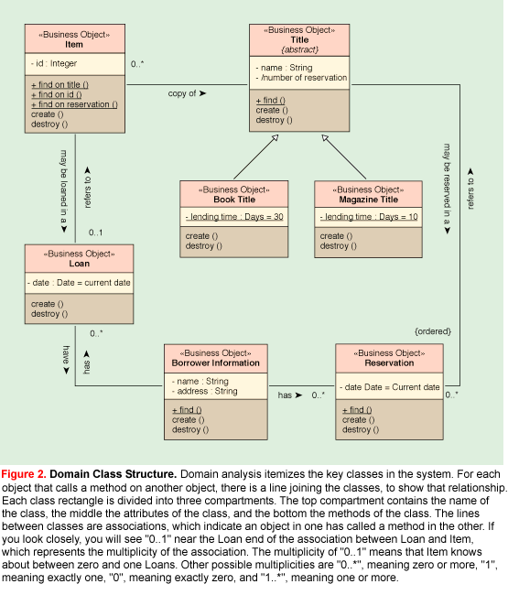
Class diagram

Slide 31
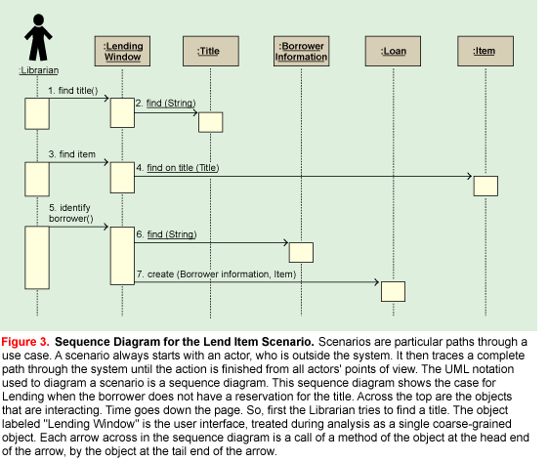
Analysis: Sequence diagram

Slide 32
Design
Design: starting from a model of the new system’s functionality, the design model describes how the new system works.
Design model:
forms and reports
user interface and dialogues
databases and files (logical and physical)
programs and processes

Slide 33
Design
Design:
Architecture design
High-level design where the packages (sub-systems) are defined, including the dependencies and communication mechanisms between the packages.
Detailed design
Detailed description of the classes and their interaction mechanisms (behavior).

Slide 34
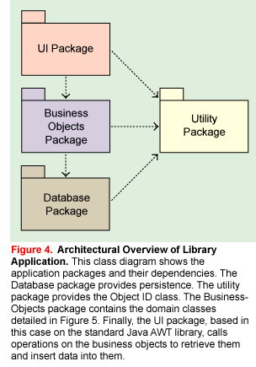
Design: architecture design

Slide 35
Design
Describes the technical classes in:
User Interface package
Database package
Describes further and more technically the Business-Objects package classes sketched during analysis

Slide 36
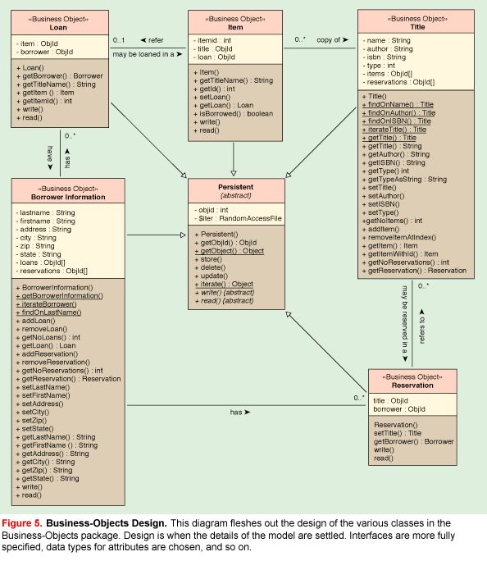

Slide 37
Design: detailed design
The Business-Objects package is based on the corresponding package in the analysis, the domain classes. The classes, their relationships and behavior are preserved, but the classes are described in more detail.

Slide 38
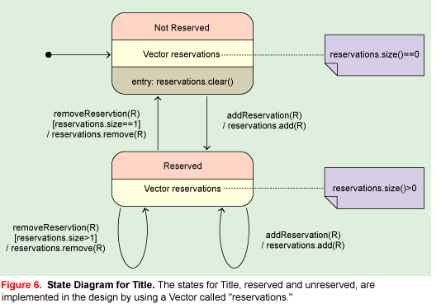
Design: detailed design

Slide 39
Design: detailed design
The User Interface package presents the services and information in the system to a user.
The dynamic models in the analysis model are allocated to this package since all interactions with the user are initiated through the user interface.

Slide 40
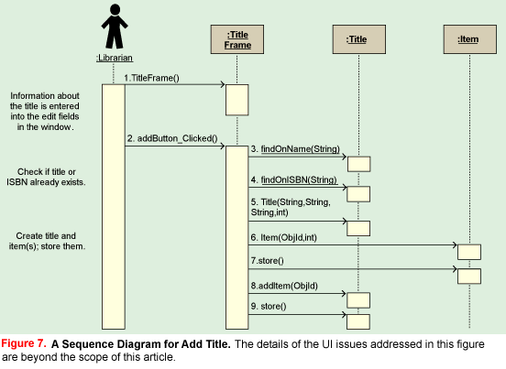
Design: detailed design

Slide 41
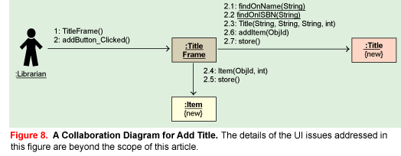
Design: detailed design

Slide 42
Design: detailed design
The User Interface package contains:
Functions: windows for the primary functions of the system: lending and returning items.
Information: windows for viewing the information in the system.
Maintenance: windows for maintaining the system: add/update/remove titles, borrowers and items.

Slide 43
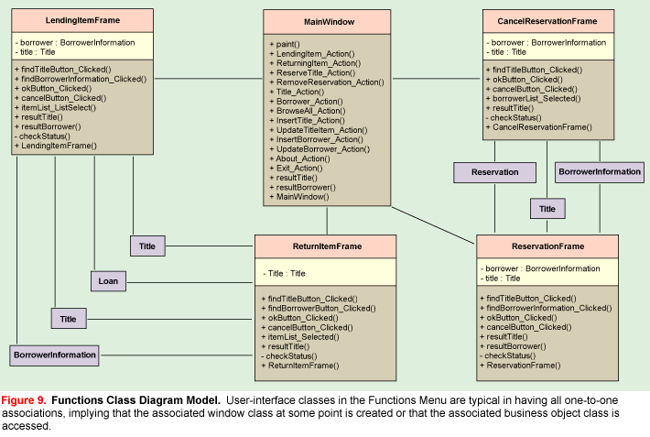

Slide 44
Design: detailed design
Implementation: the classes in the design model are mapped into Java classes.
The specifications were fetched from the class diagrams, state diagrams, dynamic diagrams (sequence, collaboration, activity), use-case diagrams and specifications.

Slide 45
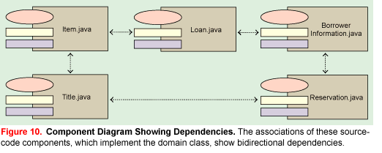
Design: detailed design

Slide 46
Software Development Team
People involved
lead designer
project leader
software planner
architectural lead
programmers artists
level designers
testers
Time involved
12-24 months

Slide 47
Change Management
Change management is the task of managing change, and may involve
Strategic management
Project management
Re-engineering

Slide 48
Strategic Management
Strategic management involves
Situation analysis of an organization
External environment analysis
Internal environment analysis
Directional strategies
Mission (Who are we? What do we do ?)
Vision (What do we want to do ?)
Values (beliefs or truths)
Strategy formulation
Strategic implementation
Strategic control.

Slide 49
Strategic Management
Project management uses planning, organizing, directing, and controlling to bring a project to a successful conclusion – particularly when teams are involved.
Project management tools can be used to determine the longest path to complete the project – the critical path
Gantt charts
Pert networks

Slide 50
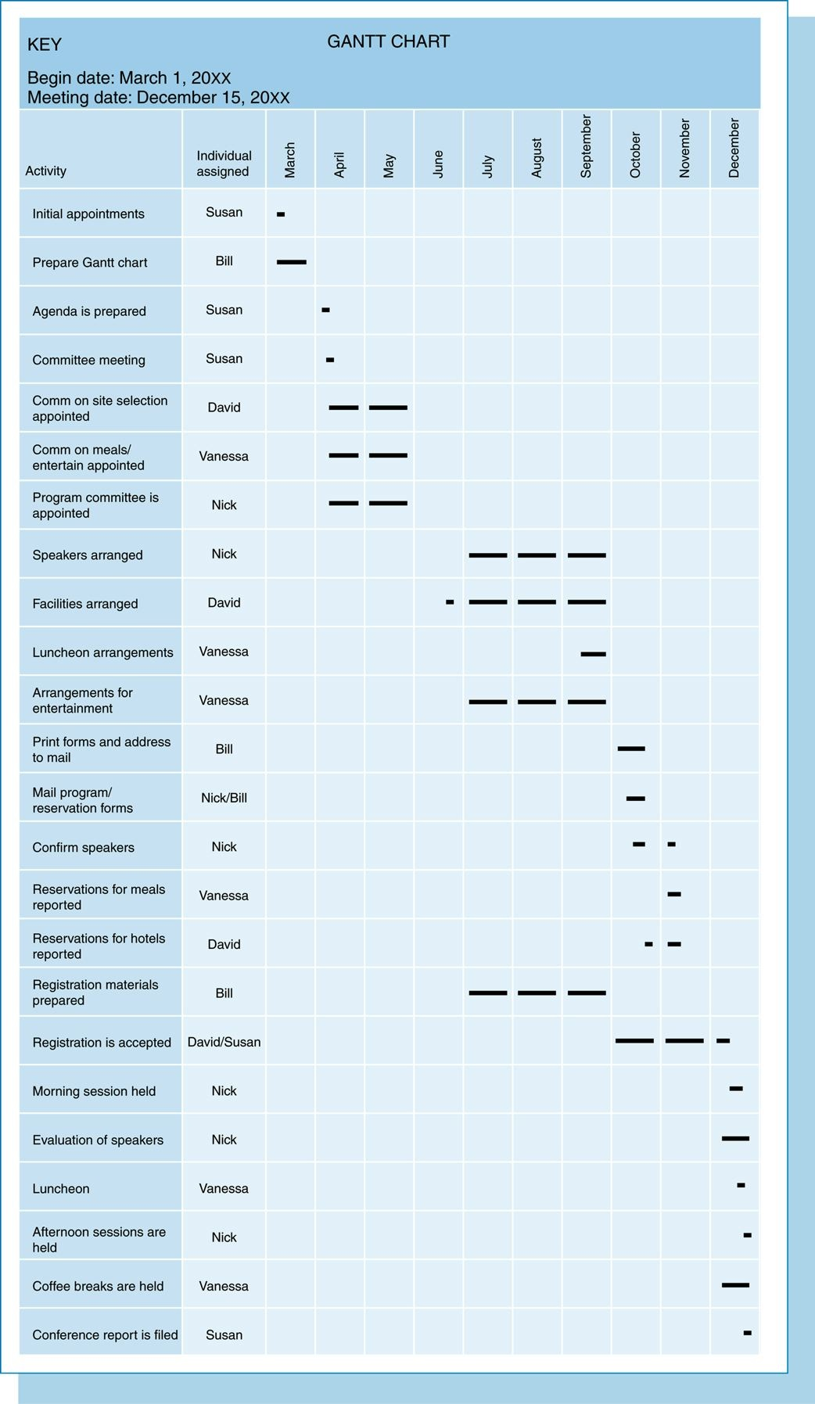
Strategic Management

Slide 51
Strategic Management

Slide 52
Re-engineering
Re-engineering involves a theory in which the way business is done is radically re-evaluated to achieve dramatic performance improvement.
Examples of objectives: reduce time, reduce cost, increase revenue, reduce effort, enhance the quality of service, reduce risk …
Policies and procedures are very useful during departmental re-engineering.

